Slide 1
6.853sp17: Lecture 13
Price of Anarchy in Auctions
Vasilis Syrgkanis
Microsoft Research, New England

Slide 2
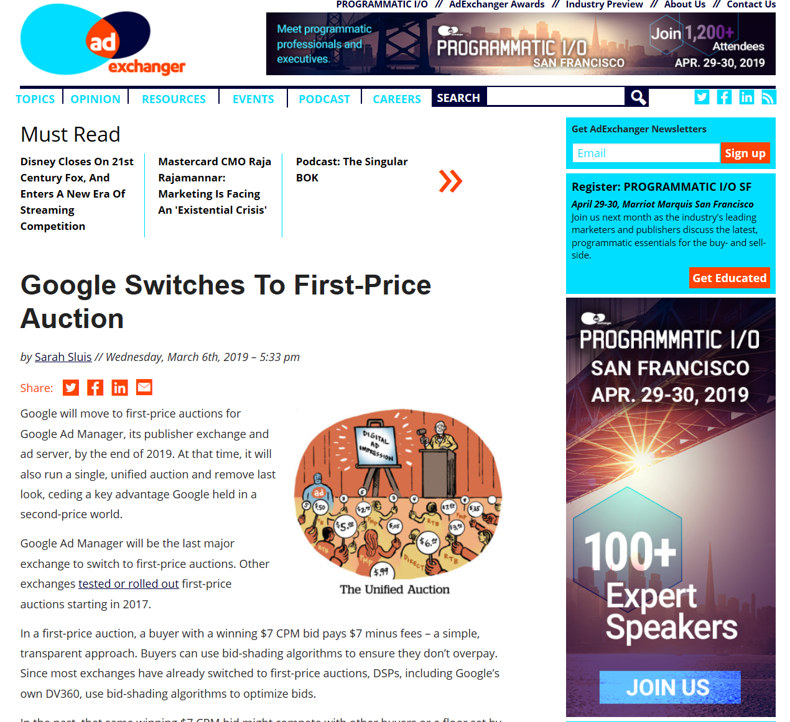
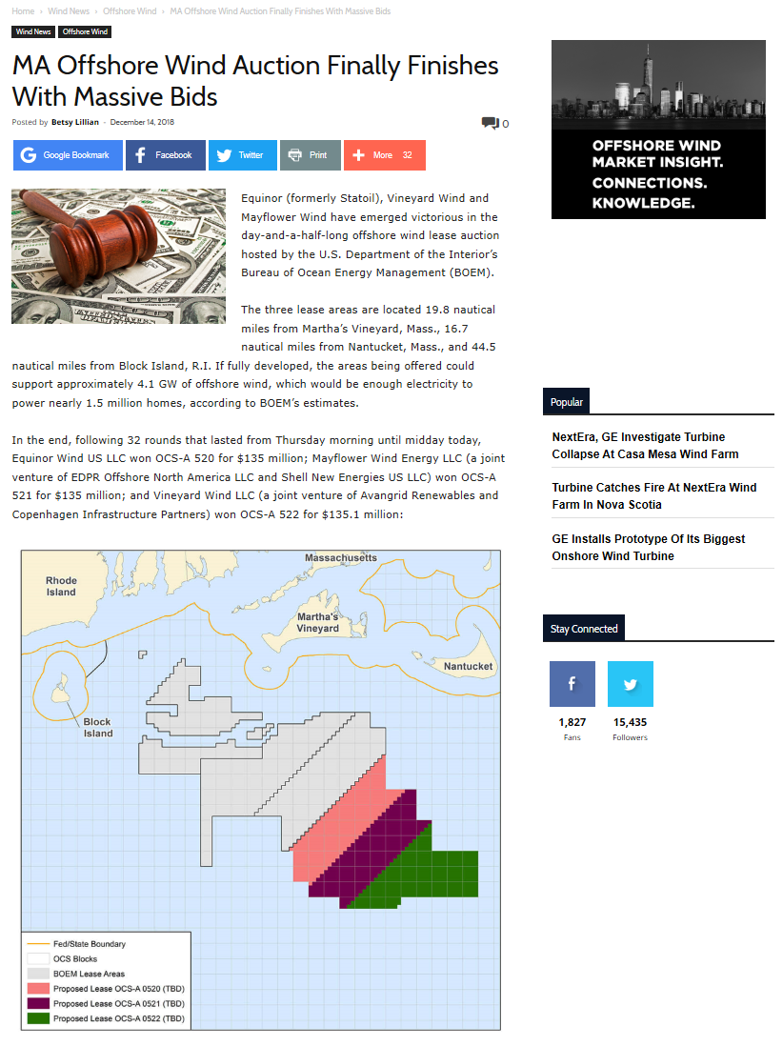

Non truthful auctions are ubiquitous
We need to develop theoretical tools to analyze the quality of their outcomes

Slide 3
Three Challenging Settings in Auction Analysis
Asymmetry among bidders
  Symmetric single-item sVickrey’61etting: [Milgrom-Weber’82]
  Two asymmetric bidders: [Maskin-Vickrey’61,Riley’00, Amann-Leininger’96, Kirkegaard’08, Kaplan-Zamir’10,Siegel’14]
  Complete information: [Baye et al’96]
Simultaneous/Sequential heterogeneous item auctions
  Milgrom-Weber’82: “Most analyses of competitive bidding situations are based on the assumption that each auction can be treated in isolation. This assumption is sometimes unreasonable.“
  Complete information: [Engelbrecht-Wiggans-Weber’79, Bikhchandani’99, Bae et al’08]
  Symmetric bidders, homogeneous items: [Milgrom-Weber’99]
Unknown fundamentals by the players and learning
  Simple learning strategies: fictitious play [Robinson’51,Brown’51,Monderer-Shapley’96,Fundenberg-Levine’95], rational learning [Kalai-Lehrer’93], regret matching [Hart-Mas-Colell’00], Hannan consistency [Hannan’57], multiplicative weights [Freund-Schapire’99]. Mostly analyzing convergence to an equilibrium notion [Fudenberg-Levine’98].
  Bayes-correlated equilibrium: [Bergemann-Morris’11], yields generic LP for robust predictions, hard to analyze structurally for auction setting. [Bergemann-Brooks-Morris’16] for first price auctions

Slide 4
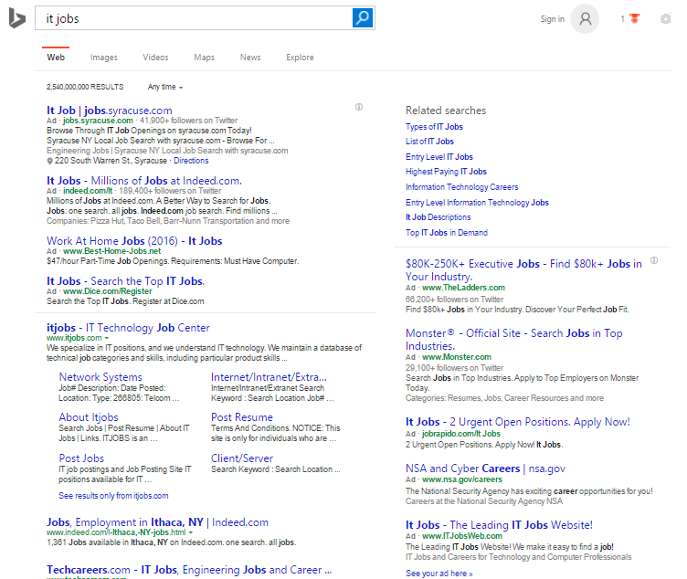
Example: Online Ad Auctions
Advertisers bidding for ad slots along search results
$140 Billion dollar industry, 2015 [techcrunch.com, zenithoptimedia.com]
Bid on some keyword
Data-Set from Microsoft’s Bing
“Econometrics for Learning Agents” Nekipelov, Syrgkanis, Tardos, EC’15
Notes:
I want to start with an example application that portrays some of the main themes I will be talking today.

Slide 5





Example: Online Ad Auctions
Advertisers bidding for ad slots along search results
$140 Billion dollar industry, 2015 [techcrunch.com, zenithoptimedia.com]
Notes:
I want to start with an example application that portrays some of the main themes I will be talking today.

Slide 6
Steady Progress but Restricted Settings
Asymmetry among bidders
  Symmetric single-item setting: [Milgrom-Weber’82]
  Two asymmetric bidders: [Vickrey’61, Maskin-Riley’00, Amann-Leininger’96, Kirkegaard’08, Kaplan-Zamir’10, Siegel’14]
  Complete information: [Baye et al’96]
Simultaneous/Sequential heterogeneous item auctions
  Milgrom-Weber’82: “Most analyses of competitive bidding situations are based on the assumption that each auction can be treated in isolation. This assumption is sometimes unreasonable.“
  Complete information: [Engelbrecht-Wiggans-Weber’79, Bikhchandani’99, Bae et al’08]
  Symmetric bidders, homogeneous items: [Milgrom-Weber’99]
Unknown fundamentals by the players and learning
  Simple learning strategies: fictitious play [Robinson’51,Brown’51,Monderer-Shapley’96,Fundenberg-Levine’95], rational learning [Kalai-Lehrer’93], regret matching [Hart-Mas-Colell’00], Hannan consistency [Hannan’57], multiplicative weights [Freund-Schapire’99]. Mostly analyzing convergence to an equilibrium notion [Fudenberg-Levine’98].
  Bayes-correlated equilibrium: [Bergemann-Morris’11], yields generic LP for robust predictions, hard to analyze structurally for auction setting. [Bergemann-Brooks-Morris’16] for first price auctions

Slide 7
This Lecture
Welfare Guarantees in Non-Truthful Auctions
Welfare of “Equilibrium” Outcomes vs Optimal Welfare
Welfare loss from not switching to centralized Vickrey-Clarkes-Groves based market

Slide 8
Main Take-Away
All three challenges can be sufficiently addressed if one is interested in welfare guarantees
Analysis can be reduced to pure Nash equilibria of complete information one-shot auction in isolation!
Don’t characterize equilibria, directly prove welfare properties

Slide 9
Challenge 1
Asymmetric bidders

Slide 10








Through the lens of a simple example
$$v_{1}$$
$$∼F_{1}$$
Highest bidder wins
Pays his bid
Utility = Value-Payment
$${Utility}_{i}\left(b\right)=(v_{i}−b_{i})⋅x_{i}\left(b\right)$$
$$v_{i}$$
$$∼F_{i}$$
$$v_{n}$$
$$∼F_{n}$$

Slide 11
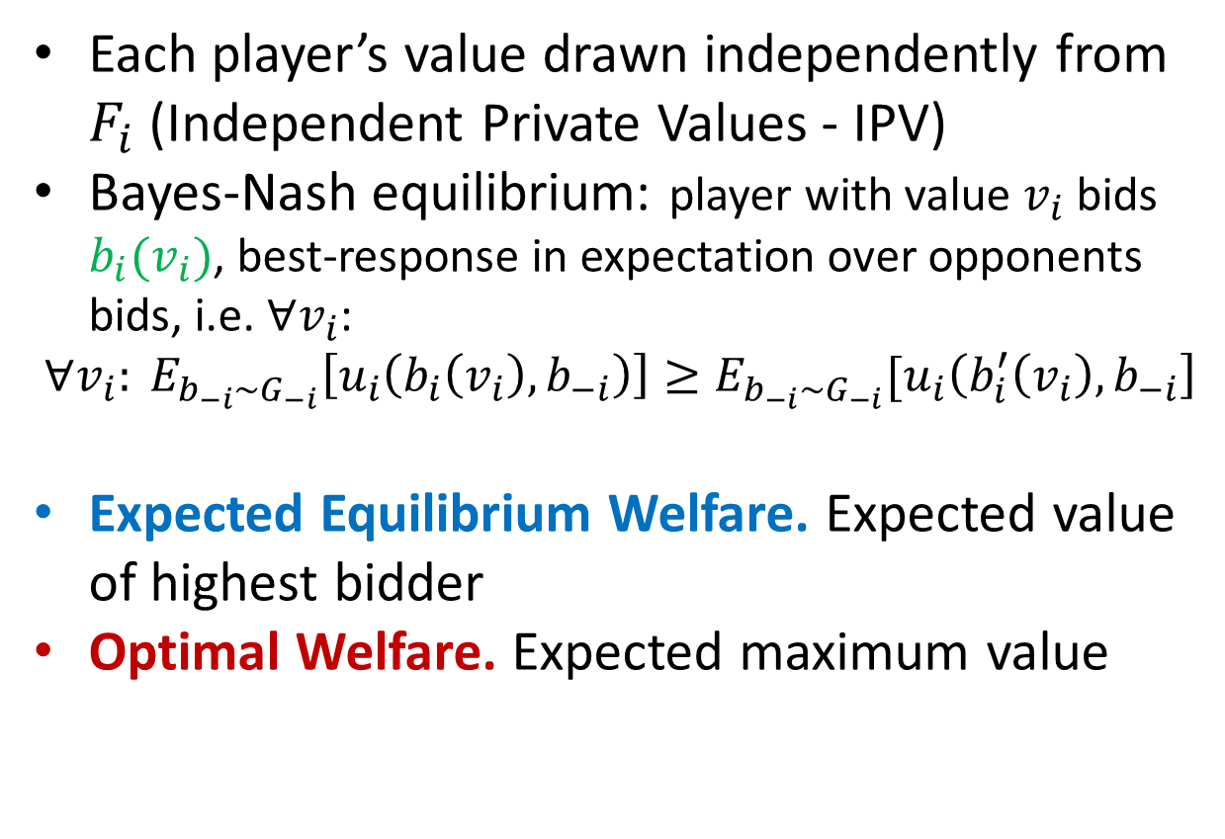
Through the lens of a simple example
$$v_{1}$$
$$∼F_{1}$$
Each player’s value drawn independently from $F_{i}$ (Independent Private Values - IPV)
Bayes-Nash equilibrium: player with value $v_{i}$ bids $b_{i}(v_{i})$, best-response in expectation over opponents bids, i.e. $∀v_{i}$:
$$∀v_{i}: E_{b_{−i}∼G_{−i}}\left[u_{i}\left(b_{i}\left(v_{i}\right), b_{−i}\right)\right]≥E_{b_{−i}∼G_{−i}}[u_{i}\left(b_{i}^{′}\left(v_{i}\right), b_{−i}\right]$$
Expected Equilibrium Welfare. Expected value of highest bidder
Optimal Welfare. Expected maximum value
$$v_{i}$$
$$∼F_{i}$$
$$v_{n}$$
$$∼F_{n}$$

Slide 12
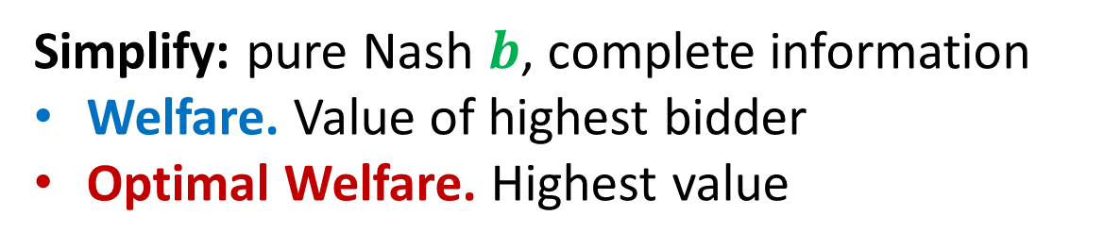



Bounding equilibrium welfare
Simplify: pure Nash $b$, complete information
Welfare. Value of highest bidder
Optimal Welfare. Highest value
$$v_{1}$$
$$b_{1}$$
$$v_{i}$$
$$b_{i}$$
$$b_{n}$$
$$v_{n}$$

Slide 13
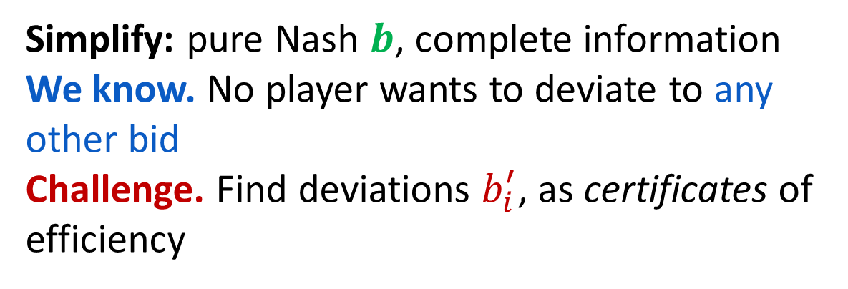

Bounding equilibrium welfare
Simplify: pure Nash $b$, complete information
We know. No player wants to deviate to any other bid
Challenge. Find deviations $b_{i}^{′}$, as certificates of efficiency
$$v_{1}$$
$$b_{1}$$
$$v_{i}$$
$$b_{i}^{′}$$
$$b_{i}$$
$$b_{n}$$
$$v_{n}$$

Slide 14
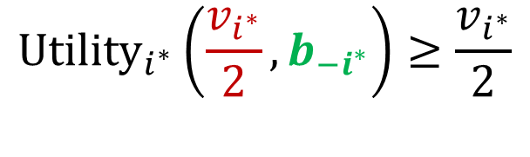



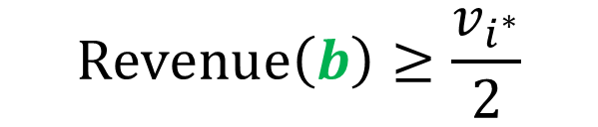




Bounding equilibrium welfare
Candidate. Optimal player, bid half value, $b_{i^{∗}}^{′}=\frac{v_{i^{∗}}}{2}$
$$v_{1}$$
$$0$$
$${Utility}_{i^{∗}}\left(\frac{v_{i^{∗}}}{2},b_{−i^{∗}}\right)≥\frac{v_{i^{∗}}}{2}$$
$$b_{1}$$
$$v_{i^{∗}}$$
$$v_{i^{∗}}/2$$
Either win $⇒$Net utility half my value
$$b_{i^{∗}}$$
$$0$$
$$Revenue\left(b\right)≥\frac{v_{i^{∗}}}{2}$$
$$b_{n}$$
$$v_{n}$$
Or lose $⇒$Someone else paying half my value

Slide 15
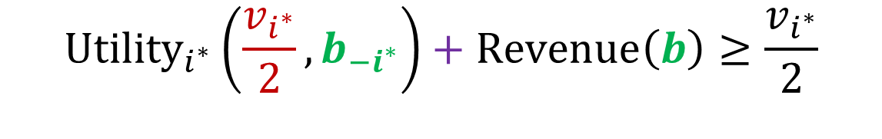
Bounding equilibrium welfare
Candidate. Optimal player, bid half value, $b_{i^{∗}}^{′}=\frac{v_{i^{∗}}}{2}$
$$v_{1}$$
$$0$$
$$b_{1}$$
$${Utility}_{i^{∗}}\left(\frac{v_{i^{∗}}}{2},b_{−i^{∗}}\right)+Revenue\left(b\right)≥\frac{v_{i^{∗}}}{2}$$
$$v_{i^{∗}}/2$$
$$v_{i^{∗}}$$
$$b_{i^{∗}}$$
Deviating Utility
Revenue
Half of optimal
$$0$$
$$b_{n}$$
$$v_{n}$$

Slide 16
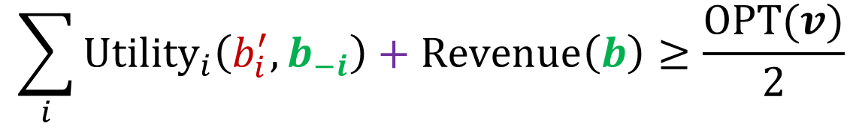
Bounding equilibrium welfare
Candidate. Optimal player, bid half value, $b_{i^{∗}}^{′}=\frac{v_{i^{∗}}}{2}$
$$v_{1}$$
$$0$$
$$b_{1}$$
$$\sum_{i}{{Utility}_{i}\left(b_{i}^{′},b_{−i}\right)}+Revenue\left(b\right)≥\frac{OPT(v)}{2}$$
$$v_{i^{∗}}/2$$
$$v_{i^{∗}}$$
$$b_{i^{∗}}$$
Total Deviating Utility
Revenue
Half of optimal
$$0$$
$$b_{n}$$
$$v_{n}$$

Slide 17
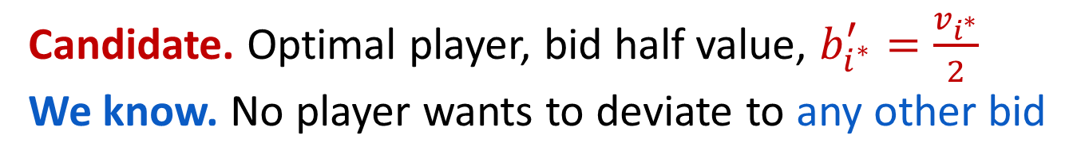

Bounding equilibrium welfare
Candidate. Optimal player, bid half value, $b_{i^{∗}}^{′}=\frac{v_{i^{∗}}}{2}$
We know. No player wants to deviate to any other bid
$$\sum_{i}{{Utility}_{i}\left(b_{i}^{′},b_{−i}\right)}+Revenue\left(b\right)≥\frac{OPT(v)}{2}$$
Total Deviating Utility
Revenue
Half of optimal

Slide 18
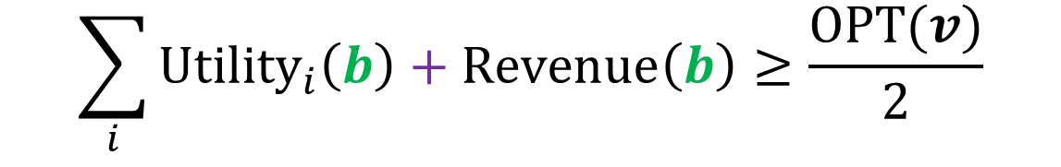
Bounding equilibrium welfare
Candidate. Optimal player, bid half value, $b_{i^{∗}}^{′}=\frac{v_{i^{∗}}}{2}$
We know. No player wants to deviate to any other bid
$$\sum_{i}{{Utility}_{i}\left(b\right)}+Revenue\left(b\right)≥\frac{OPT(v)}{2}$$
Total Equilibrium Utility
Revenue
Half of optimal

Slide 19

Bounding equilibrium welfare
Candidate. Optimal player, bid half value, $b_{i^{∗}}^{′}=\frac{v_{i^{∗}}}{2}$
We know. No player wants to deviate to any other bid
$$Welfare\left(b\right)≥\frac{OPT(v)}{2}$$
Equilibrium Welfare
Half of optimal

Slide 20
Extension to BNE of IPV setting
Candidate. Optimal player, bid half value, $b_{i^{∗}}^{′}=\frac{v_{i^{∗}}}{2}$
$$\sum_{i}{{Utility}_{i}\left(b_{i}^{′},b_{−i}\right)}+Revenue\left(b\right)≥\frac{OPT(v)}{2}$$
Total Deviating Utility
Revenue
Half of optimal

Slide 21
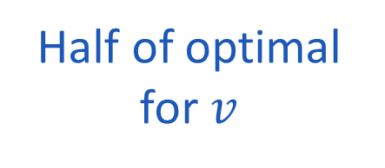
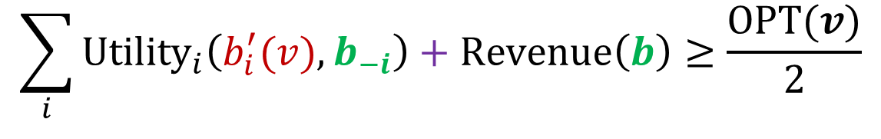
Extension to BNE of IPV setting
Candidate. Optimal player, bid half value, $b_{i^{∗}}^{′}=\frac{v_{i^{∗}}}{2}$
$$\sum_{i}{{Utility}_{i}\left(b_{i}^{′}(v),b_{−i}\right)}+Revenue\left(b\right)≥\frac{OPT(v)}{2}$$
Total Deviating Utility
Revenue
Half of optimal for $v$

Slide 22
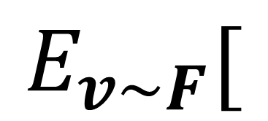
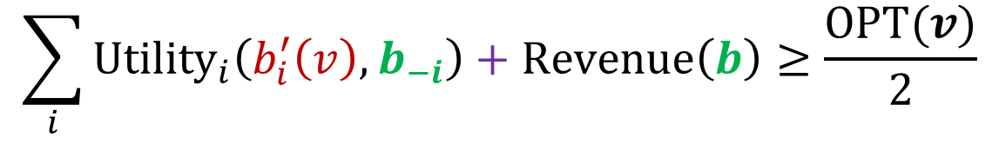

Extension to BNE of IPV setting
Candidate. Optimal player, bid half value, $b_{i^{∗}}^{′}=\frac{v_{i^{∗}}}{2}$
$$E_{v∼F}[$$
$$]$$
$$\sum_{i}{{Utility}_{i}\left(b_{i}^{′}\left(v\right),b_{−i}\right)}+Revenue\left(b\right)≥\frac{OPT(v)}{2}$$
Total Deviating Utility
Revenue
Half of optimal for $v$

Slide 23
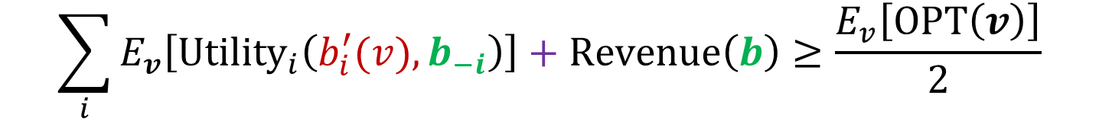
Extension to BNE of IPV setting
Candidate. Optimal player, bid half value, $b_{i^{∗}}^{′}=\frac{v_{i^{∗}}}{2}$
$$\sum_{i}{E_{v}\left[{Utility}_{i}\left(b_{i}^{′}(v),b_{−i}\right)\right]}+Revenue\left(b\right)≥\frac{E_{v}\left[OPT\left(v\right)\right]}{2}$$
Deviating Utility of
sample opponent values
bid half value if you are optimal
Revenue
Half of expected optimal

Slide 24
Extension to BNE of IPV setting
Candidate. Sample opponents values, bid half value if you are optimal
$$\sum_{i}{E_{v}\left[{Utility}_{i}\left(b_{i}^{′}(v),b_{−i}\right)\right]}+Revenue\left(b\right)≥\frac{E_{v}\left[OPT\left(v\right)\right]}{2}$$
Deviating Utility of
sample opponent values
bid half value if you are optimal
Revenue
Half of expected optimal

Slide 25
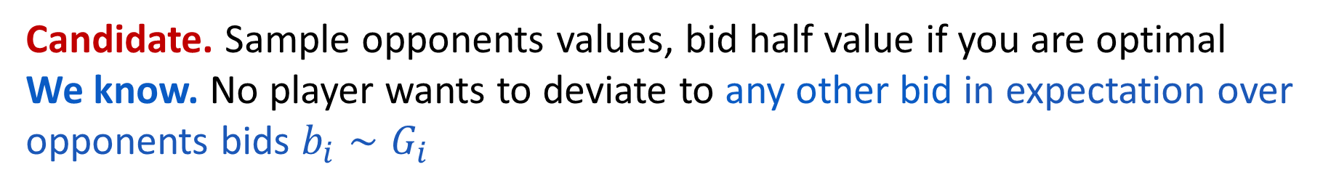
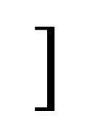
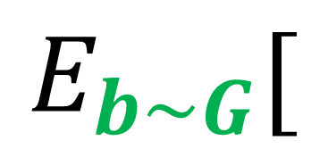
Extension to BNE of IPV setting
Candidate. Sample opponents values, bid half value if you are optimal
We know. No player wants to deviate to any other bid in expectation over opponents bids $b_{i}∼G_{i}$
$$E_{b∼G}[$$
$$]$$
$$\sum_{i}{E_{v}\left[{Utility}_{i}\left(b_{i}^{′}(v),b_{−i}\right)\right]}+Revenue\left(b\right)≥\frac{E_{v}\left[OPT\left(v\right)\right]}{2}$$
Deviating Utility of
sample opponent values
bid half value if you are optimal
Revenue
Half of expected optimal

Slide 26

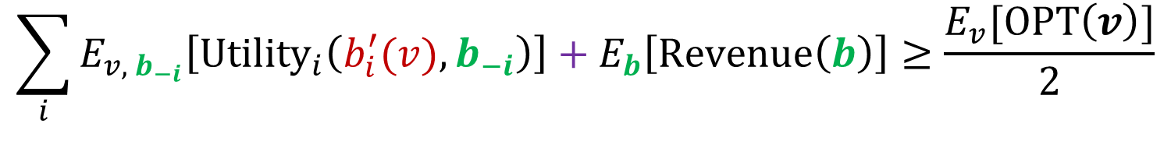
Extension to BNE of IPV setting
Candidate. Sample opponents values, bid half value if you are optimal
We know. No player wants to deviate to any other bid in expectation over opponents bids $b_{i}∼G_{i}$
$$\sum_{i}{E_{v, b_{−i}}\left[{Utility}_{i}\left(b_{i}^{′}(v),b_{−i}\right)\right]}+E_{b}\left[Revenue\left(b\right)\right]≥\frac{E_{v}[OPT\left(v\right)]}{2}$$
Independence crucial:
In correlated values, distribution of opponent bids changes conditional on value
Expected
Revenue
Half of expected optimal
Expected Deviating Utility of
sample opponent values
bid half value if you are optimal

Slide 27
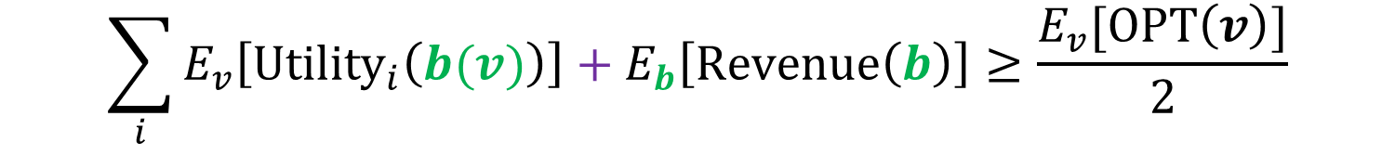
Extension to BNE of IPV setting
Candidate. Sample opponents values, bid half value if you are optimal
We know. No player wants to deviate to any other bid in expectation over opponents bids $b_{i}∼G_{i}$
$$\sum_{i}{E_{v}\left[{Utility}_{i}\left(b(v)\right)\right]}+E_{b}\left[Revenue\left(b\right)\right]≥\frac{E_{v}[OPT\left(v\right)]}{2}$$
Expected Equilibrium Utility
Expected
Revenue
Half of expected optimal

Slide 28

Extension to BNE of IPV setting
Candidate. Sample opponents values, bid half value if you are optimal
We know. No player wants to deviate to any other bid in expectation over opponents bids $b_{i}∼G_{i}$
$$E_{v}\left[Welfare\left(b\left(v\right)\right)\right]≥\frac{E_{v}[OPT\left(v\right)]}{2}$$
Expected Equilibrium Welfare
Half of expected optimal

Slide 29
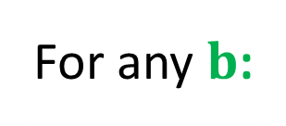
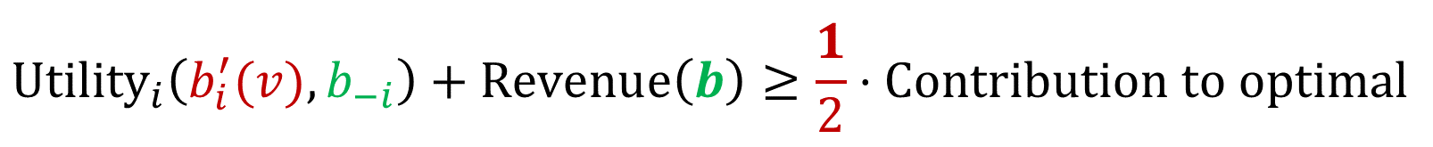
Core Property
Mechanism admits for any valuation profile $v$, deviations $b_{i}^{′}(v)$
$${Utility}_{i}\left(b_{i}^{′}(v),b_{−i}\right)+Revenue\left(b\right)≥\frac{1}{2}⋅Contribution to optimal$$
For any $b$:
Either guarantees me high utility
Or someone else is paying a lot
Compared to my contribution to optimal

Slide 30
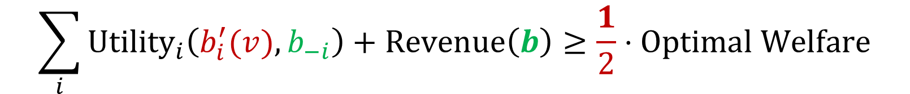
Core Property
Mechanism admits for any valuation profile $v$, deviations $b_{i}^{′}(v)$
For any $b$:
$$\sum_{i}{{Utility}_{i}\left(b_{i}^{′}(v),b_{−i}\right)}+Revenue\left(b\right)≥\frac{1}{2}⋅Optimal Welfare$$
Suffices on aggregate across players

Slide 31
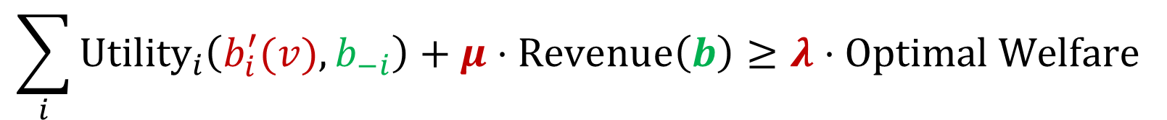

Core Property
Mechanism admits for any valuation profile $v$, deviations $b_{i}^{′}(v)$
For any $b$:
$$\sum_{i}{{Utility}_{i}\left(b_{i}^{′}(v),b_{−i}\right)}+μ⋅Revenue\left(b\right)≥λ⋅Optimal Welfare$$
For some arbitrary constants $(λ,μ)$

Slide 32

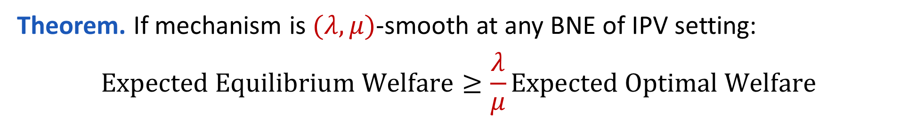

$\left(λ,μ\right)$-Smooth Mechanism
Mechanism admits for any valuation profile $v$, deviations $b_{i}^{′}(v)$
For any $b$:
$$\sum_{i}{{Utility}_{i}\left(b_{i}^{′}(v),b_{−i}\right)}+μ⋅Revenue\left(b\right)≥λ⋅Optimal Welfare$$
Theorem. If mechanism is $(λ,μ)$-smooth at any BNE of IPV setting:
$$Expected Equilibrium Welfare≥\frac{λ}{μ}Expected Optimal Welfare$$
Composable and Efficient Mechanisms
V. Syrgkanis, E. Tardos
2013 ACM Symposium on Theory of Computing (STOC’13)

Slide 33
Smooth mechanisms in the literature
Simultaneous Item Auctions
  Christodoulou, Kovacs, Schapira ICALP’08, Bhawalkar, Roughgarden SODA’11, Hassidim, Kaplan, Mansour, Nisan EC’11
Auctions based on Greedy Allocation Algorithms
  Lucier, Borodin SODA’10
AdAuctions (GSP, GFP)
  Paes-Leme Tardos FOCS’10, Lucier, Paes-Leme + CKKK EC’11
Sequential First/Second Price Auctions
  Paes Leme, Syrgkanis, Tardos SODA’12, Syrgkanis, Tardos EC’12
Walrasian Mechanism
  Babaioff, Lucier, Nisan, Paes-Leme EC’14
Uniform Price Auctions
  De Keijzer et al. ESA’13
Relax-and-Round Mechanisms
  Duetting et al. EC’15
Bandwidth Allocation
  Boudouris et al. SAGT’15
Online mechanisms for energy markets
  Kesselheim et al. EC’15

Slide 34
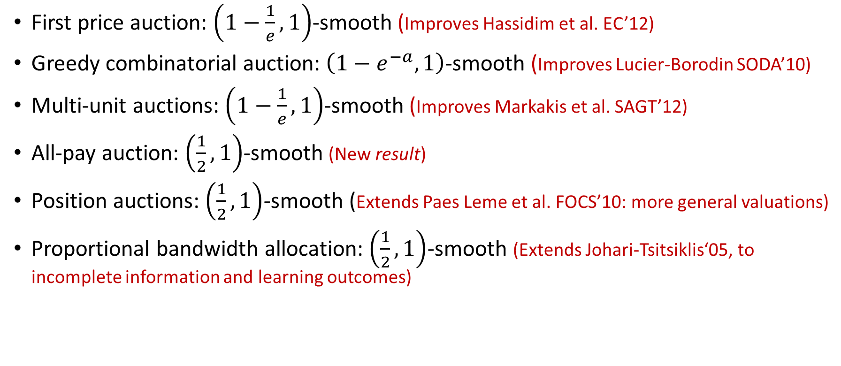
New results via smooth mechanisms
First price auction: $\left(1−\frac{1}{e},1\right)$-smooth (Improves Hassidim et al. EC’12)
Greedy combinatorial auction: $\left(1−e^{−a},1\right)$-smooth (Improves Lucier-Borodin SODA’10)
Multi-unit auctions: $\left(1−\frac{1}{e},1\right)$-smooth (Improves Markakis et al. SAGT’12)
All-pay auction: $\left(\frac{1}{2},1\right)$-smooth (New result)
Position auctions: $\left(\frac{1}{2},1\right)$-smooth (Extends Paes Leme et al. FOCS’10: more general valuations)
Proportional bandwidth allocation: $\left(\frac{1}{2},1\right)$-smooth (Extends Johari-Tsitsiklis‘05, to incomplete information and learning outcomes)

Slide 35
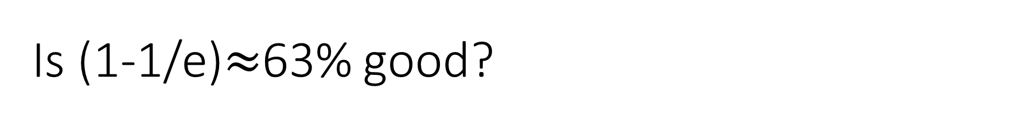
Is (1-1/e)$≈$63% good?
Tight for correlated valuations [S.’14]
Not so for independent: 87% lower bound example [Hartline et al. ‘14]
In the next section, for combinatorial auction settings tight among all mechanisms with polynomial communication complexity

Slide 36
Challenge 2
Simultaneous auctions

Slide 37

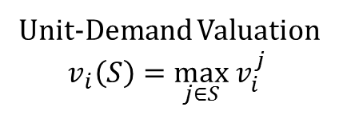





Example cont’d: Simultaneous First-Price Auctions
$$v_{1}$$
$$v_{i}$$
$$v_{i}^{1}$$
$$v_{i}^{2}$$
Unit-Demand Valuation
$$v_{i}\left(S\right)=\max_{j∈S}{ v}_{i}^{j}$$
$$v_{i}^{3}$$
$$v_{n}$$

Slide 38



Example cont’d: Simultaneous First-Price Auctions
$$v_{1}$$
$$v_{i}$$
$$b_{i}^{1}$$
$$b_{i}^{2}$$
Unit-Demand Valuation
$$v_{i}\left(S\right)=\max_{j∈S}{ v}_{i}^{j}$$
$$b_{i}^{3}$$
$$v_{n}$$

Slide 39




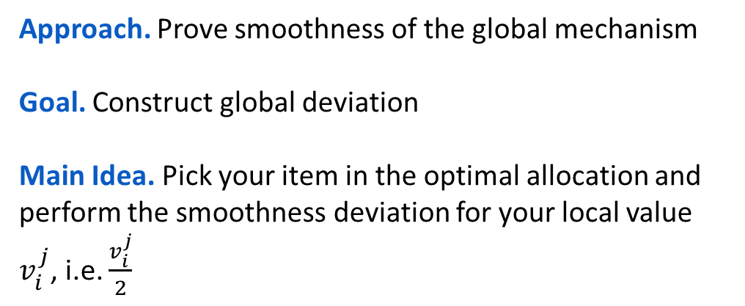

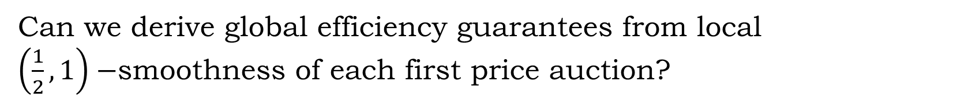



Local to global efficiency guarantees
Can we derive global efficiency guarantees from local $\left(\frac{1}{2},1\right)−$smoothness of each first price auction?
$$v_{1}$$
$$j_{i}^{∗}$$
Approach. Prove smoothness of the global mechanism
Goal. Construct global deviation
Main Idea. Pick your item in the optimal allocation and perform the smoothness deviation for your local value $v_{i}^{j}$, i.e. $\frac{v_{i}^{j}}{2}$
$$p_{1}$$
$$v_{i}$$
$$\frac{v_{i}^{j}}{2}$$
$$0$$
$$v_{n}$$
$$0$$

Slide 40
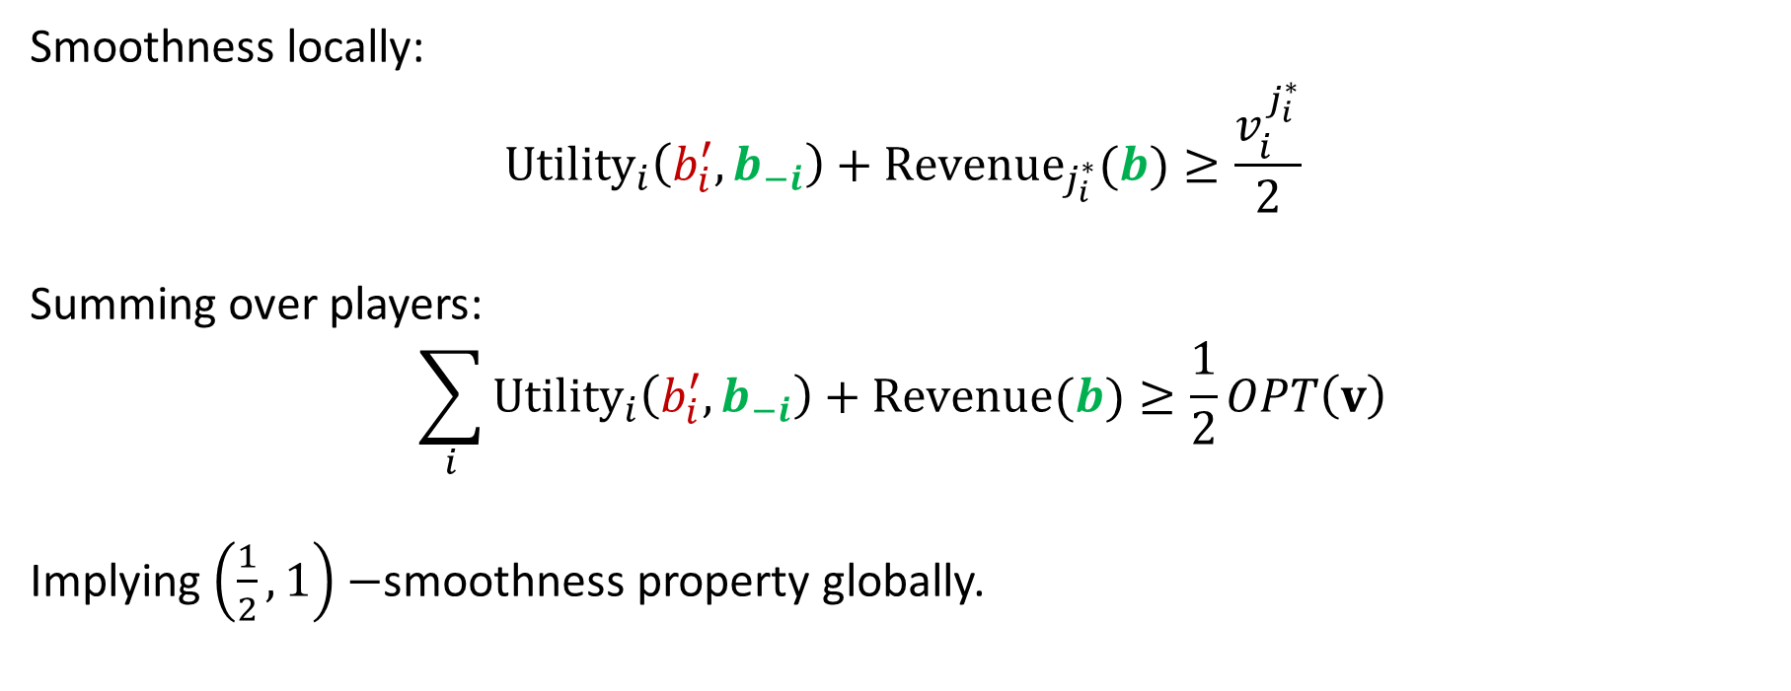
Local to global smoothness
Smoothness locally:
$${Utility}_{i}\left(b_{i}^{′},b_{−i}\right)+{Revenue}_{j_{i}^{∗}}(b)≥\frac{v_{i}^{j_{i}^{∗}}}{2}$$
Summing over players:
$$\sum_{i}{{Utility}_{i}\left(b_{i}^{′},b_{−i}\right)}+Revenue(b)≥\frac{1}{2}OPT\left(v\right)$$
Implying $\left(\frac{1}{2},1\right)−$smoothness property globally.

Slide 41
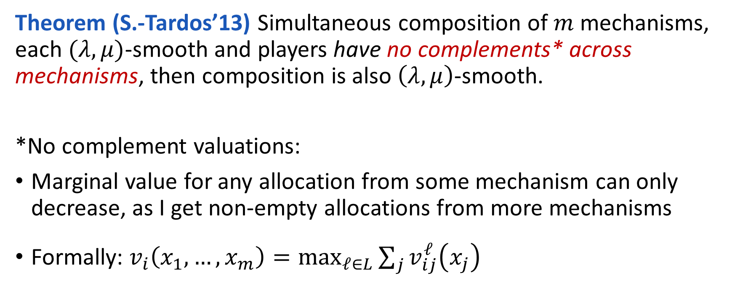
Simultaneous Composition Theorem
Theorem (S.-Tardos’13) Simultaneous composition of $m$ mechanisms, each $(λ,μ)$-smooth and players have no complements* across mechanisms, then composition is also $\left(λ,μ\right)$-smooth.
*No complement valuations:
Marginal value for any allocation from some mechanism can only decrease, as I get non-empty allocations from more mechanisms
Formally: $v_{i}\left(x_{1},…,x_{m}\right)=\max_{ℓ∈L}{\sum_{j}{v_{ij}^{ℓ}\left(x_{j}\right)}}$

Slide 42
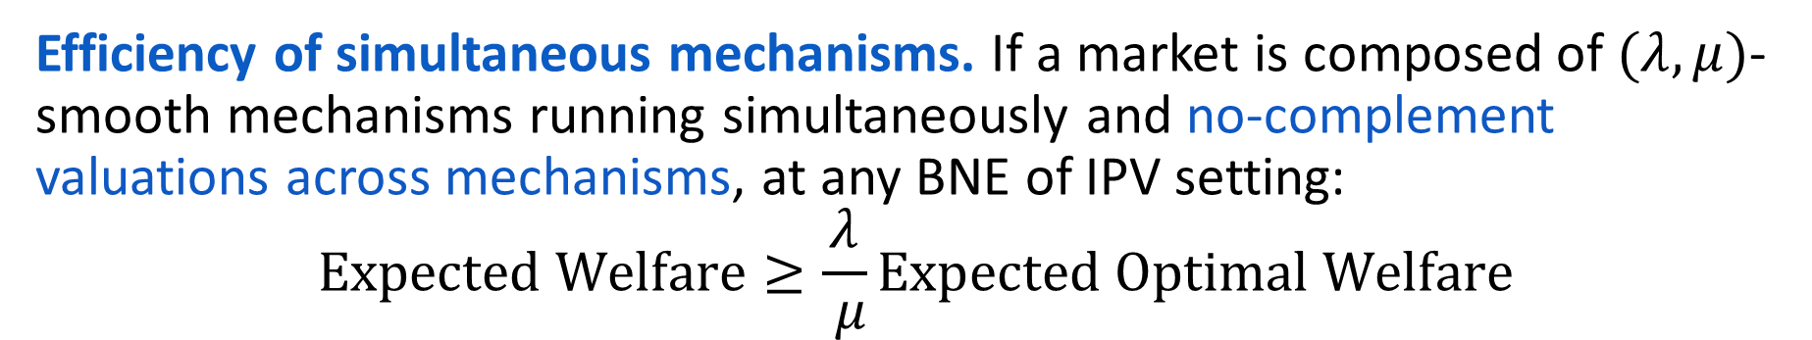
Efficiency of simultaneous mechanisms. If a market is composed of $(λ,μ)$-smooth mechanisms running simultaneously and no-complement valuations across mechanisms, at any BNE of IPV setting:
$$Expected Welfare≥\frac{λ}{ μ}Expected Optimal Welfare$$

Slide 43
Challenge 3
Unknown fundamentals and learning

Slide 44







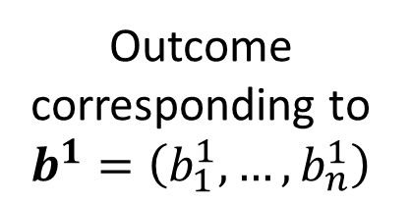












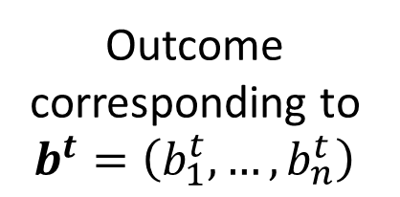










Repeated games
$$v_{1}$$
$$b_{1}^{1}$$
$$b_{1}^{2}$$
$$b_{1}^{3}$$
$$b_{1}^{t}$$
$$b_{1}^{t+1}$$
$$v_{2}$$
$$b_{2}^{1}$$
$$b_{2}^{2}$$
$$b_{2}^{3}$$
$$b_{2}^{t}$$
$$b_{2}^{t+1}$$
$$v_{i}$$
$$…$$
$$…$$
$$…$$
$$…$$
$$…$$
$$b_{i}^{1}$$
$$b_{i}^{2}$$
$$b_{i}^{3}$$
$$b_{i}^{t}$$
$$b_{i}^{t+1}$$
$$…$$
$$…$$
$$…$$
$$…$$
$$…$$
time
Outcome corresponding to $b^{1}=\left(b_{1}^{1},…,b_{n}^{1}\right)$
Outcome corresponding to $b^{t}=\left(b_{1}^{t},…,b_{n}^{t}\right)$

Slide 45
Learning
$$v_{1}$$
$$b_{1}^{1}$$
$$b_{1}^{2}$$
$$b_{1}^{3}$$
$$b_{1}^{t}$$
$$b_{1}^{t+1}$$
$$v_{2}$$
$$b_{2}^{1}$$
$$b_{2}^{2}$$
$$b_{2}^{3}$$
$$b_{2}^{t}$$
$$b_{2}^{t+1}$$
$$v_{i}$$
$$…$$
$$…$$
$$…$$
$$…$$
$$…$$
$$b_{i}^{1}$$
$$b_{i}^{2}$$
$$b_{i}^{3}$$
$$b_{i}^{t}$$
$$b_{i}^{t+1}$$
$$…$$
$$…$$
$$…$$
$$…$$
$$…$$
time
Maybe they play badly initially
Learn over time

Slide 46






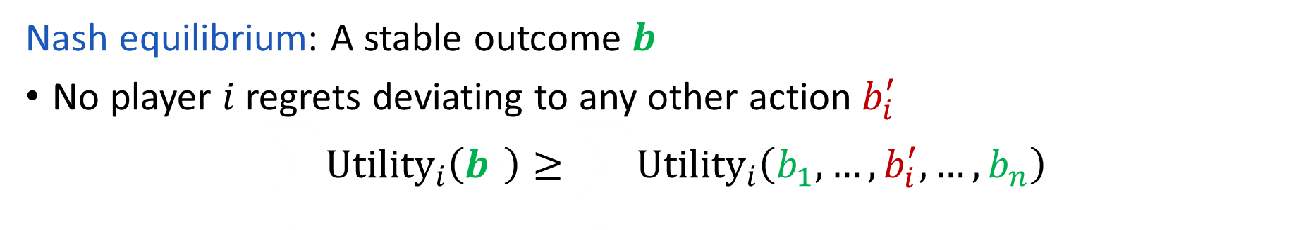
























Nash Equilibrium
$$v_{1}$$
$$b_{1}$$
$$b_{1}$$
$$b_{1}$$
$$b_{1}$$
$$b_{1}$$
$$v_{2}$$
$$b_{2}$$
$$b_{2}$$
$$b_{2}$$
$$b_{2}$$
$$b_{2}$$
$$v_{i}$$
$$…$$
$$…$$
$$…$$
$$…$$
$$…$$
$$b_{i}$$
$$b_{i}$$
$$b_{i}$$
$$b_{i}$$
$$b_{i}$$
$$b_{i}^{′}$$
$$b_{i}^{′}$$
$$b_{i}^{′}$$
$$b_{i}^{′}$$
$$b_{i}^{′}$$
$$…$$
$$…$$
$$…$$
$$…$$
$$…$$
time
Nash equilibrium: A stable outcome $b$
No player $i$ regrets deviating to any other action $b_{i}^{′}$
$$\sum_{t}{{Utility}_{i}\left(b^{t}\right)}≥\sum_{t}{{Utility}_{i}\left(b_{1},…,b_{i}^{′}, …,b_{n}^{t}\right)}$$

Slide 47
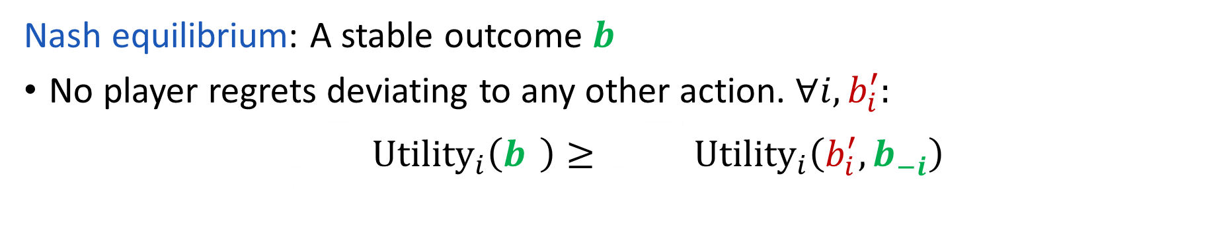
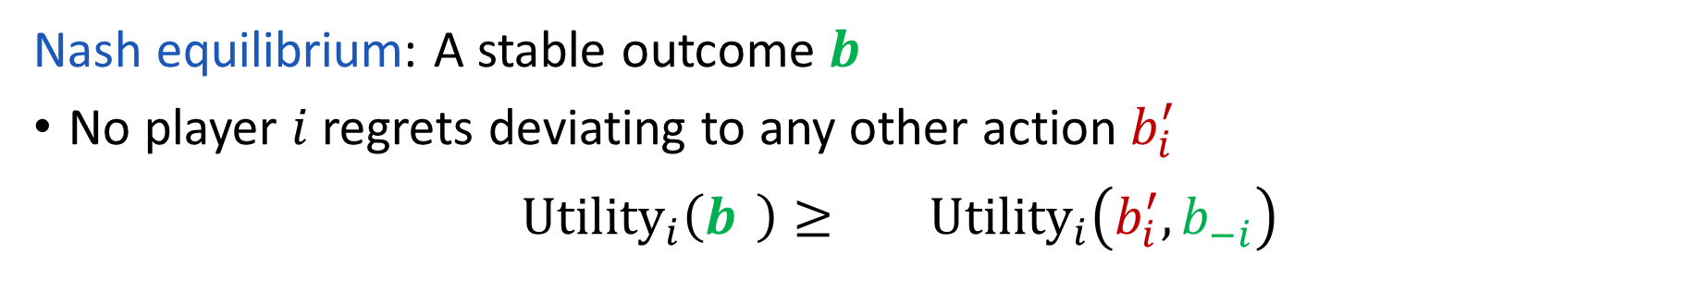
Nash Equilibrium
$$v_{1}$$
$$b_{1}$$
$$b_{1}$$
$$b_{1}$$
$$b_{1}$$
$$b_{1}$$
$$v_{2}$$
$$b_{2}$$
$$b_{2}$$
$$b_{2}$$
$$b_{2}$$
$$b_{2}$$
$$v_{i}$$
$$…$$
$$…$$
$$…$$
$$…$$
$$…$$
$$b_{i}$$
$$b_{i}$$
$$b_{i}$$
$$b_{i}$$
$$b_{i}$$
$$b_{i}^{′}$$
$$b_{i}^{′}$$
$$b_{i}^{′}$$
$$b_{i}^{′}$$
$$b_{i}^{′}$$
$$…$$
$$…$$
$$…$$
$$…$$
$$…$$
time
Nash equilibrium: A stable outcome $b$
No player $i$ regrets deviating to any other action $b_{i}^{′}$
$$\sum_{t}{{Utility}_{i}\left(b^{t}\right)}≥\sum_{t}{{Utility}_{i}\left(b_{i}^{′},b_{−i}^{t}\right)}$$

Slide 48
Nash Equilibrium vs No-Regret Learning
$$v_{1}$$
$$b_{1}$$
$$b_{1}$$
$$b_{1}$$
$$b_{1}$$
$$b_{1}$$
$$v_{2}$$
$$b_{2}$$
$$b_{2}$$
$$b_{2}$$
$$b_{2}$$
$$b_{2}$$
$$v_{i}$$
$$…$$
$$…$$
$$…$$
$$…$$
$$…$$
$$b_{i}$$
$$b_{i}$$
$$b_{i}$$
$$b_{i}$$
$$b_{i}$$
$$…$$
$$…$$
$$…$$
$$…$$
$$…$$
time

Slide 49
























Nash Equilibrium vs No-Regret Learning
$$v_{1}$$
$$b_{1}^{1}$$
$$b_{1}^{2}$$
$$b_{1}^{3}$$
$$b_{1}^{t}$$
$$b_{1}^{t+1}$$
$$v_{2}$$
$$b_{2}^{1}$$
$$b_{2}^{2}$$
$$b_{2}^{3}$$
$$b_{2}^{t}$$
$$b_{2}^{t+1}$$
$$v_{i}$$
$$…$$
$$…$$
$$…$$
$$…$$
$$…$$
$$b_{i}^{1}$$
$$b_{i}^{2}$$
$$b_{i}^{3}$$
$$b_{i}^{t}$$
$$b_{i}^{t+1}$$
$$b_{i}^{′}$$
$$b_{i}^{′}$$
$$b_{i}^{′}$$
$$b_{i}^{′}$$
$$b_{i}^{′}$$
$$…$$
$$…$$
$$…$$
$$…$$
$$…$$
time
Nash equilibrium: A stable outcome $b$
All players do not regret deviation to any other action. $∀i,b_{i}^{′}:$
$$\frac{1}{T}\sum_{t}{{Utility}_{i}\left(b^{t}\right)}≥\frac{1}{T}\sum_{t}{{Utility}_{i}\left(b_{i}^{′}, b_{−i}^{t}\right)}$$

Slide 50

Nash Equilibrium vs No-Regret Learning
$$v_{1}$$
$$b_{1}^{1}$$
$$b_{1}^{2}$$
$$b_{1}^{3}$$
$$b_{1}^{t}$$
$$b_{1}^{t+1}$$
$$v_{2}$$
$$b_{2}^{1}$$
$$b_{2}^{2}$$
$$b_{2}^{3}$$
$$b_{2}^{t}$$
$$b_{2}^{t+1}$$
$$v_{i}$$
$$…$$
$$…$$
$$…$$
$$…$$
$$…$$
$$b_{i}^{1}$$
$$b_{i}^{2}$$
$$b_{i}^{3}$$
$$b_{i}^{t}$$
$$b_{i}^{t+1}$$
$$b_{i}^{′}$$
$$b_{i}^{′}$$
$$b_{i}^{′}$$
$$b_{i}^{′}$$
$$b_{i}^{′}$$
$$…$$
$$…$$
$$…$$
$$…$$
$$…$$
time
Average deviating utility from fixed action
No-Regret: A sequence of outcomes $b^{1}, …,b^{t}$
No player regrets deviating to a fixed action in hindsight.
$$\frac{1}{T}\sum_{t}{{Utility}_{i}\left(b^{t}\right)}≥\frac{1}{T}\sum_{t}{{Utility}_{i}\left(b_{i}^{′},b_{−i}^{t}\right)}$$
Current average utility

Slide 51
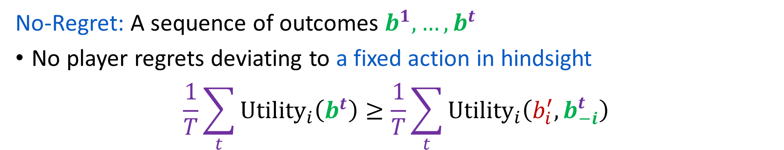
No-Regret Learning
$$v_{1}$$
$$b_{1}^{1}$$
$$b_{1}^{2}$$
$$b_{1}^{3}$$
$$b_{1}^{t}$$
$$b_{1}^{t+1}$$
$$v_{2}$$
$$b_{2}^{1}$$
$$b_{2}^{2}$$
$$b_{2}^{3}$$
$$b_{2}^{t}$$
$$b_{2}^{t+1}$$
$$v_{i}$$
$$…$$
$$…$$
$$…$$
$$…$$
$$…$$
$$b_{i}^{1}$$
$$b_{i}^{2}$$
$$b_{i}^{3}$$
$$b_{i}^{t}$$
$$b_{i}^{t+1}$$
$$b_{i}^{′}$$
$$b_{i}^{′}$$
$$b_{i}^{′}$$
$$b_{i}^{′}$$
$$b_{i}^{′}$$
$$…$$
$$…$$
$$…$$
$$…$$
$$…$$
time
No-Regret: A sequence of outcomes $b^{1}, …,b^{t}$
No player regrets deviating to a fixed action in hindsight.
$$\frac{1}{T}\sum_{t}{{Utility}_{i}\left(b^{t}\right)}≥\frac{1}{T}\sum_{t}{{Utility}_{i}\left(b_{i}^{′},b_{−i}^{t}\right)}$$

Slide 52
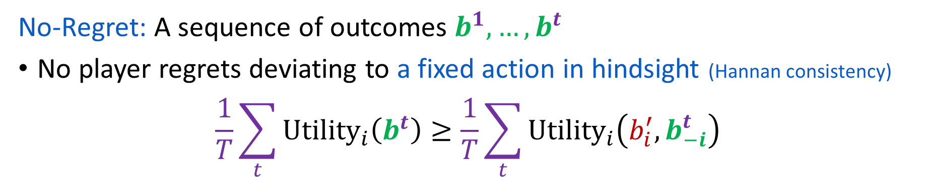

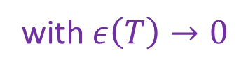
No-Regret Learning
$$v_{1}$$
$$b_{1}^{1}$$
$$b_{1}^{2}$$
$$b_{1}^{3}$$
$$b_{1}^{t}$$
$$b_{1}^{t+1}$$
$$v_{2}$$
$$b_{2}^{1}$$
$$b_{2}^{2}$$
$$b_{2}^{3}$$
$$b_{2}^{t}$$
$$b_{2}^{t+1}$$
$$v_{i}$$
$$…$$
$$…$$
$$…$$
$$…$$
$$…$$
$$b_{i}^{1}$$
$$b_{i}^{2}$$
$$b_{i}^{3}$$
$$b_{i}^{t}$$
$$b_{i}^{t+1}$$
$$b_{i}^{′}$$
$$b_{i}^{′}$$
$$b_{i}^{′}$$
$$b_{i}^{′}$$
$$b_{i}^{′}$$
$$…$$
$$…$$
$$…$$
$$…$$
$$…$$
time
No-Regret: A sequence of outcomes $b^{1}, …,b^{t}$
No player regrets deviating to a fixed action in hindsight (Hannan consistency).
$$\frac{1}{T}\sum_{t}{{Utility}_{i}\left(b^{t}\right)}≥\frac{1}{T}\sum_{t}{{Utility}_{i}\left(b_{i}^{′},b_{−i}^{t}\right)}$$
$$−ε(T)$$
with $ε\left(T\right)→0$

Slide 53
Why no-regret?
Many simple algorithms achieve no-regret (MWU, Regret Matching) [e.g. Freund-Schapire 1995, Foster-Vohra 1997, Hart-Mas-Collel 2000, Cesa-Bianchi-Lugosi 2006, …, field of online learning theory]
Many require only black-box utility feedback
No knowledge of competition/parameters of auction
Requirement on behavior minimal
Requirement inclusive (even repeated Nash satisfies)
No-Regret Outcomes
Nash

Slide 54


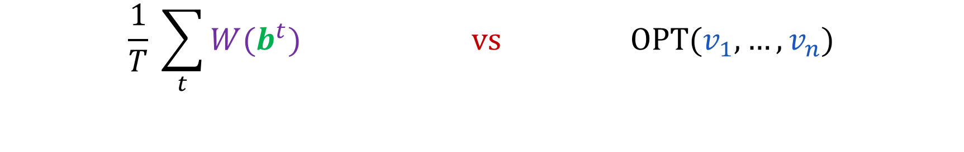



Efficiency of learning outcomes
$$v_{1}$$
$$b_{1}^{1}$$
$$b_{1}^{2}$$
$$b_{1}^{3}$$
$$b_{1}^{t}$$
$$b_{1}^{t+1}$$
[Roughgarden’09]
[Blum, Hajiaghayi, Liggett, Roth’08]
$$v_{2}$$
$$b_{2}^{1}$$
$$b_{2}^{2}$$
$$b_{2}^{3}$$
$$b_{2}^{t}$$
$$b_{2}^{t+1}$$
$$v_{i}$$
$$…$$
$$…$$
$$…$$
$$…$$
$$…$$
$$b_{i}^{1}$$
$$b_{i}^{2}$$
$$b_{i}^{3}$$
$$b_{i}^{t}$$
$$b_{i}^{t+1}$$
$$…$$
$$…$$
$$…$$
$$…$$
$$…$$
time
$$W(b^{1})$$
$$W(b^{2})$$
$$W(b^{3})$$
$$W(b^{t})$$
$$W(b^{t+1})$$
$$\frac{1}{T} \sum_{t}{W(b^{t})} vs OPT(v_{1},…,v_{n})$$
Average Welfare of No-Regret Learners
Optimal Welfare

Slide 55

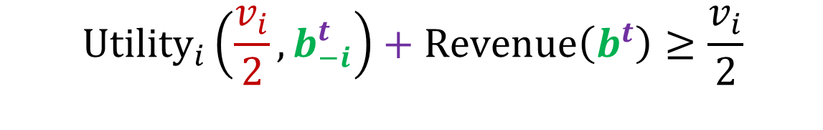



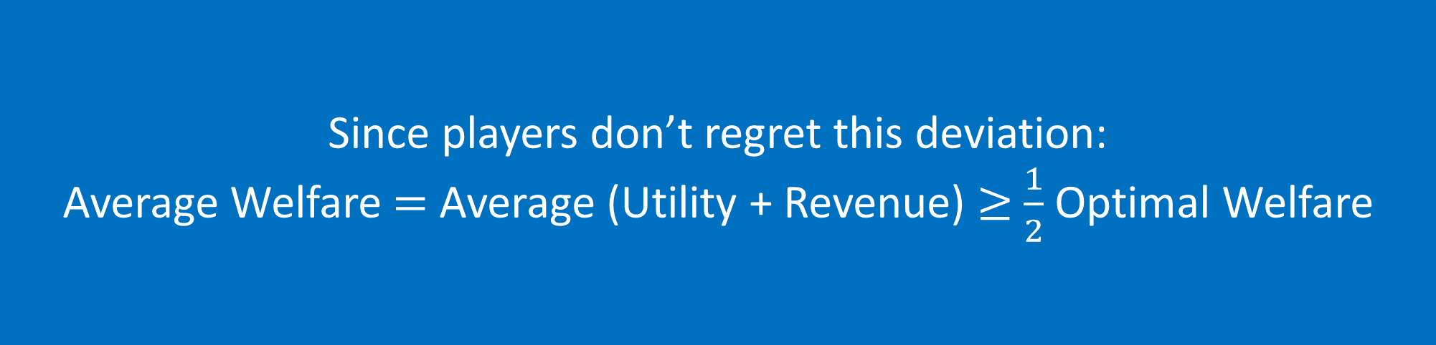

Bounding efficiency of learning outcomes
$$v_{1}$$
$$b_{1}^{1}$$
$$b_{1}^{2}$$
$$b_{1}^{3}$$
$$b_{1}^{t}$$
$$b_{1}^{t+1}$$
$$v_{2}$$
$$b_{2}^{1}$$
$$b_{2}^{2}$$
$$b_{2}^{3}$$
$$b_{2}^{t}$$
$$b_{2}^{t+1}$$
$$v_{i}$$
$$…$$
$$…$$
$$…$$
$$…$$
$$…$$
$$b_{i}^{1}$$
$$b_{i}^{2}$$
$$b_{i}^{3}$$
$$b_{i}^{t}$$
$$b_{i}^{t+1}$$
$$v_{i}/2$$
$$v_{i}/2$$
$$v_{i}/2$$
$$v_{i}/2$$
$$v_{i}/2$$
$$…$$
$$…$$
$$…$$
$$…$$
$$…$$
time
Since players don’t regret this deviation:
Average Welfare $=$ Average (Utility + Revenue) $≥$ $\frac{1}{2}$ Optimal Welfare
$${Utility}_{i}\left(\frac{v_{i}}{2},b_{−i}^{t}\right)+Revenue\left(b^{t}\right)≥\frac{v_{i}}{2}$$
Deviating Utility
Revenue
Half my value

Slide 56
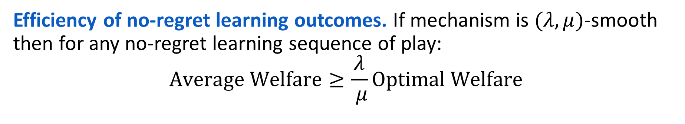
Efficiency of no-regret learning outcomes. If mechanism is $(λ,μ)$-smooth then for any no-regret learning sequence of play:
$$Average Welfare≥\frac{λ}{ μ}Optimal Welfare$$

Slide 57
Further Extensions of Smooth Mechanisms

Slide 58


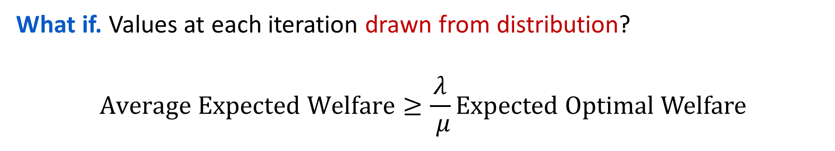






Robustness of efficiency guarantee
No-Regret Outcomes
Bayes-Nash
$$v_{i}^{1}∼F_{i}$$
$$v_{i}^{3}∼F_{i}$$
$$v_{i}^{t}∼F_{i}$$
$$b_{i}^{1}$$
$$b_{i}^{2}$$
$$b_{i}^{3}$$
$$b_{i}^{t}$$
$$b_{i}^{t+1}$$
time
What if. Values at each iteration drawn from distribution?
$$Average Expected Welfare≥\frac{λ}{ μ}Expected Optimal Welfare$$
No-Regret Learning in Bayesian Games
J. Hartline, V. Syrgkanis, E. Tardos
2015 Conference on Neural Information Processing Systems (NIPS’15)

Slide 59






Robustness of efficiency guarantee
$$v_{i}^{1}$$
$$v_{i}^{2}$$
$$v_{i}^{3}$$
$$v_{i}^{t}$$
$$v_{i}^{t+1}$$
$$b_{i}^{1}$$
$$b_{i}^{2}$$
$$b_{i}^{3}$$
$$b_{i}^{t}$$
$$b_{i}^{t+1}$$
time
What if. Players or their values change over time adversarially?
Each player/value w.p. $p$ replaced by new player/value
$(λ,μ)$-smooth mechanism + existence of stable algorithmic solution
$$Average Welfare≥\left(\frac{λ}{ μ}−ε(p)\right)Average Optimal Welfare$$
Learning and Efficiency in Games with Dynamic Population
T. Lykouris, V. Syrgkanis, E. Tardos
2016 SIAM Symposium on Discrete Algorithms (SODA’16)

Slide 60

Addressing pessimism of worst-case analysis
Data-Driven Guarantees [Hoy, Nekipelov, S.’16]
combine data with smoothness analysis for data-driven welfare bounds
Measure $λ,μ$ from data
Yields meaningful guarantees for Bing’s sponsored search auction
Large Markets [Feldman, Immorlica, Lucier, Roughgarden, S., STOC’16]
convergence to more efficient allocations in the large
smoothness + conditions for convergence to price taking behavior
Simultaneous uniform price auctions are fully efficient in the large

Slide 61

Revenue?
Smoothness for Revenue [Hartline-Hoy-Taggart’14]
Single-dimensional environments
“Smoothness” + reserve price $⇒$ approximately optimal revenue
Revenue guarantees for asymmetric first price auction with reserves
Main open question: multi-dimensional environments?

Slide 62
In conclusion
Smoothness analysis unlocks the analysis of complex auctions, unimaginable with equilibrium characterization
  General asymmetric IPV settings
  Simultaneous/Sequential auctions with asymmetric items
  Out-of-equilibrium learning behavior
Useful analysis tool for efficiency in complex auction marketplaces
Thank you!

