Slide 1
Econometric Theory for Games
Part 1: Introduction to Econometrics and Econometrics of Discrete Bayesian Games
Vasilis Syrgkanis
Microsoft Research New England

Slide 2
Outline of tutorial
Day 1:
  Brief Primer on Econometric Theory
  Estimation in Static Games of Incomplete Information: two stage estimators
  Markovian Dynamic Games of Incomplete Information
Day 2:
  Discrete Static Games of Complete Information: multiplicity of equilibria and set inference
Day 3:
  Auction games: Identification and estimation in first price auctions with independent private values
  Algorithmic game theory and econometrics
    Mechanism design for data science
    Econometrics for learning agents

Slide 3
A Primer on Econometric Theory
Basic Tools and Terminology

Slide 4
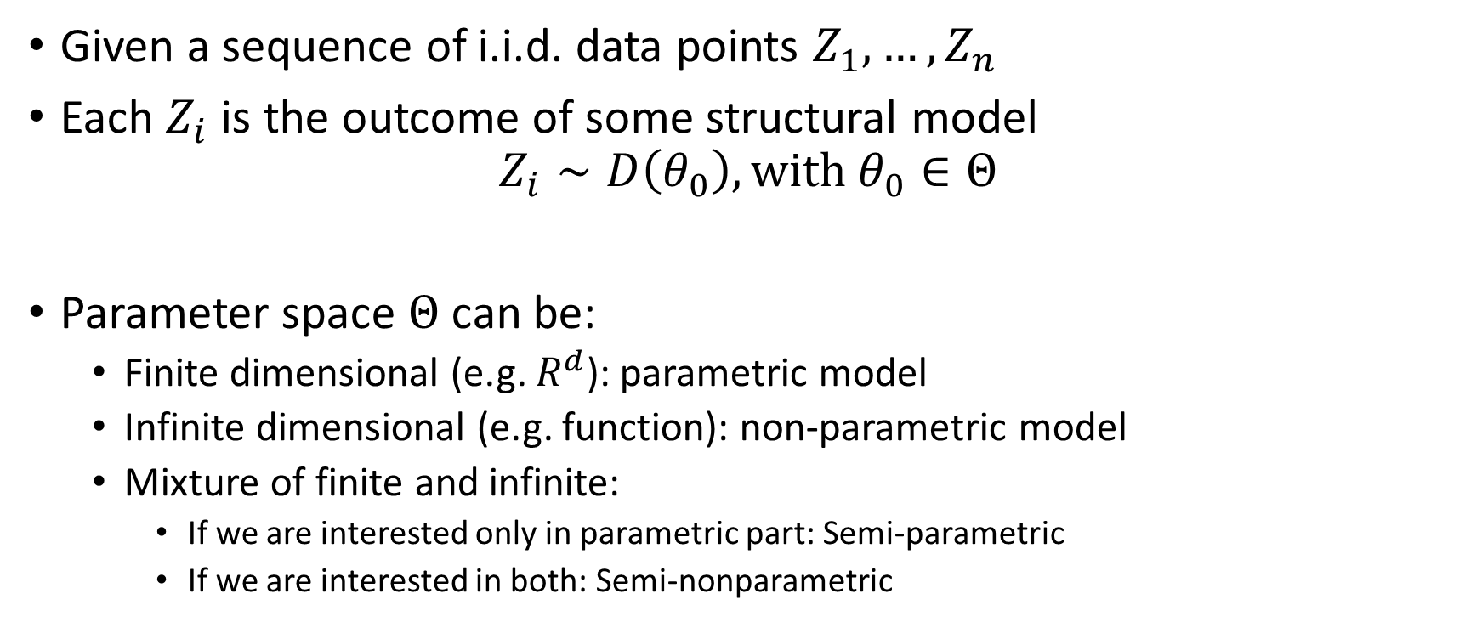
Econometric Theory
Given a sequence of i.i.d. data points $Z_{1},…,Z_{n}$
Each $Z_{i}$ is the outcome of some structural model
$$Z_{i}∼D\left(θ_{0}\right), with θ_{0}∈Θ$$
Parameter space $Θ$ can be:
  Finite dimensional (e.g. $R^{d}$): parametric model
  Infinite dimensional (e.g. function): non-parametric model
  Mixture of finite and infinite:
    If we are interested only in parametric part: Semi-parametric
    If we are interested in both: Semi-nonparametric

Slide 5
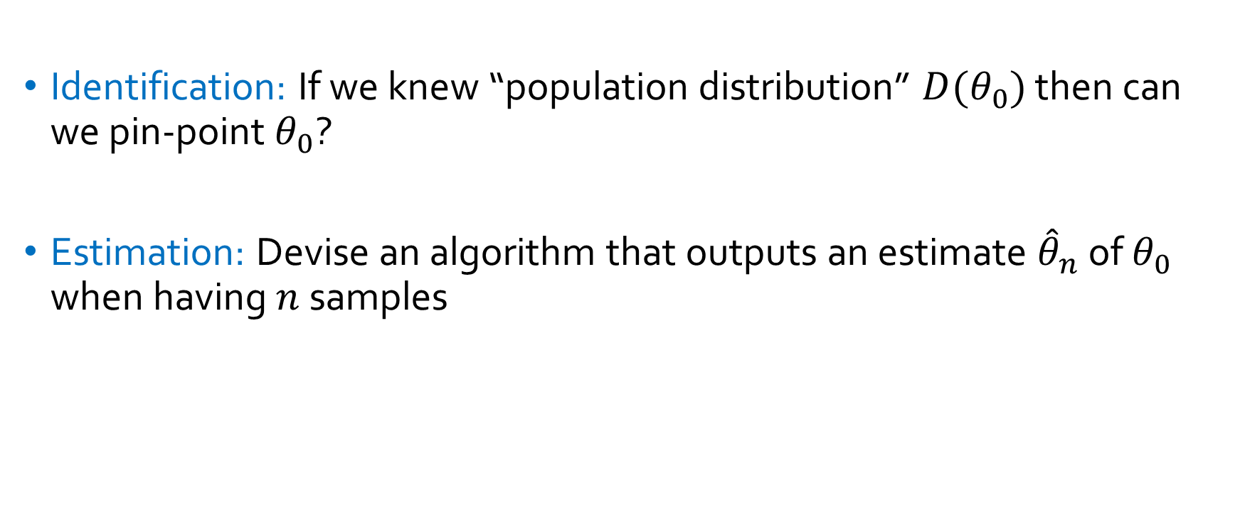
Main Goals
Identification: If we knew “population distribution” $D(θ_{0})$ then can we pin-point $θ_{0}$?
Estimation: Devise an algorithm that outputs an estimate ${\hat{θ}}_{n}$ of $θ_{0}$ when having $n$ samples

Slide 6
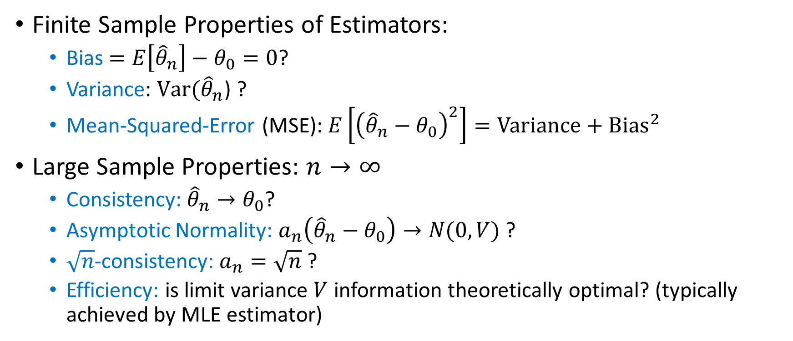
Estimator Properties of Interest
Finite Sample Properties of Estimators:
  Bias $=E\left[{\hat{θ}}_{n}\right]−θ_{0}=0$?
  Variance: $Var({\hat{θ}}_{n}$) ?
  Mean-Squared-Error (MSE): $E\left[{\left({\hat{θ}}_{n}−θ_{0}\right)}^{2}\right]=Variance+Bias^{2}$
Large Sample Properties: $n→∞$
  Consistency: ${\hat{θ}}_{n}→θ_{0}$?
  Asymptotic Normality: $a_{n}\left({\hat{θ}}_{n}−θ_{0}\right)→N(0,V)$ ?
  $\sqrt{n}$-consistency: $a_{n}=\sqrt{n}$ ?
  Efficiency: is limit variance $V$ information theoretically optimal? (typically achieved by MLE estimator)

Slide 7
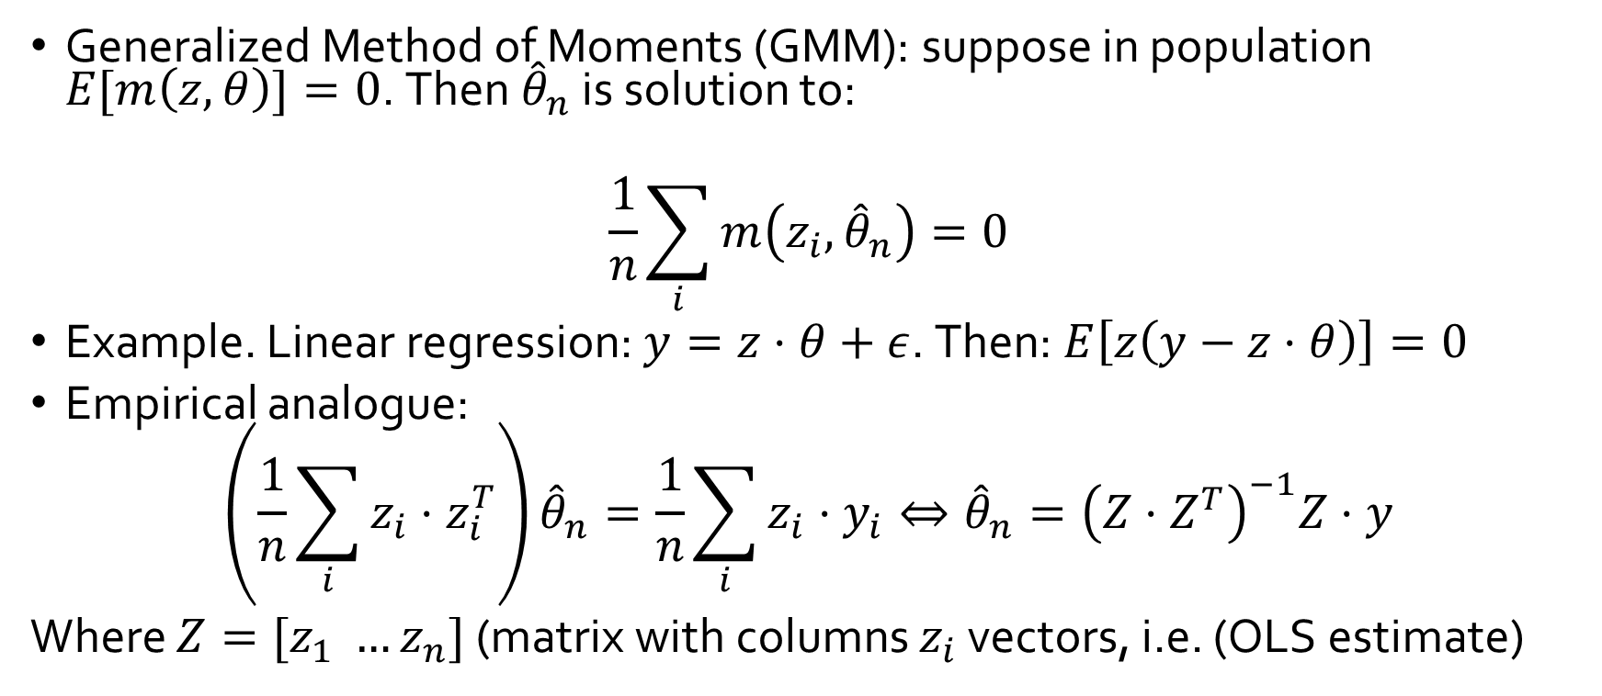
General Classes of Estimators
Generalized Method of Moments (GMM): suppose in population $E[m\left(z,θ\right)]=0$. Then ${\hat{θ}}_{n}$ is solution to:
$$\frac{1}{n}\sum_{i}{m\left(z_{i},{\hat{θ}}_{n}\right)}=0$$
Example. Linear regression: $y=z⋅θ+ε$. Then: $E\left[z\left(y−z⋅θ\right)\right]=0$
Empirical analogue:
$$\left(\frac{1}{n}\sum_{i}{z_{i}⋅z_{i}^{T}}\right){\hat{θ}}_{n}=\frac{1}{n}\sum_{i}{z_{i}⋅y_{i}}⇔{\hat{θ}}_{n}={\left(Z⋅Z^{T}\right)}^{−1}Z⋅y$$
Where $Z=[z_{1} …z_{n}]$ (matrix with columns $z_{i}$ vectors, i.e. (OLS estimate)

Slide 8
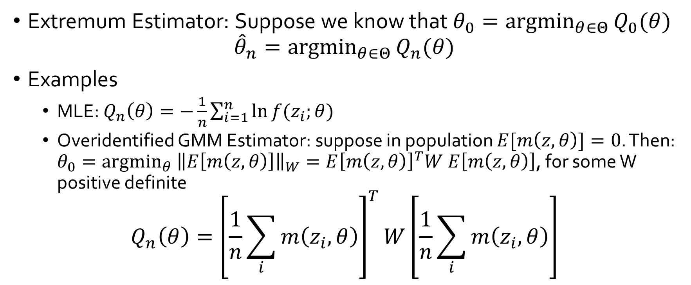
General Classes of Estimators
Extremum Estimator: Suppose we know that $θ_{0}={argmin}_{θ∈Θ}{Q_{0}(θ)}$
$${\hat{θ}}_{n}={argmin}_{θ∈Θ}{Q_{n}(θ)}$$
Examples
  MLE: $Q_{n}\left(θ\right)=−\frac{1}{n}\sum_{i=1}^{n}{\ln{f(z_{i};θ)}}$
  Overidentified GMM Estimator: suppose in population $E[m\left(z,θ\right)]=0$. Then: $θ_{0}={argmin}_{θ} {\left\|E\left[m\left(z,θ\right)\right]\right\|}_{W}=E{\left[m\left(z,θ\right)\right]}^{T}W E\left[m\left(z,θ\right)\right]$, for some W positive definite
$$Q_{n}\left(θ\right)={\left[\frac{1}{n}\sum_{i}{m\left(z_{i},θ\right)}\right]}^{T}W\left[\frac{1}{n}\sum_{i}{m\left(z_{i},θ\right)}\right]$$

Slide 9
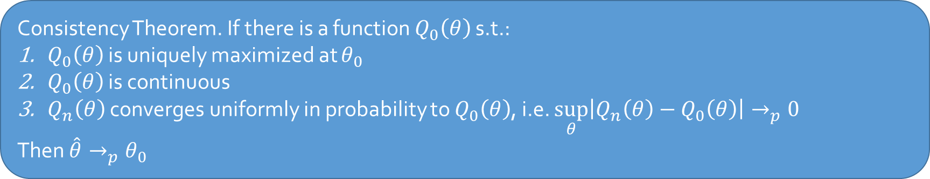
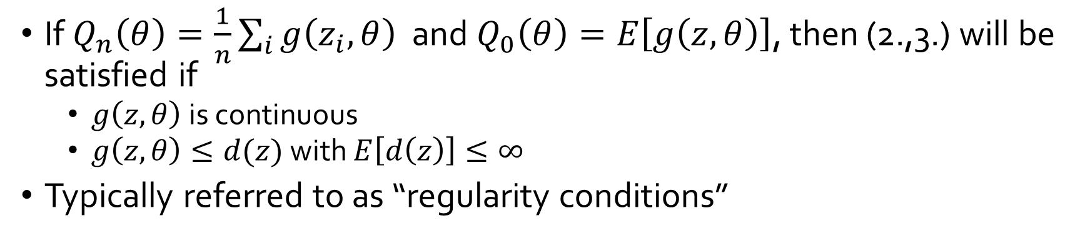
Consistency of Extremum Estimators
Consistency Theorem. If there is a function $Q_{0}\left(θ\right)$ s.t.:
$Q_{0}\left(θ\right)$ is uniquely maximized at $θ_{0}$
$Q_{0}\left(θ\right)$ is continuous
$Q_{n}\left(θ\right)$ converges uniformly in probability to $Q_{0}\left(θ\right)$, i.e. $\sup_{θ}\left|Q_{n}\left(θ\right)−Q_{0}\left(θ\right)\right|→_{p}0$
Then $\hat{θ}→_{p}θ_{0}$
If $Q_{n}\left(θ\right)=\frac{1}{n}\sum_{i}{g\left(z_{i},θ\right)}$ and $Q_{0}\left(θ\right)=E\left[g\left(z,θ\right)\right]$, then (2.,3.) will be satisfied if
  $g\left(z,θ\right)$ is continuous
  $g\left(z,θ\right)≤d(z)$ with $E\left[d\left(z\right)\right]≤∞$
Typically referred to as “regularity conditions”

Slide 10

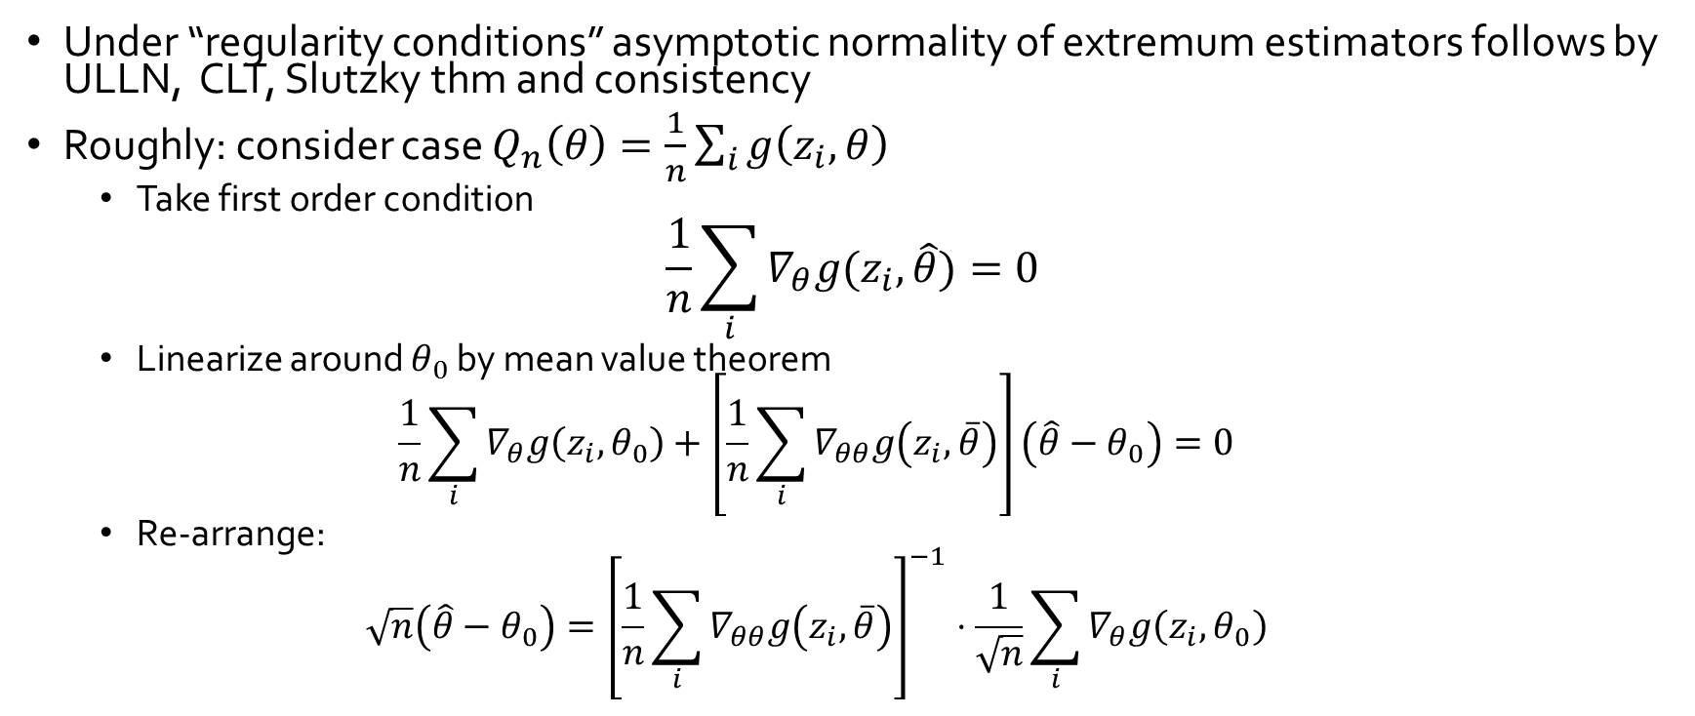


Asymptotic Normality
Under “regularity conditions” asymptotic normality of extremum estimators follows by ULLN, CLT, Slutzky thm and consistency
Roughly: consider case $Q_{n}\left(θ\right)=\frac{1}{n}\sum_{i}{g\left(z_{i},θ\right)}$
  Take first order condition
$$\frac{1}{n}\sum_{i}{∇_{θ}g(z_{i},\hat{θ})}=0$$
  Linearize around $θ_{0}$ by mean value theorem
  $$\frac{1}{n}\sum_{i}{∇_{θ}g\left(z_{i},θ_{0}\right)}+\left[\frac{1}{n}\sum_{i}{∇_{θθ}g\left(z_{i},\overline{θ}\right)}\right]\left(\hat{θ}−θ_{0}\right)=0$$
  Re-arrange:
  $$\sqrt{n}\left(\hat{θ}−θ_{0}\right)={\left[\frac{1}{n}\sum_{i}{∇_{θθ}g\left(z_{i},\overline{θ}\right)}\right]}^{−1}⋅\frac{1}{\sqrt{n}}\sum_{i}{∇_{θ}g\left(z_{i},θ_{0}\right)}$$
In practice, typically variance is computed via Bootstrap [Efron’79]:
Re-sample from your samples with replacement and compute empirical variance
$$→_{d}N\left(0,U\right)$$
$$→_{p}E\left[∇_{θθ}g\left(z,θ_{0}\right)\right]$$
$$→_{d}N\left(0,Var\left(∇_{θ}g\left(z,θ_{0}\right)\right)\right)$$

Slide 11
Econometric Theory for Games

Slide 12
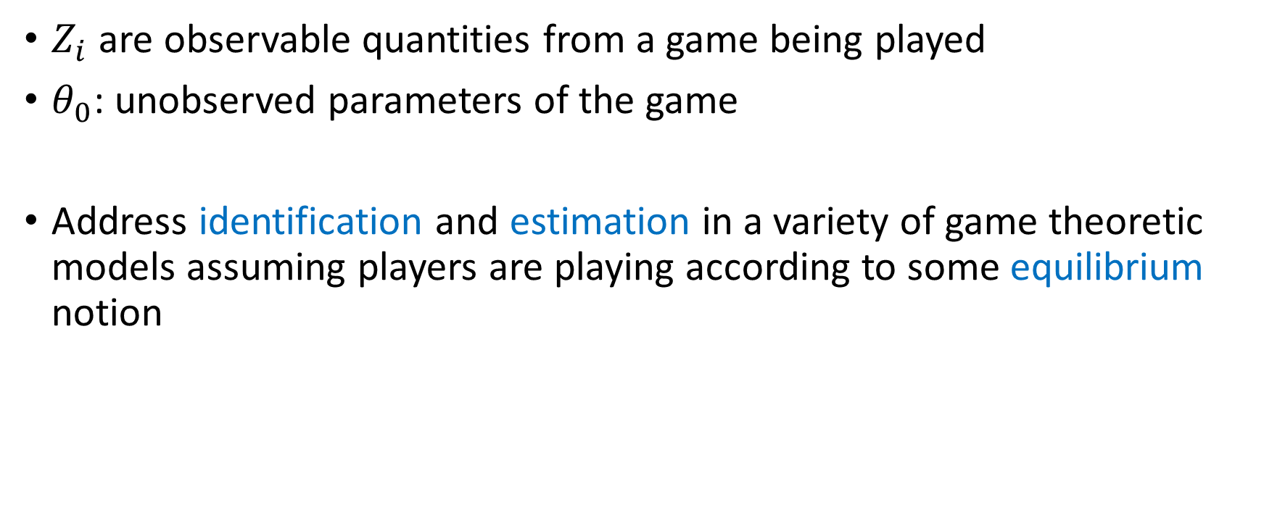
Econometric Theory for Games
$Z_{i}$ are observable quantities from a game being played
$θ_{0}$: unobserved parameters of the game
Address identification and estimation in a variety of game theoretic models assuming players are playing according to some equilibrium notion

Slide 13
Why useful?
Scientific: economically meaningful quantities
Perform counter-factual analysis: what would happen if we change the game?
Performance measures: welfare, revenue
Testing game-theoretic models: if theory on estimated quantities predicts different behavior, then in trouble

Slide 14
Incomplete Information Games and Two-Stage Estimators
Static Games: [Bajari-Hong-Krainer-Nekipelov’12]
Dynamic Games: [Bajari-Benkard-Levin’07], [Pakes-Ostrovsky-Berry’07], [Aguirregabiria-Mira’07], [Ackerberg-Benkard-Berry-Pakes’07], [Bajari-Hong-Chernozhukov-Nekipelov’09]

Slide 15
High level idea
At equilibrium agents have beliefs about other players actions and best respond
If econometrician observes the same information about opponents as the player does then:
  Estimate these beliefs from the data in first stage
  Use best-response inequalities to these estimated beliefs in the second stage and infer parameters of utility

Slide 16
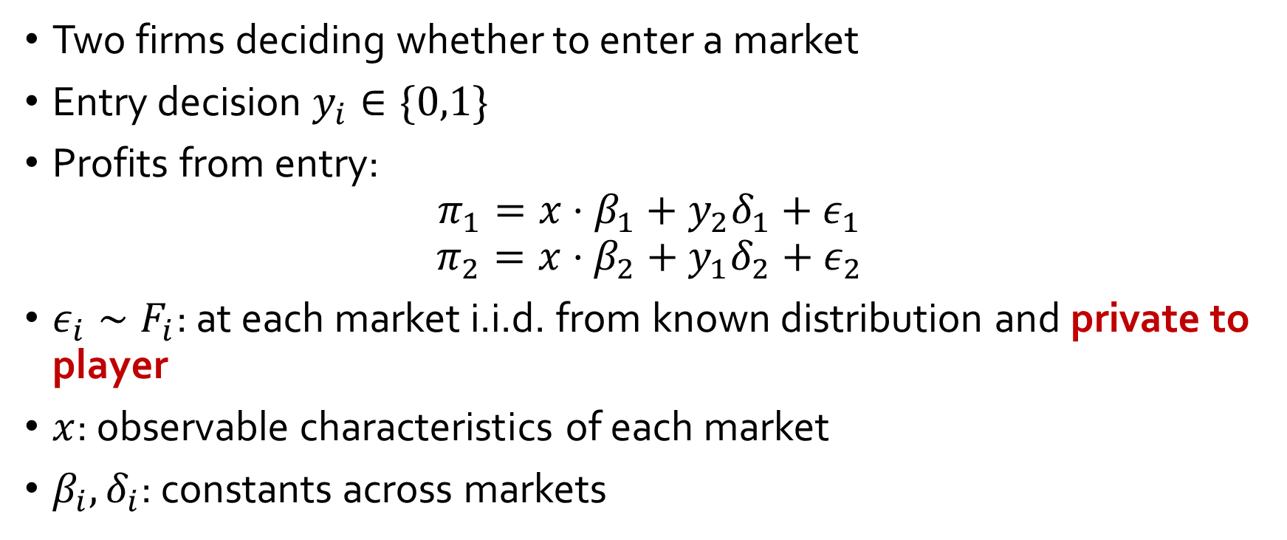
Static Entry Game with Private Shocks
Two firms deciding whether to enter a market
Entry decision $y_{i}∈\{0,1\}$
Profits from entry:
$$π_{1}=x⋅β_{1}+y_{2}δ_{1}+ε_{1}$$
$$π_{2}=x⋅β_{2}+y_{1}δ_{2}+ε_{2}$$
$ε_{i}∼F_{i}$: at each market i.i.d. from known distribution and private to player
$x$: observable characteristics of each market
$β_{i},δ_{i}$: constants across markets

Slide 17
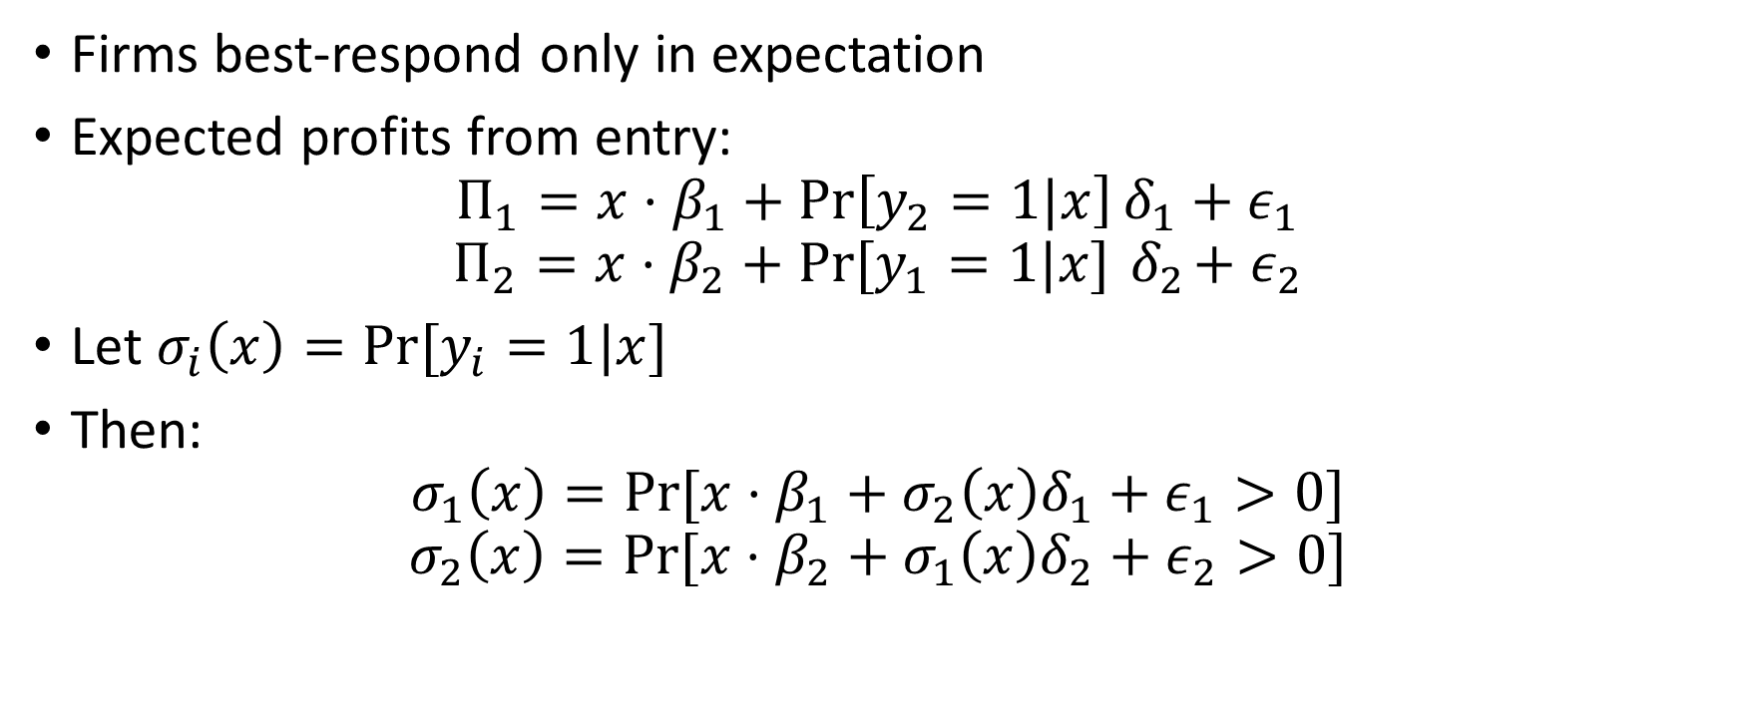
Static Entry Game with Private Shocks
Firms best-respond only in expectation
Expected profits from entry:
$$Π_{1}=x⋅β_{1}+\operatorname{Pr}\left[y_{2}=1|x\right]δ_{1}+ε_{1}$$
$$Π_{2}=x⋅β_{2}+Pr⁡[y_{1}=1|x]{ δ}_{2}+ε_{2}$$
Let $σ_{i}\left(x\right)=Pr⁡[y_{i}=1|x]$
Then:
$$σ_{1}\left(x\right)=Pr⁡[x⋅β_{1}+σ_{2}\left(x\right)δ_{1}+ε_{1}>0]$$
$$σ_{2}\left(x\right)=Pr⁡[x⋅β_{2}+σ_{1}\left(x\right)δ_{2}+ε_{2}>0]$$

Slide 18
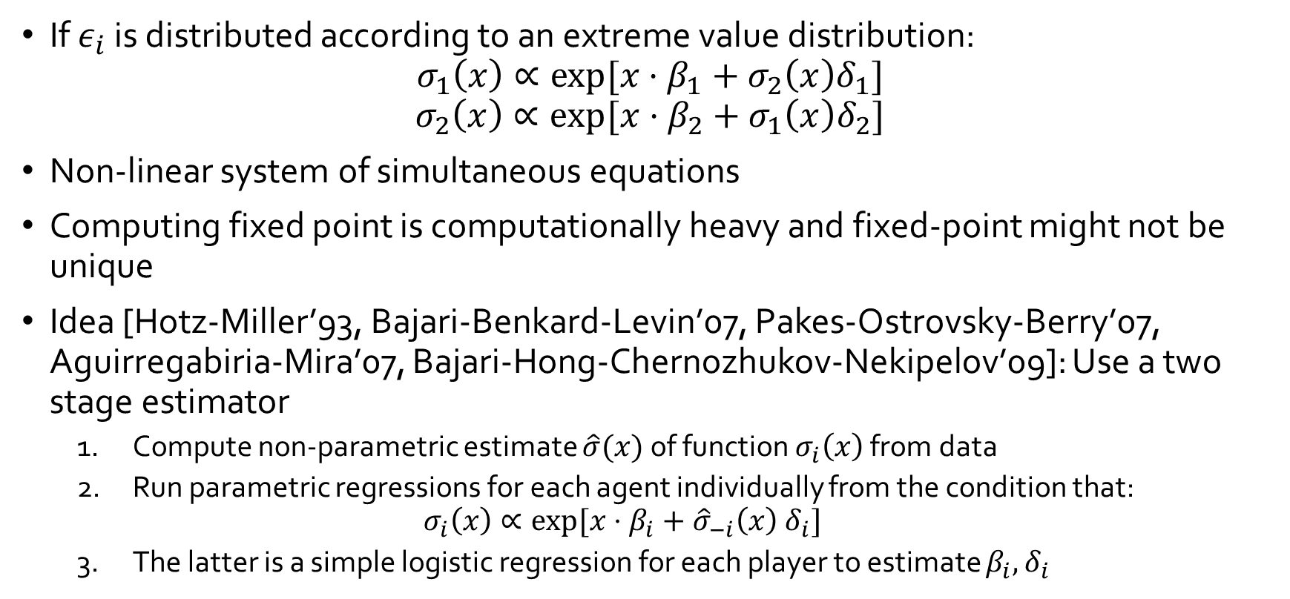
Static Entry Game with Private Shocks
If $ε_{i}$ is distributed according to an extreme value distribution:
$$σ_{1}\left(x\right)∝exp⁡[x⋅β_{1}+σ_{2}\left(x\right)δ_{1}]$$
$$σ_{2}\left(x\right)∝\exp{⁡[x⋅β_{2}+σ_{1}\left(x\right)δ_{2}]}$$
Non-linear system of simultaneous equations
Computing fixed point is computationally heavy and fixed-point might not be unique
Idea [Hotz-Miller’93, Bajari-Benkard-Levin’07, Pakes-Ostrovsky-Berry’07, Aguirregabiria-Mira’07, Bajari-Hong-Chernozhukov-Nekipelov’09]: Use a two stage estimator
  Compute non-parametric estimate $\hat{σ}(x)$ of function $σ_{i}\left(x\right)$ from data
  Run parametric regressions for each agent individually from the condition that:
  $$σ_{i}\left(x\right)∝\exp{[x⋅β_{i}+{\hat{σ}}_{−i}\left(x\right) δ_{i}]}$$
  The latter is a simple logistic regression for each player to estimate $β_{i},δ_{i}$

Slide 19
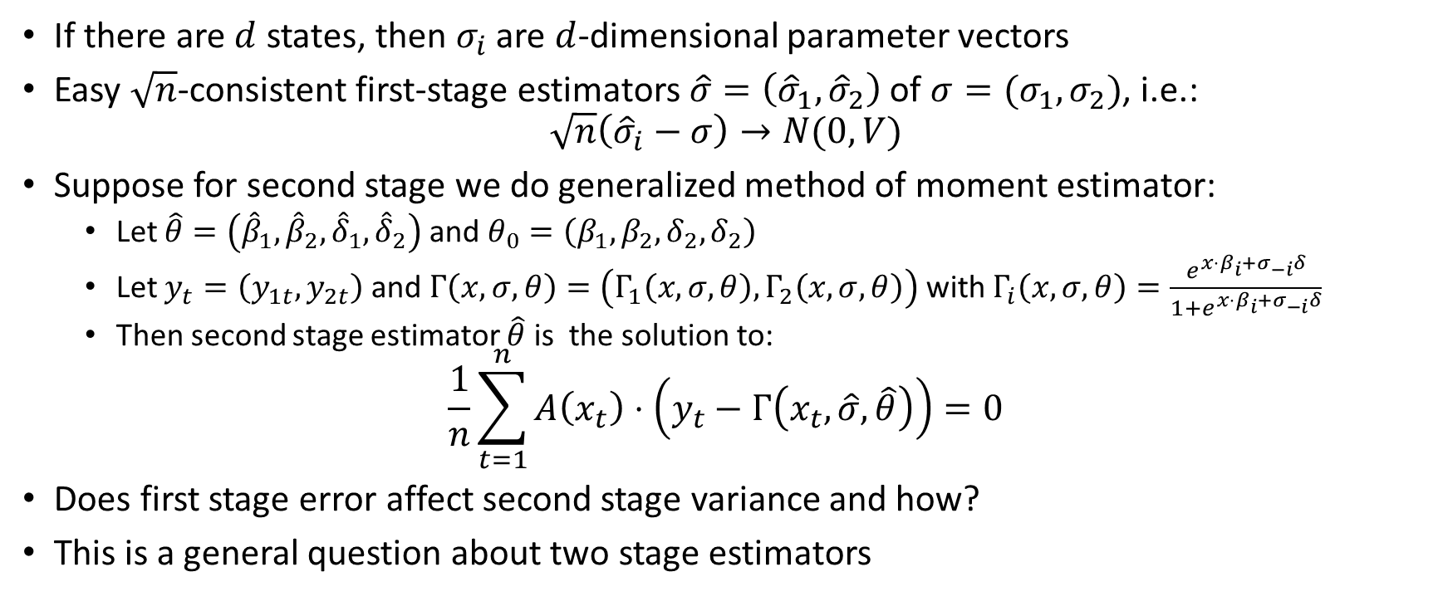
Simple case: finite discrete states
If there are $d$ states, then $σ_{i}$ are $d$-dimensional parameter vectors
Easy $\sqrt{n}$-consistent first-stage estimators $\hat{σ}=\left({\hat{σ}}_{1},{\hat{σ}}_{2}\right)$ of $σ=(σ_{1},σ_{2})$, i.e.:
$$\sqrt{n}\left({\hat{σ}}_{i}−σ\right)→N(0,V)$$
Suppose for second stage we do generalized method of moment estimator:
  Let $\hat{θ}=\left({\hat{β}}_{1},{\hat{β}}_{2},{\hat{δ}}_{1},{\hat{δ}}_{2}\right)$ and $θ_{0}=\left(β_{1},β_{2}, δ_{2},δ_{2}\right)$
  Let $y_{t}=\left(y_{1t},y_{2t}\right)$ and $Γ\left(x,σ,θ\right)=\left(Γ_{1}\left(x,σ,θ\right), Γ_{2}\left(x,σ,θ\right)\right)$ with $Γ_{i}\left(x,σ,θ\right)=\frac{e^{x⋅β_{i}+σ_{−i}δ}}{1+e^{x⋅β_{i}+σ_{−i}δ}}$
  Then second stage estimator $\hat{θ}$ is the solution to:
$$\frac{1}{n}\sum_{t=1}^{n}{A\left(x_{t}\right)⋅\left(y_{t}−Γ\left(x_{t},\hat{σ}, \hat{θ}\right)\right)}=0$$
Does first stage error affect second stage variance and how?
This is a general question about two stage estimators

Slide 20






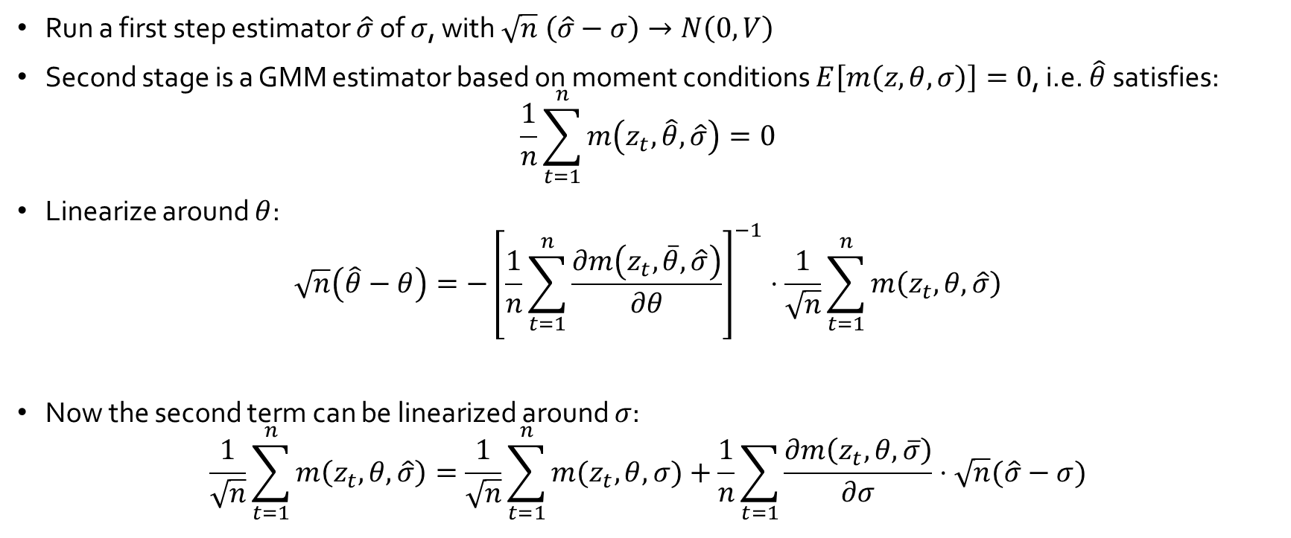
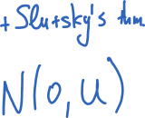

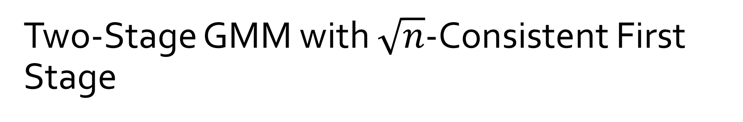
Two-Stage GMM with $\sqrt{n}$-Consistent First Stage
[Newey-McFadden’94: Large Sample Estimation and Hypothesis Testing]
Run a first step estimator $\hat{σ}$ of $σ$, with $\sqrt{n} \left(\hat{σ}−σ\right)→N\left(0,V\right)$
Second stage is a GMM estimator based on moment conditions $E\left[m\left(z,θ,σ\right)\right]=0$, i.e. $\hat{θ}$ satisfies:
$$\frac{1}{n}\sum_{t=1}^{n}{m\left(z_{t},\hat{θ},\hat{σ}\right)}=0$$
Linearize around $θ$:
$$\sqrt{n}\left(\hat{θ}−θ\right)={−\left[\frac{1}{n}\sum_{t=1}^{n}{\frac{∂m\left(z_{t},\overline{θ},\hat{σ}\right)}{∂θ}}\right]}^{−1}⋅\frac{1}{\sqrt{n}}\sum_{t=1}^{n}{m\left(z_{t},θ,\hat{σ}\right)}$$
Now the second term can be linearized around $σ$:
$$\frac{1}{\sqrt{n}}\sum_{t=1}^{n}{m\left(z_{t},θ,\hat{σ}\right)}=\frac{1}{\sqrt{n}}\sum_{t=1}^{n}{m(z_{t},θ,σ)}+\frac{1}{n}\sum_{t=1}{\frac{∂m\left(z_{t}, θ,\overline{σ}\right)}{∂σ}}⋅\sqrt{n}(\hat{σ}−σ)$$

Slide 21
Continuous State Space and Semi-Parametric Efficiency

Slide 22
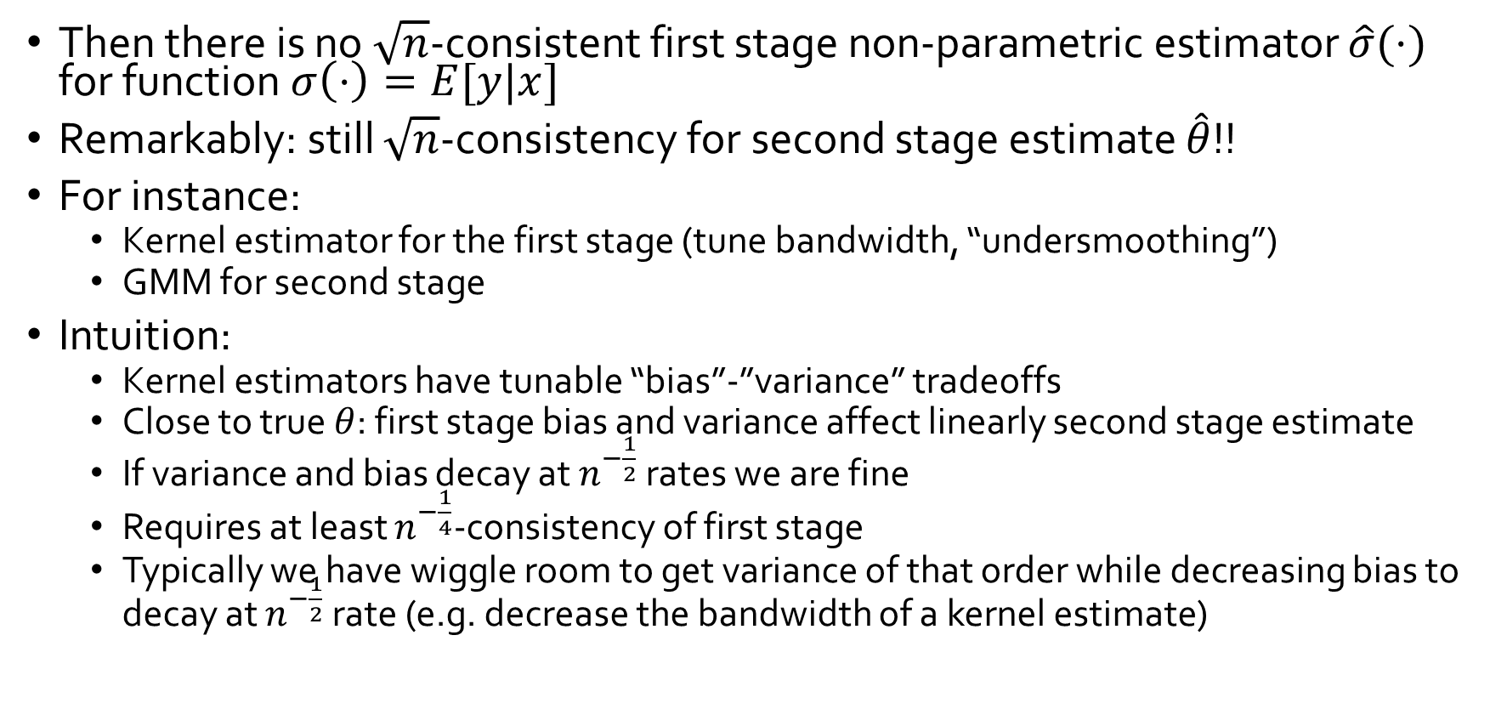
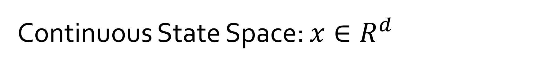
Continuous State Space: $x∈R^{d}$
[Bajari-Hong-Kranier-Nekipelov’12]
Then there is no $\sqrt{n}$-consistent first stage non-parametric estimator $\hat{σ}(⋅)$ for function $σ\left(⋅\right)=E[y|x]$
Remarkably: still $\sqrt{n}$-consistency for second stage estimate $\hat{θ}$!!
For instance:
  Kernel estimator for the first stage (tune bandwidth, “undersmoothing”)
  GMM for second stage
Intuition:
  Kernel estimators have tunable “bias”-”variance” tradeoffs
  Close to true $θ$: first stage bias and variance affect linearly second stage estimate
  If variance and bias decay at $n^{−\frac{1}{2}}$ rates we are fine
  Requires at least $n^{−\frac{1}{4}}$-consistency of first stage
  Typically we have wiggle room to get variance of that order while decreasing bias to decay at $n^{−\frac{1}{2}}$ rate (e.g. decrease the bandwidth of a kernel estimate)

Slide 23


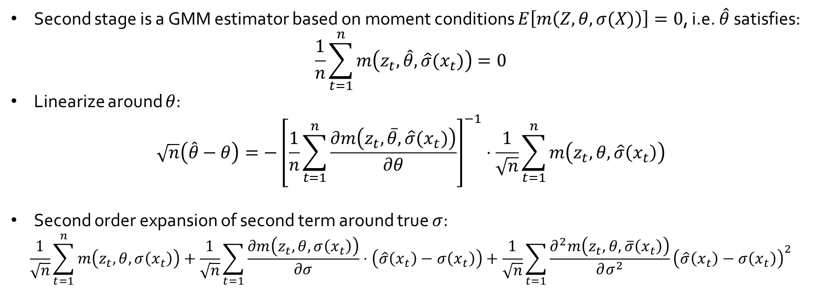


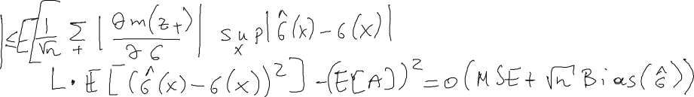

Semi-Parametric Two-Stage Estimation
[Newey-McFadden’94, Chernozhukov et al ‘16]
Second stage is a GMM estimator based on moment conditions $E\left[m\left(Z,θ,σ(X)\right)\right]=0$, i.e. $\hat{θ}$ satisfies:
$$\frac{1}{n}\sum_{t=1}^{n}{m\left(z_{t},\hat{θ},\hat{σ}(x_{t})\right)}=0$$
Linearize around $θ$:
$$\sqrt{n}\left(\hat{θ}−θ\right)={−\left[\frac{1}{n}\sum_{t=1}^{n}{\frac{∂m\left(z_{t},\overline{θ},\hat{σ}(x_{t})\right)}{∂θ}}\right]}^{−1}⋅\frac{1}{\sqrt{n}}\sum_{t=1}^{n}{m\left(z_{t},θ,\hat{σ}\left(x_{t}\right)\right)}$$
Second order expansion of second term around true $σ$:
$$\frac{1}{\sqrt{n}}\sum_{t=1}^{n}{m\left(z_{t},θ,σ\left(x_{t}\right)\right)}+\frac{1}{\sqrt{n}}\sum_{t=1}{\frac{∂m\left(z_{t}, θ,σ\left(x_{t}\right)\right)}{∂σ}}⋅\left(\hat{σ}\left(x_{t}\right)−σ\left(x_{t}\right)\right)+\frac{1}{\sqrt{n}}\sum_{t=1}{\frac{∂^{2}m\left(z_{t},θ,\overline{σ}\left(x_{t}\right)\right)}{∂σ^{2}}{\left(\hat{σ}\left(x_{t}\right)−σ\left(x_{t}\right)\right)}^{2}}$$
Split data set to estimate $\hat{σ}$ with a separate dataset than the one used for $\hat{θ}$.
Makes $\hat{σ}$ independent of $x_{t}$

Slide 24
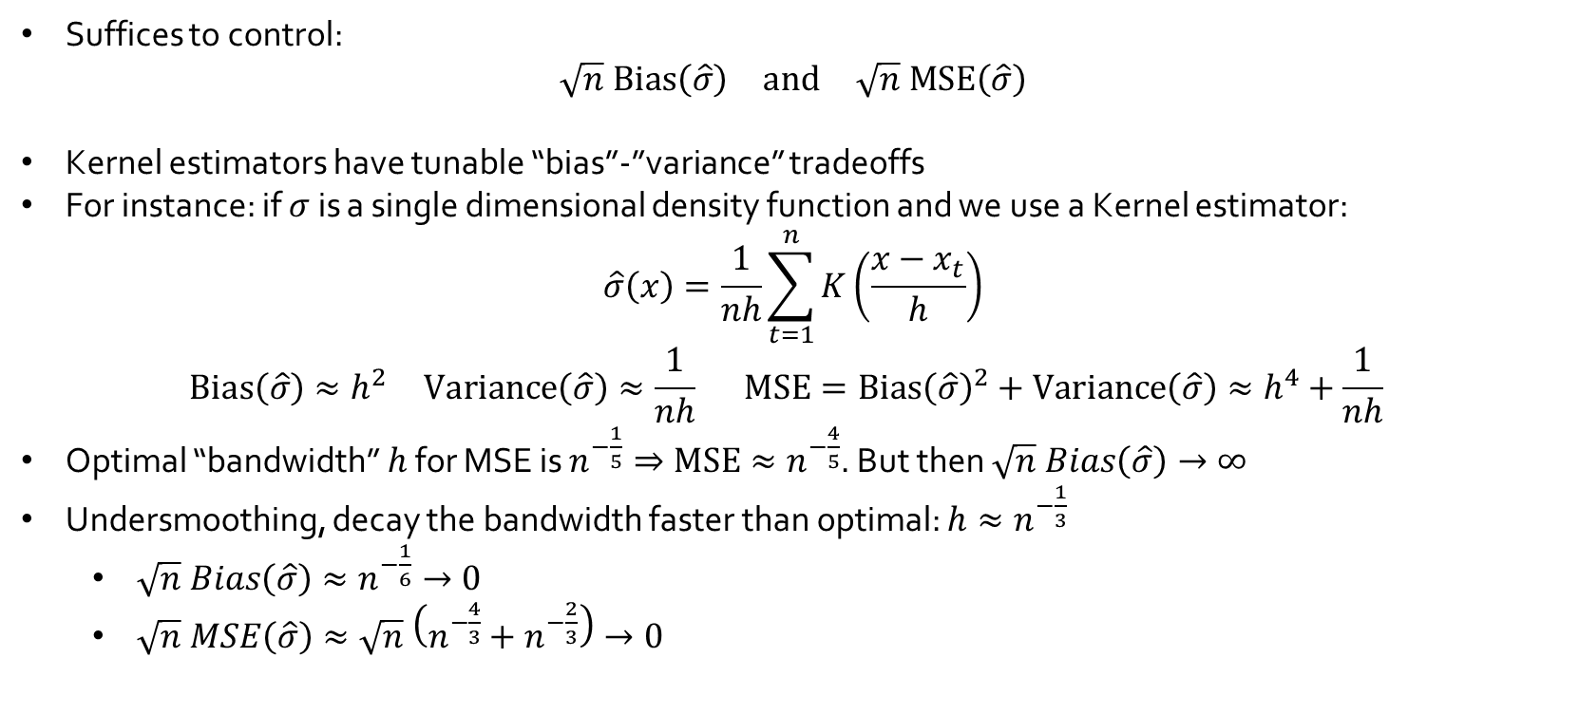
Semi-Parametric Two-Stage Estimation
[Newey-McFadden’94]
Suffices to control:
$$\begin{matrix}\sqrt{n} Bias\left(\hat{σ}\right) & and & \sqrt{n} MSE\left(\hat{σ}\right)\end{matrix}$$
Kernel estimators have tunable “bias”-”variance” tradeoffs
For instance: if $σ$ is a single dimensional density function and we use a Kernel estimator:
$$\hat{σ}\left(x\right)=\frac{1}{nh}\sum_{t=1}^{n}{K\left(\frac{x−x_{t}}{h}\right)}$$
$$\begin{matrix}Bias\left(\hat{σ}\right)≈h^{2} & Variance\left(\hat{σ}\right)≈\frac{1}{nh} & MSE=Bias{\left(\hat{σ}\right)}^{2}+Variance\left(\hat{σ}\right)≈h^{4}+\frac{1}{nh} \end{matrix}$$
Optimal “bandwidth” $h$ for MSE is $n^{−\frac{1}{5}}⇒MSE≈n^{−\frac{4}{5}}$. But then $\sqrt{n} Bias\left(\hat{σ}\right)→∞$
Undersmoothing, decay the bandwidth faster than optimal: $h≈n^{−\frac{1}{3}}$
  $\sqrt{n} Bias\left(\hat{σ}\right)≈n^{−\frac{1}{6}}→0$
  $\sqrt{n} MSE\left(\hat{σ}\right)≈\sqrt{n} \left(n^{−\frac{4}{3}}+n^{−\frac{2}{3}}\right)→0$
  For detailed exposition see:
  [Newey94, Ai-Chen’03]
  Section 8.3 of survey of [Newey-McFadden’94]
  Han Hong’s Lecture notes on semi-parametric efficiency [ECO276 Stanford]

Slide 25
General Dynamic Games
[Bajari-Benkard-Levin’07], [Pakes-Ostrovsky-Berry’07], [Aguirregabiria-Mira’07], [Ackerberg-Benkard-Berry-Pakes’07], [Bajari-Hong-Chernozhukov-Nekipelov’09]

Slide 26



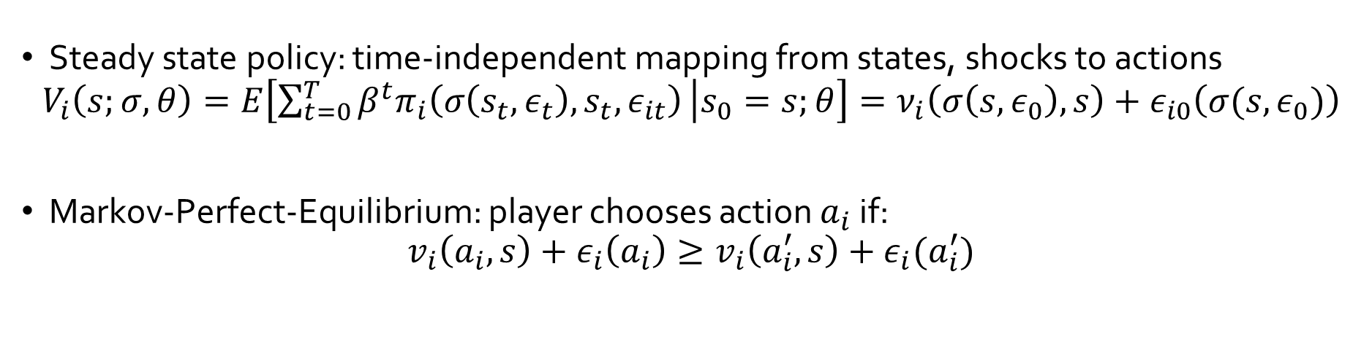




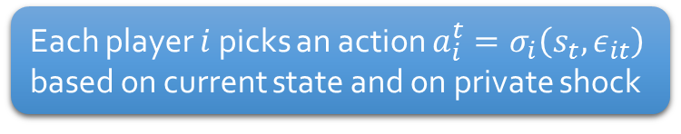
Steady-State Markovian Dynamic Games
…
$$s_{t}$$
$$s_{t+1}$$
…
1.
4.
Private shocks i.i.d., independent of state and private information to each player
State probabilistically transitions to next state, based on prior state and on action profile
$$ε_{1t}$$
$$a_{1}^{t}$$
2.
$$ε_{nt}$$
$$a_{n}^{t}$$
3.
Each player $i$ picks an action $a_{i}^{t}=σ_{i}\left(s_{t},ε_{it}\right)$ based on current state and on private shock
$$π_{1}\left(a^{t},s_{t},ε_{it}\right)={\tilde{π}}_{1}\left(a^{t},s_{t}\right)+ε_{it}\left(a_{i}\right)$$
Each player receives payoff
$$π_{n}\left(a^{t},s_{t},ε_{nt}\right)={\tilde{π}}_{n}\left(a^{t},s_{t}\right)+ε_{nt}\left(a_{n}\right)$$
Steady state policy: time-independent mapping from states, shocks to actions
$$V_{i}\left(s;σ,θ\right)=E\left[\sum_{t=0}^{T}{β^{t}π_{i}\left(σ\left(s_{t},ε_{t}\right),s_{t},ε_{it}\right)} | s_{0}=s;θ\right]=ν_{i}\left(σ\left(s,ε_{0}\right),s\right)+ε_{i0}\left(σ(s,ε_{0})\right)$$
Markov-Perfect-Equilibrium: player chooses action $a_{i}$ if:
$$v_{i}\left(a_{i},s\right)+ε_{i}\left(a_{i}\right)≥v_{i}\left(a_{i}^{′},s\right)+ε_{i}(a_{i}^{′})$$
“shockless” discounted expected equilibrium payoff.

Slide 27
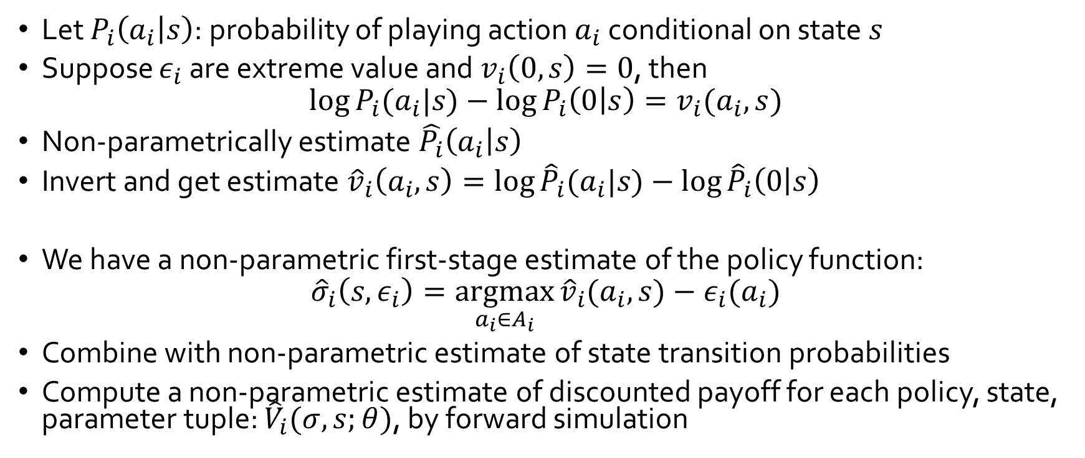
Dynamic Games: First Stage
[Bajari-Benkard-Levin’07]
Let $P_{i}\left(a_{i} | s\right)$: probability of playing action $a_{i}$ conditional on state $s$
Suppose $ε_{i}$ are extreme value and $v_{i}\left(0,s\right)=0$, then
$$\log{P_{i}(a_{i}|s)}−\log{P_{i}\left(0 | s\right)}=v_{i}(a_{i}, s)$$
Non-parametrically estimate $\hat{P_{i}}\left(a_{i} | s\right)$
Invert and get estimate ${\hat{v}}_{i}\left(a_{i},s\right)=\log{{\hat{P}}_{i}(a_{i}|s)}−\log{{\hat{P}}_{i}\left(0 | s\right)}$
We have a non-parametric first-stage estimate of the policy function:
$${\hat{σ}}_{i}\left(s,ε_{i}\right)=\underset{a_{i}∈A_{i}}{argmax}{{\hat{v}}_{i}(a_{i},s})−ε_{i}(a_{i})$$
Combine with non-parametric estimate of state transition probabilities
Compute a non-parametric estimate of discounted payoff for each policy, state, parameter tuple: ${\hat{V}}_{i}(σ,s;θ)$, by forward simulation

Slide 28
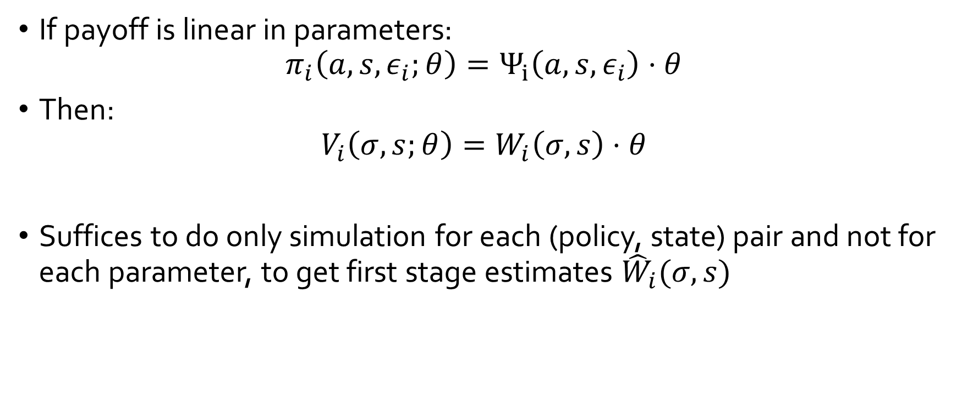
Dynamic Games: First Stage
[Bajari-Benkard-Levin’07]
If payoff is linear in parameters:
$$π_{i}\left(a,s,ε_{i};θ\right)=Ψ_{i}\left(a,s,ε_{i}\right)⋅θ$$
Then:
$$V_{i}\left(σ,s;θ\right)=W_{i}\left(σ,s\right)⋅θ$$
Suffices to do only simulation for each (policy, state) pair and not for each parameter, to get first stage estimates ${\hat{W}}_{i}(σ,s)$

Slide 29
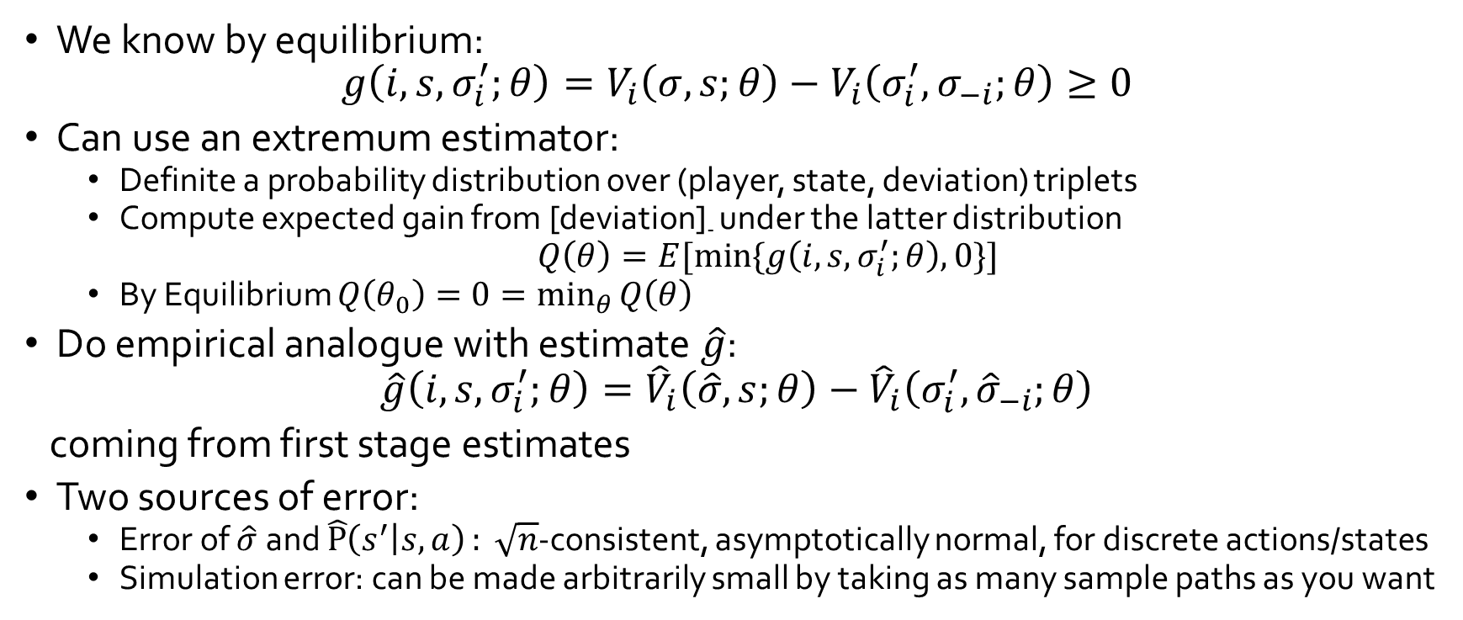
Dynamic Games: Second Stage
[Bajari-Benkard-Levin’07]
We know by equilibrium:
$$g\left(i,s,σ_{i}^{′};θ\right)=V_{i}\left(σ,s;θ\right)−V_{i}\left(σ_{i}^{′},σ_{−i};θ\right)≥0$$
Can use an extremum estimator:
  Definite a probability distribution over (player, state, deviation) triplets
  Compute expected gain from [deviation]₋ under the latter distribution
  $Q\left(θ\right)=E[\min{\{g\left(i,s,σ_{i}^{′};θ\right),0\}}]$
  By Equilibrium $Q\left(θ_{0}\right)=0=\min_{θ}{Q\left(θ\right)}$
Do empirical analogue with estimate $\hat{g}$:
$$\hat{g}\left(i,s,σ_{i}^{′};θ\right)={\hat{V}}_{i}\left(\hat{σ},s;θ\right)−{\hat{V}}_{i}\left(σ_{i}^{′},{\hat{σ}}_{−i};θ\right)$$
coming from first stage estimates
Two sources of error:
  Error of $\hat{σ}$ and $\hat{P}\left(s^{′} | s,a\right): \sqrt{n}$-consistent, asymptotically normal, for discrete actions/states
  Simulation error: can be made arbitrarily small by taking as many sample paths as you want

Slide 30
Recap of main idea
At equilibrium agents have beliefs about other players actions and best respond
If econometrician observes the same information about opponents as the player does then:
  Estimate these beliefs from the data in first stage
  Use best-response inequalities to these estimated beliefs in the second stage and infer parameters of utility

Slide 31
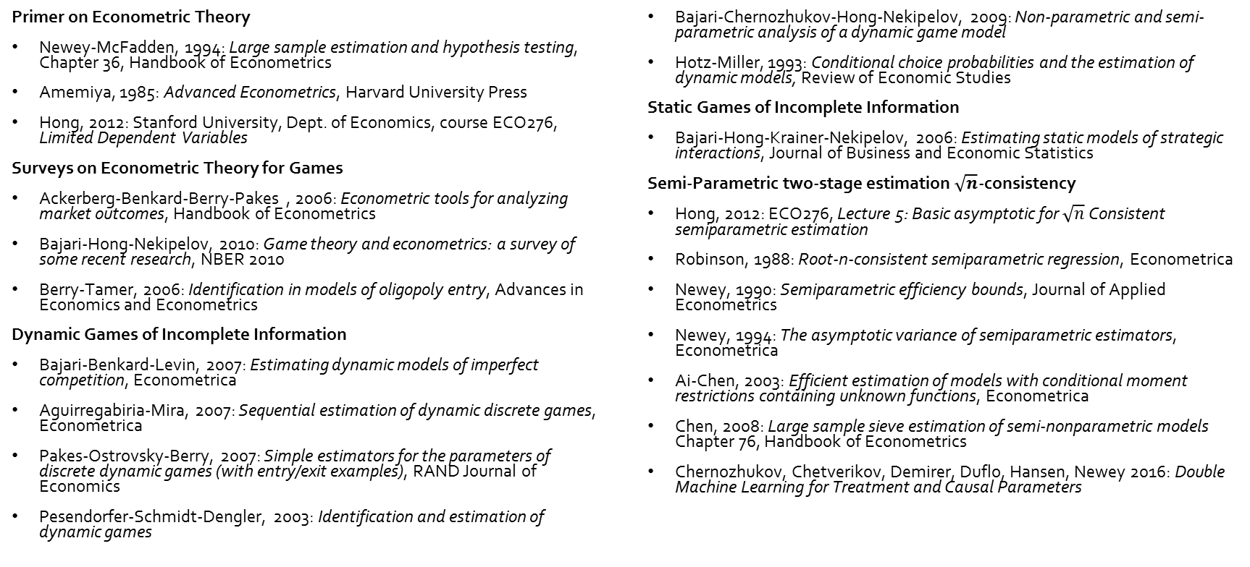
References
Primer on Econometric Theory
Newey-McFadden, 1994: Large sample estimation and hypothesis testing, Chapter 36, Handbook of Econometrics
Amemiya, 1985: Advanced Econometrics, Harvard University Press
Hong, 2012: Stanford University, Dept. of Economics, course ECO276, Limited Dependent Variables
Surveys on Econometric Theory for Games
Ackerberg-Benkard-Berry-Pakes , 2006: Econometric tools for analyzing market outcomes, Handbook of Econometrics
Bajari-Hong-Nekipelov, 2010: Game theory and econometrics: a survey of some recent research, NBER 2010
Berry-Tamer, 2006: Identification in models of oligopoly entry, Advances in Economics and Econometrics
Dynamic Games of Incomplete Information
Bajari-Benkard-Levin, 2007: Estimating dynamic models of imperfect competition, Econometrica
Aguirregabiria-Mira, 2007: Sequential estimation of dynamic discrete games, Econometrica
Pakes-Ostrovsky-Berry, 2007: Simple estimators for the parameters of discrete dynamic games (with entry/exit examples), RAND Journal of Economics
Pesendorfer-Schmidt-Dengler, 2003: Identification and estimation of dynamic games
Bajari-Chernozhukov-Hong-Nekipelov, 2009: Non-parametric and semi-parametric analysis of a dynamic game model
Hotz-Miller, 1993: Conditional choice probabilities and the estimation of dynamic models, Review of Economic Studies
Static Games of Incomplete Information
Bajari-Hong-Krainer-Nekipelov, 2006: Estimating static models of strategic interactions, Journal of Business and Economic Statistics
Semi-Parametric two-stage estimation $\sqrt{n}$-consistency
Hong, 2012: ECO276, Lecture 5: Basic asymptotic for $\sqrt{n}$ Consistent semiparametric estimation
Robinson, 1988: Root-n-consistent semiparametric regression, Econometrica
Newey, 1990: Semiparametric efficiency bounds, Journal of Applied Econometrics
Newey, 1994: The asymptotic variance of semiparametric estimators, Econometrica
Ai-Chen, 2003: Efficient estimation of models with conditional moment restrictions containing unknown functions, Econometrica
Chen, 2008: Large sample sieve estimation of semi-nonparametric models Chapter 76, Handbook of Econometrics
Chernozhukov, Chetverikov, Demirer, Duflo, Hansen, Newey 2016: Double Machine Learning for Treatment and Causal Parameters

