Slide 1
Econometric Theory for Games
Part 2: Complete Information Games, Multiplicity of Equilibria and Set Inference
Vasilis Syrgkanis
Microsoft Research New England

Slide 2
Outline of tutorial
Day 1:
  Brief Primer on Econometric Theory
  Estimation in Static Games of Incomplete Information: two stage estimators
  Markovian Dynamic Games of Incomplete Information
Day 2:
  Discrete Static Games of Complete Information: multiplicity of equilibria and set inference
Day 3:
  Auction games: Identification and estimation in first price auctions with independent private values
  Algorithmic game theory and econometrics
    Mechanism design for data science
    Econometrics for learning agents

Slide 3
General Dynamic Games
[Bajari-Benkard-Levin’07], [Pakes-Ostrovsky-Berry’07], [Aguirregabiria-Mira’07], [Ackerberg-Benkard-Berry-Pakes’07], [Bajari-Hong-Chernozhukov-Nekipelov’09]

Slide 4



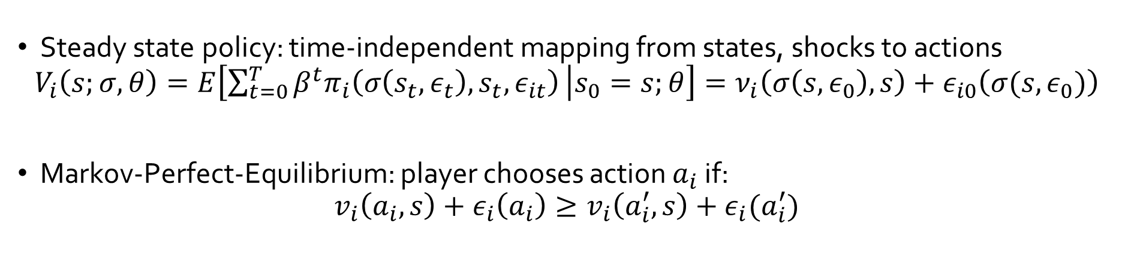




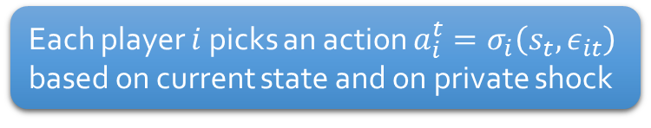
Steady-State Markovian Dynamic Games
…
$$s_{t}$$
$$s_{t+1}$$
…
1.
4.
Private shocks i.i.d., independent of state and private information to each player
State probabilistically transitions to next state, based on prior state and on action profile
$$ε_{1t}$$
$$a_{1}^{t}$$
2.
$$ε_{nt}$$
$$a_{n}^{t}$$
3.
Each player $i$ picks an action $a_{i}^{t}=σ_{i}\left(s_{t},ε_{it}\right)$ based on current state and on private shock
$$π_{1}\left(a^{t},s_{t},ε_{it}\right)={\tilde{π}}_{1}\left(a^{t},s_{t}\right)+ε_{it}\left(a_{i}\right)$$
Each player receives payoff
$$π_{n}\left(a^{t},s_{t},ε_{nt}\right)={\tilde{π}}_{n}\left(a^{t},s_{t}\right)+ε_{nt}\left(a_{n}\right)$$
Steady state policy: time-independent mapping from states, shocks to actions
$$V_{i}\left(s;σ,θ\right)=E\left[\sum_{t=0}^{T}{β^{t}π_{i}\left(σ\left(s_{t},ε_{t}\right),s_{t},ε_{it}\right)} | s_{0}=s;θ\right]=ν_{i}\left(σ\left(s,ε_{0}\right),s\right)+ε_{i0}\left(σ(s,ε_{0})\right)$$
Markov-Perfect-Equilibrium: player chooses action $a_{i}$ if:
$$v_{i}\left(a_{i},s\right)+ε_{i}\left(a_{i}\right)≥v_{i}\left(a_{i}^{′},s\right)+ε_{i}(a_{i}^{′})$$
“shockless” discounted expected equilibrium payoff.

Slide 5
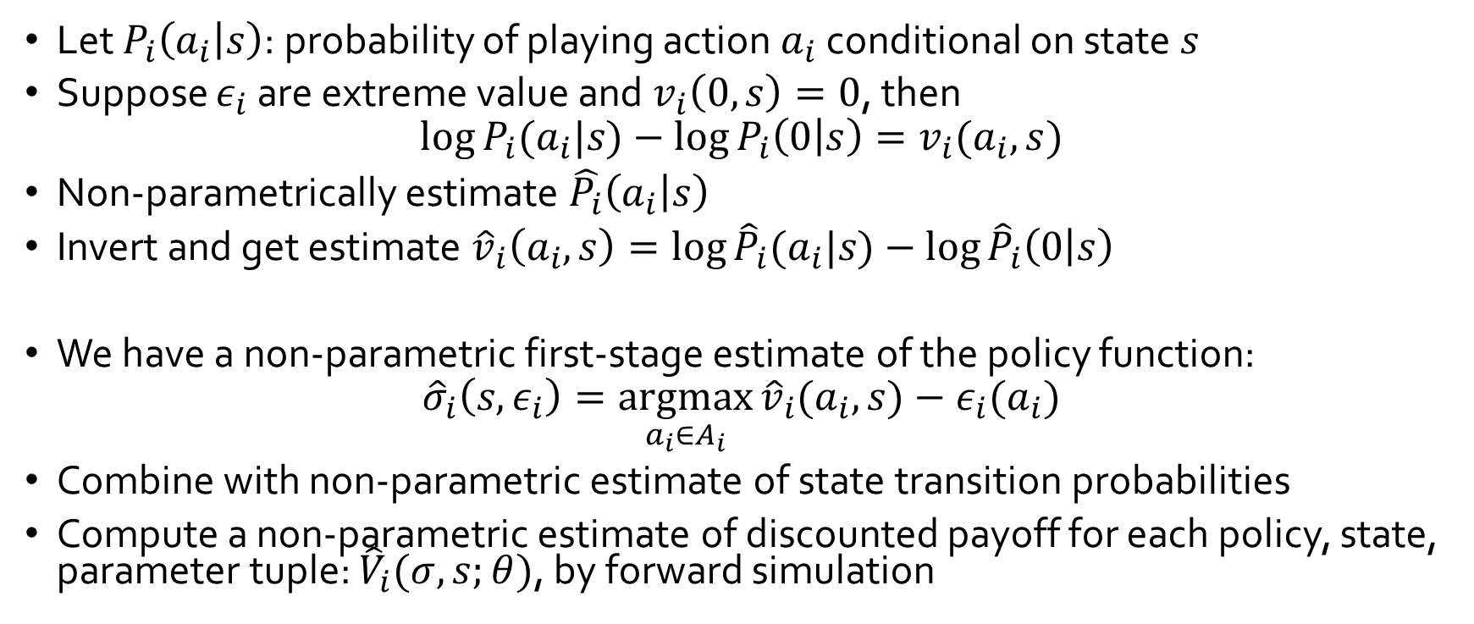
Dynamic Games: First Stage
[Bajari-Benkard-Levin’07]
Let $P_{i}\left(a_{i} | s\right)$: probability of playing action $a_{i}$ conditional on state $s$
Suppose $ε_{i}$ are extreme value and $v_{i}\left(0,s\right)=0$, then
$$\log{P_{i}(a_{i}|s)}−\log{P_{i}\left(0 | s\right)}=v_{i}(a_{i}, s)$$
Non-parametrically estimate $\hat{P_{i}}\left(a_{i} | s\right)$
Invert and get estimate ${\hat{v}}_{i}\left(a_{i},s\right)=\log{{\hat{P}}_{i}(a_{i}|s)}−\log{{\hat{P}}_{i}\left(0 | s\right)}$
We have a non-parametric first-stage estimate of the policy function:
$${\hat{σ}}_{i}\left(s,ε_{i}\right)=\underset{a_{i}∈A_{i}}{argmax}{{\hat{v}}_{i}(a_{i},s})−ε_{i}(a_{i})$$
Combine with non-parametric estimate of state transition probabilities
Compute a non-parametric estimate of discounted payoff for each policy, state, parameter tuple: ${\hat{V}}_{i}(σ,s;θ)$, by forward simulation

Slide 6
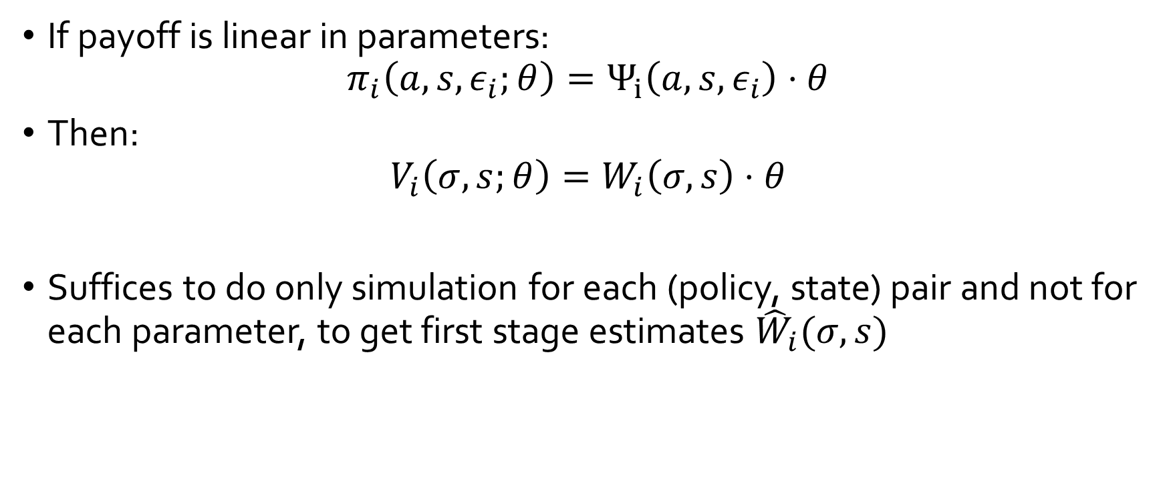
Dynamic Games: First Stage
[Bajari-Benkard-Levin’07]
If payoff is linear in parameters:
$$π_{i}\left(a,s,ε_{i};θ\right)=Ψ_{i}\left(a,s,ε_{i}\right)⋅θ$$
Then:
$$V_{i}\left(σ,s;θ\right)=W_{i}\left(σ,s\right)⋅θ$$
Suffices to do only simulation for each (policy, state) pair and not for each parameter, to get first stage estimates ${\hat{W}}_{i}(σ,s)$

Slide 7
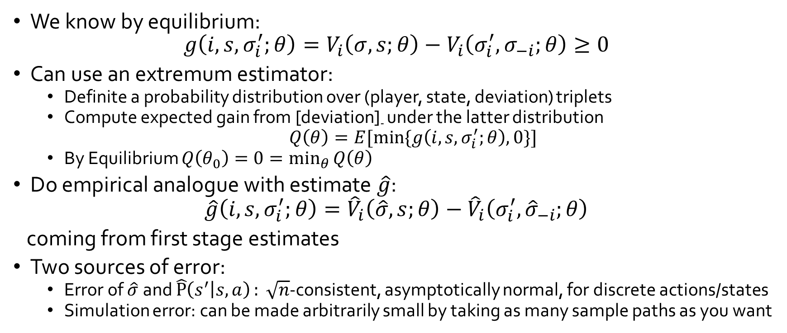
Dynamic Games: Second Stage
[Bajari-Benkard-Levin’07]
We know by equilibrium:
$$g\left(i,s,σ_{i}^{′};θ\right)=V_{i}\left(σ,s;θ\right)−V_{i}\left(σ_{i}^{′},σ_{−i};θ\right)≥0$$
Can use an extremum estimator:
  Definite a probability distribution over (player, state, deviation) triplets
  Compute expected gain from [deviation]₋ under the latter distribution
  $Q\left(θ\right)=E[\min{\{g\left(i,s,σ_{i}^{′};θ\right),0\}}]$
  By Equilibrium $Q\left(θ_{0}\right)=0=\min_{θ}{Q\left(θ\right)}$
Do empirical analogue with estimate $\hat{g}$:
$$\hat{g}\left(i,s,σ_{i}^{′};θ\right)={\hat{V}}_{i}\left(\hat{σ},s;θ\right)−{\hat{V}}_{i}\left(σ_{i}^{′},{\hat{σ}}_{−i};θ\right)$$
coming from first stage estimates
Two sources of error:
  Error of $\hat{σ}$ and $\hat{P}\left(s^{′} | s,a\right): \sqrt{n}$-consistent, asymptotically normal, for discrete actions/states
  Simulation error: can be made arbitrarily small by taking as many sample paths as you want

Slide 8
Recap of main idea
At equilibrium agents have beliefs about other players actions and best respond
If econometrician observes the same information about opponents as the player does then:
  Estimate these beliefs from the data in first stage
  Use best-response inequalities to these estimated beliefs in the second stage and infer parameters of utility

Slide 9
Complete Information Games
[Bresnahan-Reiss’90,91, Berry’92, Tamer’03, Cilliberto-Tamer’09, Beresteanu-Molchanov-Mollinari’07]

Slide 10
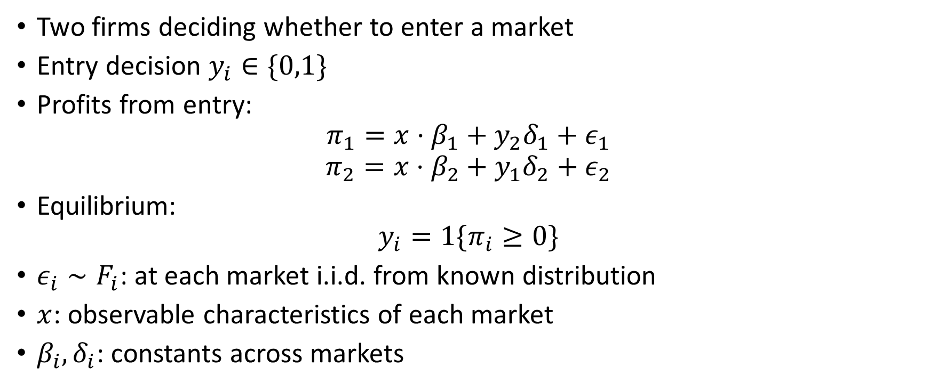
Entry Game
Two firms deciding whether to enter a market
Entry decision $y_{i}∈\{0,1\}$
Profits from entry:
$$π_{1}=x⋅β_{1}+y_{2}δ_{1}+ε_{1}$$
$$π_{2}=x⋅β_{2}+y_{1}δ_{2}+ε_{2}$$
Equilibrium:
$$y_{i}=1\{π_{i}≥0\}$$
$ε_{i}∼F_{i}$: at each market i.i.d. from known distribution
$x$: observable characteristics of each market
$β_{i},δ_{i}$: constants across markets

Slide 11

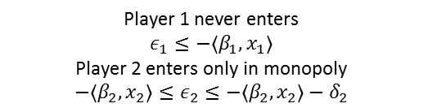
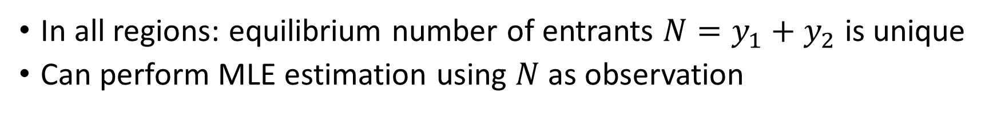




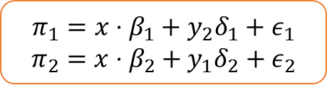




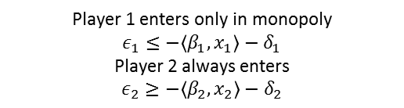



Assume $δ_{1},δ_{2}<0$
$$π_{1}=x⋅β_{1}+y_{2}δ_{1}+ε_{1}$$
$$π_{2}=x⋅β_{2}+y_{1}δ_{2}+ε_{2}$$
[Bresnahan-Reiss’90,91], [Berry’92]
$$ε_{2}$$
$(0,1)$
Player 1 enters only in monopoly
$$ε_{1}≤−\left\langle β_{1},x_{1}\right\rangle −δ_{1}$$
Player 2 always enters
$$ε_{2}≥−〈β_{2},x_{2}〉−δ_{2}$$
$(1,1)$
Both players always enter
$$ε_{1}≥−\left\langle β_{1},x_{1}\right\rangle −δ_{1}$$
$$ε_{2}≥−〈β_{2},x_{2}〉−δ_{2}$$
$$ε_{1}$$
$$\left(−\left\langle β_{1},x_{1}\right\rangle −δ_{1},−〈β_{2},x_{2}〉−δ_{2}\right)$$
Player 1 never enters
$$ε_{1}≤−\left\langle β_{1},x_{1}\right\rangle$$
Player 2 enters only in monopoly
$$−〈β_{2},x_{2}〉≤ε_{2}≤−〈β_{2},x_{2}〉−δ_{2}$$
$(0,1)$ or (1,0)
$$\left(−\left\langle β_{1},x_{1}\right\rangle ,−〈β_{2},x_{2}〉\right)$$
$(1,0)$
$(0,0)$
In all regions: equilibrium number of entrants $N=y_{1}+y_{2}$ is unique
Can perform MLE estimation using $N$ as observation

Slide 12




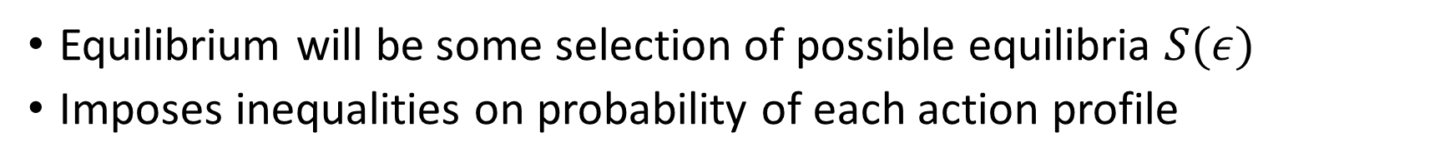





More generally
Identified set $Θ_{I}$: $β, δ$ s.t.:
$$P_{11}=\operatorname{Pr}\left[R_{1}\right]$$
$$P_{00}=\operatorname{Pr}\left[R_{5}\right]$$
$$Pr⁡[R_{2}]≤P_{01}≤\operatorname{Pr}\left[R_{2}\right]+Pr⁡[R_{3}]$$
$$\operatorname{Pr}\left[R_{4}\right]≤P_{10}≤\operatorname{Pr}\left[R_{3}\right]+\operatorname{Pr}\left[R_{4}\right]$$
[Tamer’03] [Cilliberto-Tamer’09]
$$ε_{2}$$
$(0,1)$
$(1,1)$
$$R_{2}$$
$$R_{1}$$
$$ε_{1}$$
$(0,1)$ or (1,0)
$$R_{3}$$
$$R_{4}$$
$(1,0)$
$$R_{5}$$
$(0,0)$
Equilibrium will be some selection of possible equilibria $S(ε)$
Imposes inequalities on probability of each action profile

Slide 13
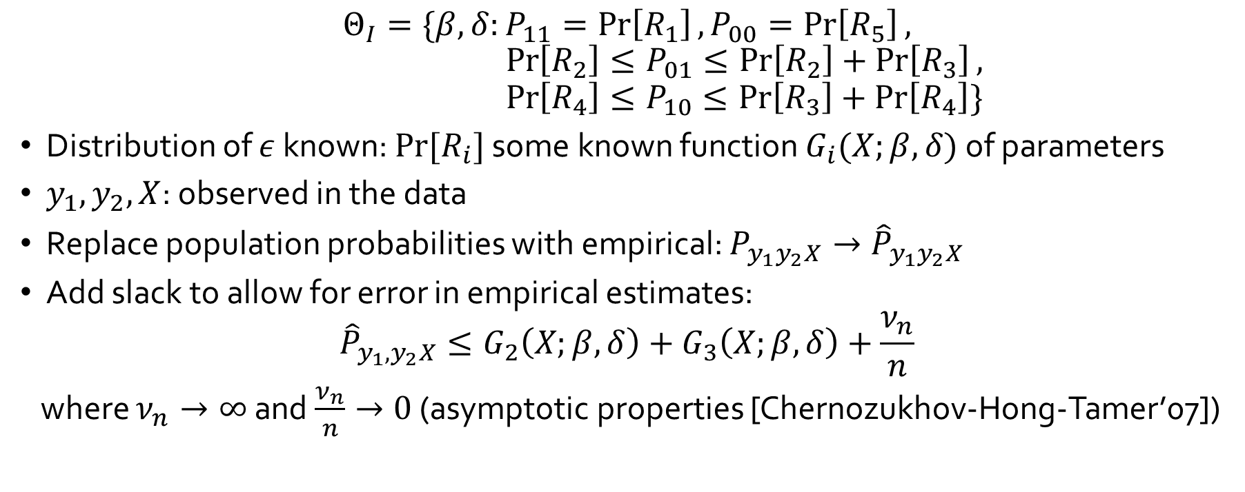
Estimating the Identified set
[Cilliberto-Tamer’09]
$$Θ_{I}=\{β,δ:P_{11}=\operatorname{Pr}\left[R_{1}\right], P_{00}=\operatorname{Pr}\left[R_{5}\right],$$
$$\operatorname{Pr}\left[R_{2}\right]≤P_{01}≤\operatorname{Pr}\left[R_{2}\right]+\operatorname{Pr}\left[R_{3}\right],$$
$$\operatorname{Pr}\left[R_{4}\right]≤P_{10}≤\operatorname{Pr}\left[R_{3}\right]+\operatorname{Pr}\left[R_{4}\right]\}$$
Distribution of $ε$ known: $Pr⁡[R_{i}]$ some known function $G_{i}(X;β,δ)$ of parameters
$y_{1}, y_{2},X$: observed in the data
Replace population probabilities with empirical: $P_{y_{1}y_{2}X}→{\hat{P}}_{y_{1}y_{2}X}$
Add slack to allow for error in empirical estimates:
$${\hat{P}}_{y_{1},y_{2}X}≤G_{2}\left(X;β,δ\right)+G_{3}\left(X;β,δ\right)+\frac{ν_{n}}{n}$$
where $ν_{n}→∞$ and $\frac{ν_{n}}{n}→0$ (asymptotic properties [Chernozukhov-Hong-Tamer’07])

Slide 14
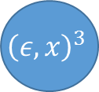
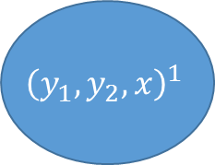

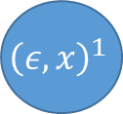




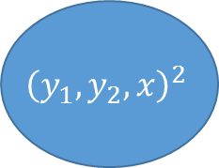



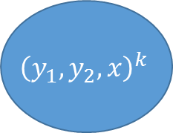


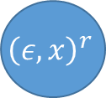

Discrete Disturbances/Characteristics
Suppose $ε$’s and $x$’s were drawn from a discrete finite distribution.
Given the population distribution, is some specific $θ$ a feasible parameter?
$${\left(y_{1},y_{2},x\right)}^{1}$$
The outcome ${\left(y_{1},y_{2}\right)}^{1}$ is not an equilibrium for this $ε$ and $x$
$${\left(ε,x\right)}^{1}$$
$$Pr⁡[{\left(ε,x\right)}^{1}]$$
$$Pr⁡[{\left(y_{1},y_{2},x\right)}^{1}]$$
The outcome ${\left(y_{1},y_{2}\right)}^{2}$ is an equilibrium for this $ε$ and $x$
$${\left(ε,x\right)}^{2}$$
$${\left(y_{1},y_{2},x\right)}^{2}$$
$$Pr⁡[{\left(y_{1},y_{2},x\right)}^{2}]$$
Known from assumption on distribution of disturbances/characteristics
Observed in the data
$${\left(ε,x\right)}^{3}$$
$$…$$
The outcome ${\left(y_{1},y_{2}\right)}^{k}$ is an equilibrium for this $ε$ and $x$
$$…$$
$${\left(y_{1},y_{2},x\right)}^{k}$$
$$Pr⁡[{\left(y_{1},y_{2},x\right)}^{k}]$$
$${\left(ε,x\right)}^{r}$$
$$Pr⁡[{\left(ε,x\right)}^{5}]$$

Slide 15
Discrete Disturbances/Characteristics
Suppose $ε$’s and $x$’s were drawn from a discrete finite distribution.
Given the population distribution, is some specific $θ$ a feasible parameter?
$${\left(y_{1},y_{2},x\right)}^{1}$$
$${\left(ε,x\right)}^{1}$$
$$Pr⁡[{\left(ε,x\right)}^{1}]$$
$$Pr⁡[{\left(y_{1},y_{2},x\right)}^{1}]$$
$${\left(ε,x\right)}^{2}$$
$${\left(y_{1},y_{2},x\right)}^{2}$$
$$Pr⁡[{\left(y_{1},y_{2},x\right)}^{2}]$$
Known from assumption on distribution of disturbances/characteristics
Observed in the data
$${\left(ε,x\right)}^{3}$$
$$…$$
$$…$$
$${\left(y_{1},y_{2},x\right)}^{k}$$
$$Pr⁡[{\left(y_{1},y_{2},x\right)}^{k}]$$
$${\left(ε,x\right)}^{r}$$
$$Pr⁡[{\left(ε,x\right)}^{5}]$$

Slide 16
Discrete Disturbances/Characteristics
Is there a way to assign ${(ε,x)}^{′}$s to $(y_{1},y_{2},x)′$s so that the total probability entering each left hand-side node is equal to $\operatorname{Pr}\left[\left(y_{1},y_{2},x\right)\right]$ observed in the population
$${\left(y_{1},y_{2},x\right)}^{1}$$
$${\left(ε,x\right)}^{1}$$
$$Pr⁡[{\left(ε,x\right)}^{1}]$$
$$Pr⁡[{\left(y_{1},y_{2},x\right)}^{1}]$$
$${\left(ε,x\right)}^{2}$$
$${\left(y_{1},y_{2},x\right)}^{2}$$
$$Pr⁡[{\left(y_{1},y_{2},x\right)}^{2}]$$
Known from assumption on distribution of disturbances/characteristics
Observed in the data
$${\left(ε,x\right)}^{3}$$
$$…$$
$$…$$
$${\left(y_{1},y_{2},x\right)}^{k}$$
$$Pr⁡[{\left(y_{1},y_{2},x\right)}^{k}]$$
$${\left(ε,x\right)}^{r}$$
$$Pr⁡[{\left(ε,x\right)}^{5}]$$

Slide 17




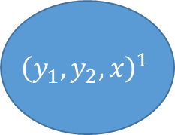








Discrete Disturbances
Essentially a max-flow question
$${\left(y_{1},y_{2},x\right)}^{1}$$
$${\left(ε,x\right)}^{1}$$
$$Pr⁡[{\left(y_{1},y_{2},x\right)}^{1}]$$
$${\left(ε,x\right)}^{2}$$
$$Pr⁡[{\left(ε,x\right)}^{1}]$$
$${\left(y_{1},y_{2},x\right)}^{2}$$
$${\left(ε,x\right)}^{3}$$
$$…$$
$$…$$
$$Pr⁡[{\left(ε,x\right)}^{5}]$$
$$Pr⁡[{\left(y_{1},y_{2},x\right)}^{k}]$$
$${\left(y_{1},y_{2},x\right)}^{k}$$
$${\left(ε,x\right)}^{r}$$

Slide 18

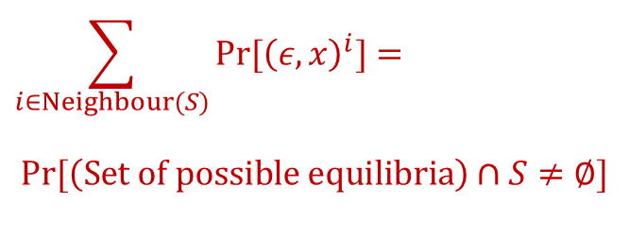
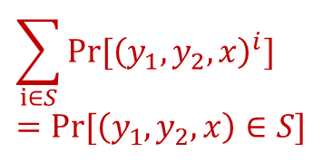
Discrete Disturbances
Iff condition: for any subset of outcomes S
$${\left(y_{1},y_{2},x\right)}^{1}$$
$${\left(ε,x\right)}^{1}$$
$$\sum_{i∈S}{Pr⁡[{\left(y_{1},y_{2},x\right)}^{i}]}=Pr⁡[\left(y_{1},y_{2},x\right)∈S]$$
$$≤$$
$${\left(ε,x\right)}^{2}$$
$$\sum_{i∈Neighbour(S)}{Pr⁡[{\left(ε,x\right)}^{i}]}=$$
$$Pr⁡[\left(Set of possible equilibria\right)∩S≠∅]$$
$${\left(y_{1},y_{2},x\right)}^{2}$$
$${\left(ε,x\right)}^{3}$$
$$…$$
$$…$$
$${\left(y_{1},y_{2},x\right)}^{k}$$
$${\left(ε,x\right)}^{r}$$

Slide 19
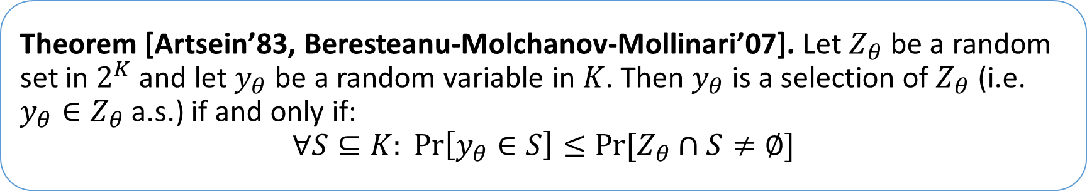
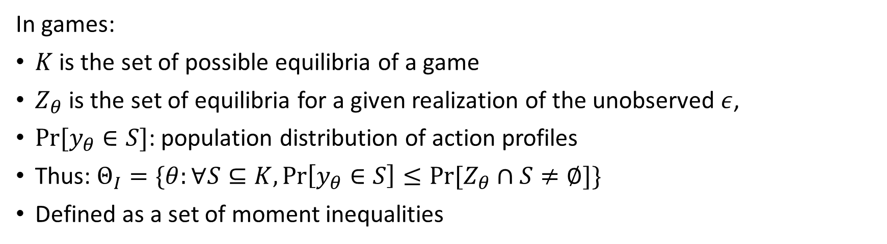
Characterization of the Identified Set
[Beresteanu-Molchanov-Mollinari’09]
Theorem [Artsein’83, Beresteanu-Molchanov-Mollinari’07]. Let $Z_{θ}$ be a random set in $2^{K}$ and let $y_{θ}$ be a random variable in $K$. Then $y_{θ}$ is a selection of $Z_{θ}$ (i.e. $y_{θ}∈Z_{θ}$ a.s.) if and only if:
$$∀S⊆K: \operatorname{Pr}\left[y_{θ}∈S\right]≤Pr⁡[Z_{θ}∩S≠∅]$$
In games:
$K$ is the set of possible equilibria of a game
$Z_{θ}$ is the set of equilibria for a given realization of the unobserved $ε$,
$Pr⁡[y_{θ}∈S]$: population distribution of action profiles
Thus: $Θ_{I}=\{θ:∀S⊆K,\operatorname{Pr}\left[y_{θ}∈S\right]≤Pr⁡[Z_{θ}∩S≠∅]\}$
Defined as a set of moment inequalities

Slide 20
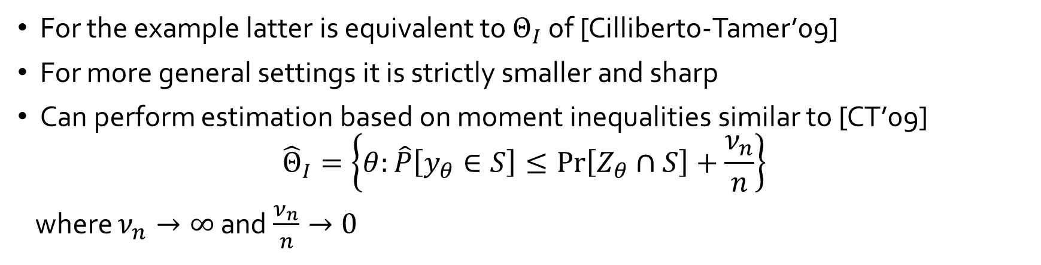
Characterization of the Identified Set
[Beresteanu-Molchanov-Mollinari’09]
Theorem [Artsein’83, Beresteanu-Molchanov-Mollinari’07]. Let $Z_{θ}$ be a random set in $2^{K}$ and let $y_{θ}$ be a random variable in $K$. Then $y_{θ}$ is a selection of $Z_{θ}$ (i.e. $y_{θ}∈Z_{θ}$ a.s.) if and only if:
$$∀S⊆K: \operatorname{Pr}\left[y_{θ}∈S\right]≤Pr⁡[Z_{θ}∩S≠∅]$$
For the example latter is equivalent to $Θ_{I}$ of [Cilliberto-Tamer’09]
For more general settings it is strictly smaller and sharp
Can perform estimation based on moment inequalities similar to [CT’09]
$${\hat{Θ}}_{I}=\left\{θ:\hat{P}\left[y_{θ}∈S\right]≤\operatorname{Pr}\left[Z_{θ}∩S\right]+\frac{ν_{n}}{n}\right\}$$
where $ν_{n}→∞$ and $\frac{ν_{n}}{n}→0$

Slide 21
Main take-aways
Games of complete information are typically partially identified
Multiplicity of equilibrium is the main issue
Leads to set-estimation strategies and machinery [Chernozhukov et al’09]
Very interesting random set theory for estimating the sharp identifying set

Slide 22
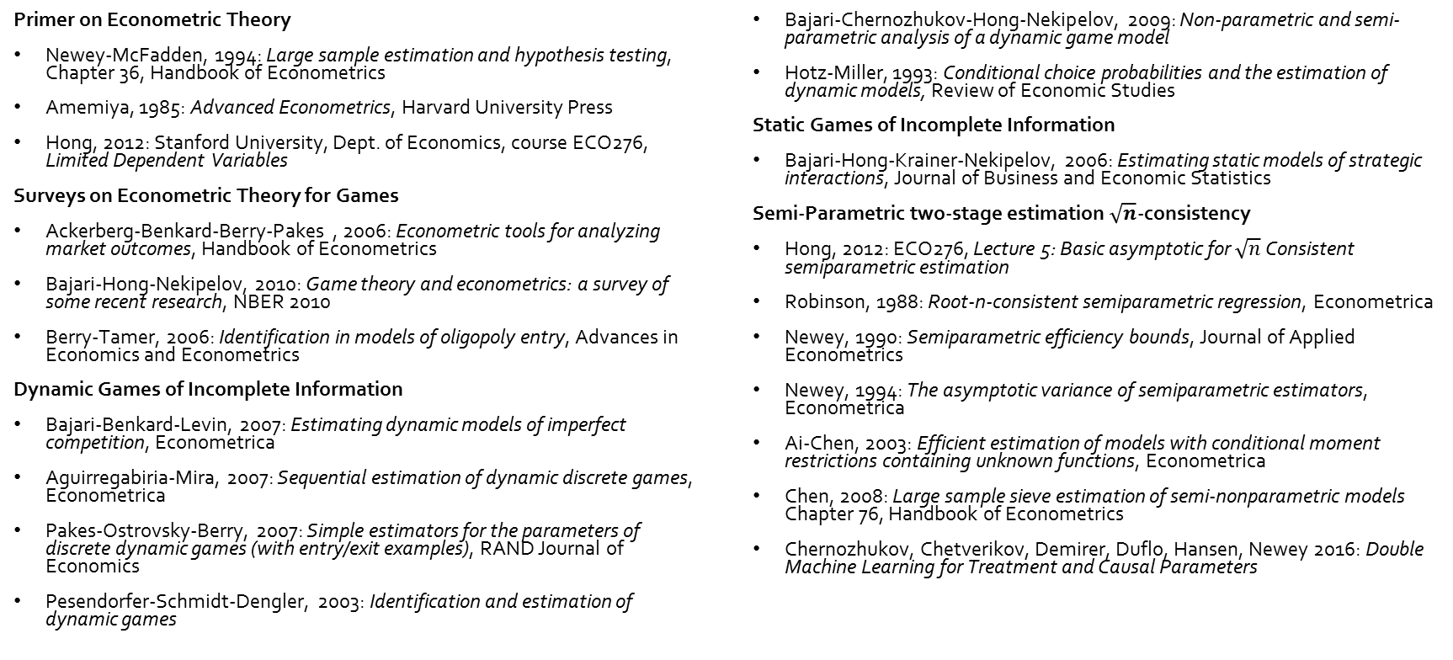
References
Primer on Econometric Theory
Newey-McFadden, 1994: Large sample estimation and hypothesis testing, Chapter 36, Handbook of Econometrics
Amemiya, 1985: Advanced Econometrics, Harvard University Press
Hong, 2012: Stanford University, Dept. of Economics, course ECO276, Limited Dependent Variables
Surveys on Econometric Theory for Games
Ackerberg-Benkard-Berry-Pakes , 2006: Econometric tools for analyzing market outcomes, Handbook of Econometrics
Bajari-Hong-Nekipelov, 2010: Game theory and econometrics: a survey of some recent research, NBER 2010
Berry-Tamer, 2006: Identification in models of oligopoly entry, Advances in Economics and Econometrics
Dynamic Games of Incomplete Information
Bajari-Benkard-Levin, 2007: Estimating dynamic models of imperfect competition, Econometrica
Aguirregabiria-Mira, 2007: Sequential estimation of dynamic discrete games, Econometrica
Pakes-Ostrovsky-Berry, 2007: Simple estimators for the parameters of discrete dynamic games (with entry/exit examples), RAND Journal of Economics
Pesendorfer-Schmidt-Dengler, 2003: Identification and estimation of dynamic games
Bajari-Chernozhukov-Hong-Nekipelov, 2009: Non-parametric and semi-parametric analysis of a dynamic game model
Hotz-Miller, 1993: Conditional choice probabilities and the estimation of dynamic models, Review of Economic Studies
Static Games of Incomplete Information
Bajari-Hong-Krainer-Nekipelov, 2006: Estimating static models of strategic interactions, Journal of Business and Economic Statistics
Semi-Parametric two-stage estimation $\sqrt{n}$-consistency
Hong, 2012: ECO276, Lecture 5: Basic asymptotic for $\sqrt{n}$ Consistent semiparametric estimation
Robinson, 1988: Root-n-consistent semiparametric regression, Econometrica
Newey, 1990: Semiparametric efficiency bounds, Journal of Applied Econometrics
Newey, 1994: The asymptotic variance of semiparametric estimators, Econometrica
Ai-Chen, 2003: Efficient estimation of models with conditional moment restrictions containing unknown functions, Econometrica
Chen, 2008: Large sample sieve estimation of semi-nonparametric models Chapter 76, Handbook of Econometrics
Chernozhukov, Chetverikov, Demirer, Duflo, Hansen, Newey 2016: Double Machine Learning for Treatment and Causal Parameters

Slide 23
References
Complete Information Games
Bresnahan-Reiss, 1990: Entry in monopoly markets, Review of Economic Studies
Bresnahan-Reiss, 1991: Empirical models of discrete games, Journal of Econometrics
Berry, 1992: Estimation of a model of entry in the airline industry, Econometrica
Tamer, 2003: Incomplete simultaneous discrete response model with multiple equilibria, Review of Economic Studies
Ciliberto-Tamer, 2009: Market Structure and Multiple Equilibria in Airline Markets, Econometrica
Beresteanu-Molchanov-Molinari, 2011: Sharp identification regions in models with convex moment predictions, Econometrica
Chernozhukov-Hong-Tamer, 2007: Estimation and confidence regions for parameter sets in econometrics models, Econometrica
Bajari-Hong-Ryan, 2010: Identification and estimation of a discrete game of complete information, Econometrica

