Slide 1
Econometric Theory for Games
Part 3: Auctions, Identification and Estimation of Value Distributions Algorithmic Game Theory and Econometrics
Vasilis Syrgkanis
Microsoft Research New England

Slide 2
Auction Games:
Identification and Estimation
FPA IPV: [Guerre-Perrigne-Vuong’00],
Beyond IPV: [Athey-Haile’02]
Partial Identification: [Haile-Tamer’03]
Comprehensive survey of structural estimation in auctions: [Paarsch-Hong’06]

Slide 3
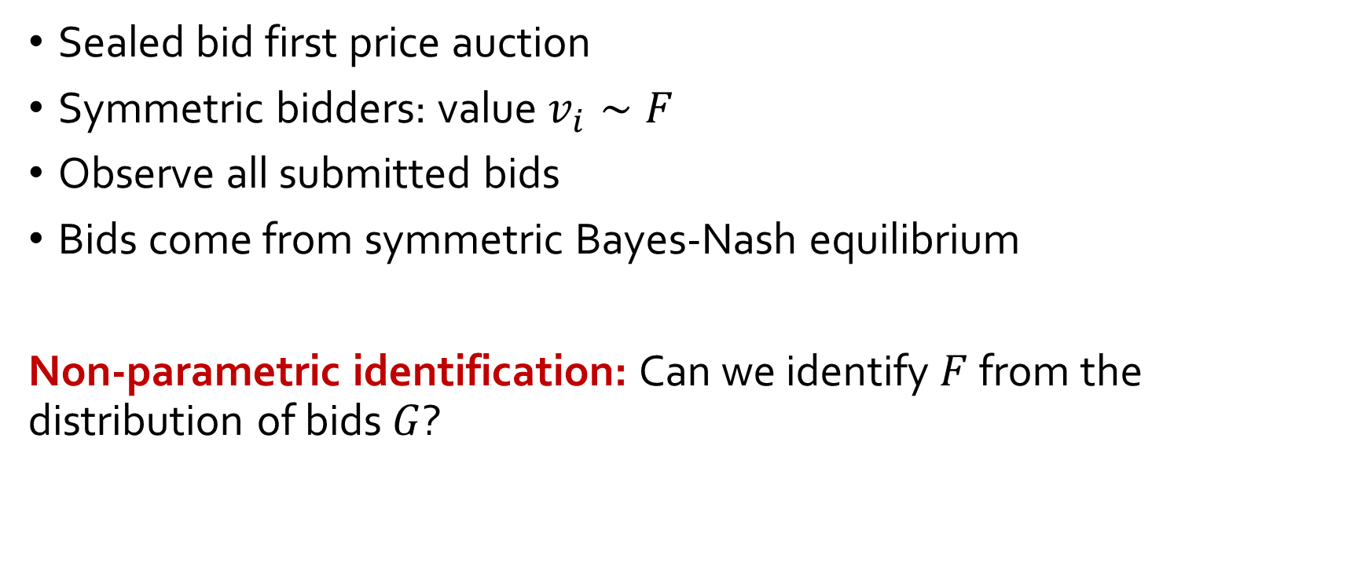
First Price Auction: Non-Parametric Identification
[Guerre-Perrigne-Vuong’00]
Sealed bid first price auction
Symmetric bidders: value $v_{i}∼F$
Observe all submitted bids
Bids come from symmetric Bayes-Nash equilibrium
Non-parametric identification: Can we identify $F$ from the distribution of bids $G$?

Slide 4
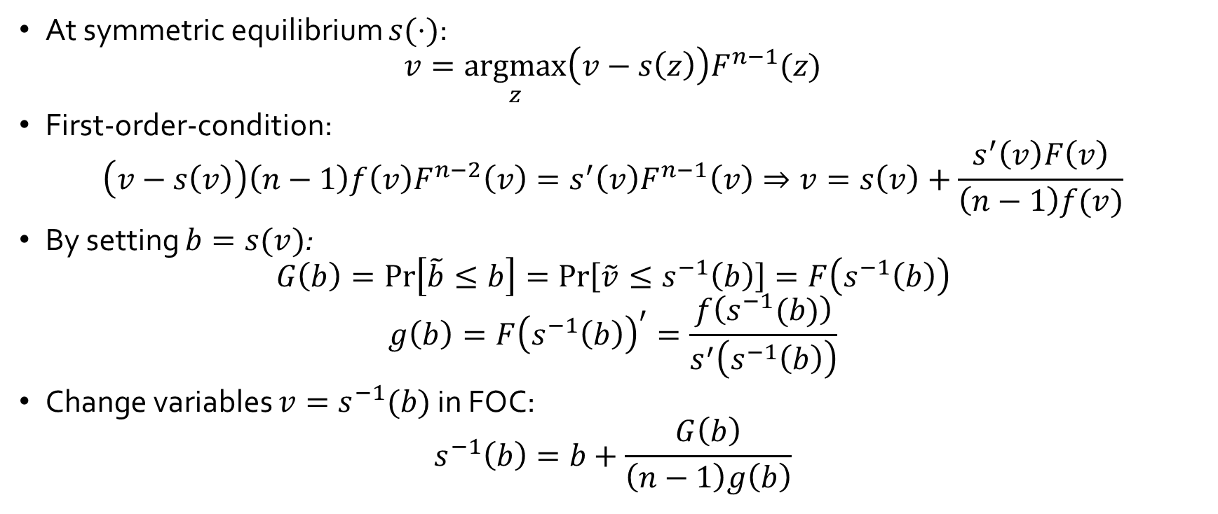
First Price Auction: Non-Parametric Identification
[Guerre-Perrigne-Vuong’00]
At symmetric equilibrium $s(⋅)$:
$$v=\underset{z}{argmax}\left(v−s\left(z\right)\right)F^{n−1}(z)$$
First-order-condition:
$$\left(v−s\left(v\right)\right)\left(n−1\right)f\left(v\right)F^{n−2}\left(v\right)=s^{′}\left(v\right)F^{n−1}\left(v\right)⇒v=s\left(v\right)+\frac{s^{′}\left(v\right)F\left(v\right)}{\left(n−1\right)f(v)}$$
By setting $b=s(v)$:
$$G\left(b\right)=\operatorname{Pr}\left[\tilde{b}≤b\right]=\operatorname{Pr}\left[\tilde{v}≤s^{−1}\left(b\right)\right]=F\left(s^{−1}\left(b\right)\right)$$
$$g\left(b\right)=F{\left(s^{−1}\left(b\right)\right)}^{′}=\frac{f\left(s^{−1}(b)\right)}{s^{′}\left(s^{−1}\left(b\right)\right)}$$
Change variables $v=s^{−1}(b)$ in FOC:
$$s^{−1}\left(b\right)=b+\frac{G\left(b\right)}{\left(n−1\right)g\left(b\right)}$$

Slide 5
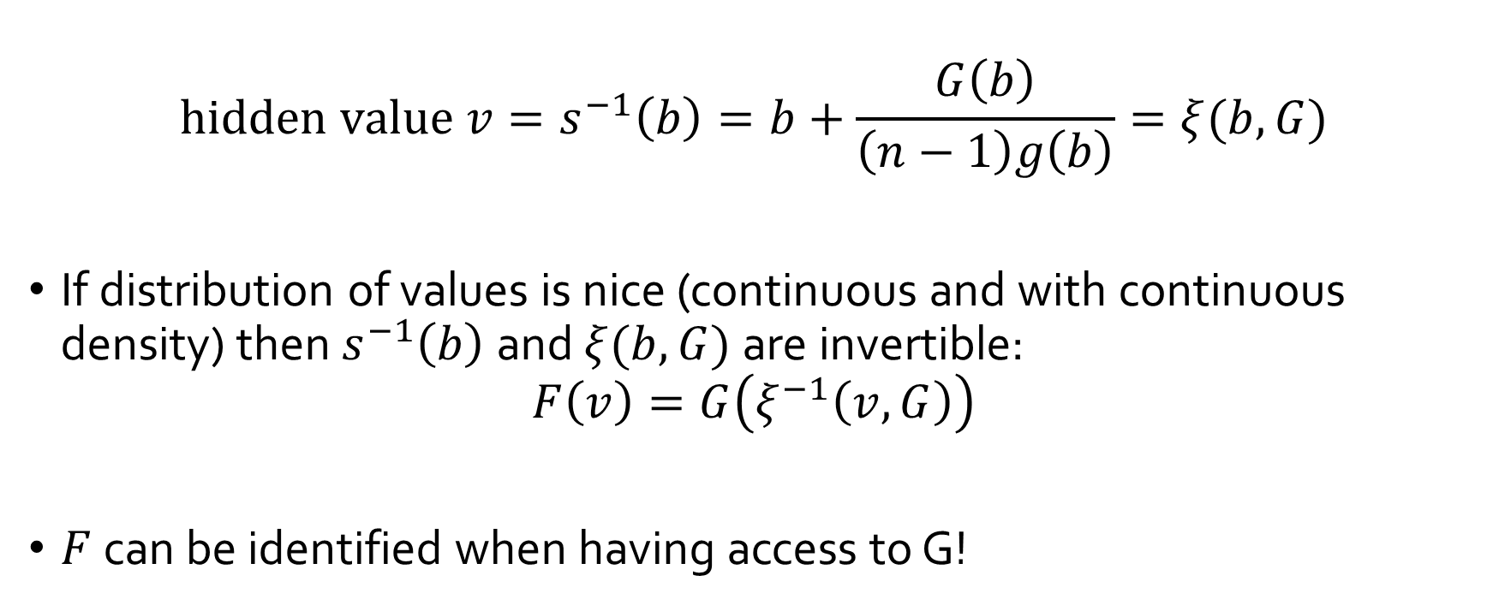
First Price Auction: Non-Parametric Identification
[Guerre-Perrigne-Vuong’00]
$$hidden value v=s^{−1}\left(b\right)=b+\frac{G\left(b\right)}{\left(n−1\right)g\left(b\right)}=ξ(b,G)$$
If distribution of values is nice (continuous and with continuous density) then $s^{−1}\left(b\right)$ and $ξ(b,G)$ are invertible:
$$F\left(v\right)=G\left(ξ^{−1}\left(v,G\right)\right)$$
$F$ can be identified when having access to G!

Slide 6
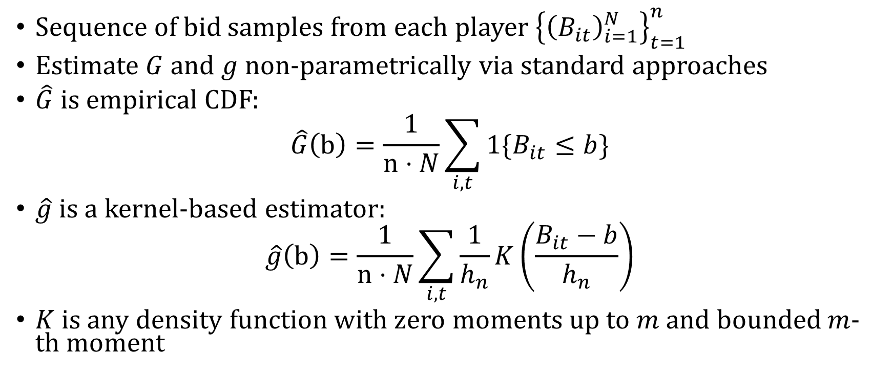
First Price Auction: Non-Parametric Estimation
[Guerre-Perrigne-Vuong’00]
Sequence of bid samples from each player ${\left\{{\left(B_{it}\right)}_{i=1}^{N}\right\}}_{t=1}^{n}$
Estimate $G$ and $g$ non-parametrically via standard approaches
$\hat{G}$ is empirical CDF:
$$\hat{G}\left(b\right)=\frac{1}{n⋅N}\sum_{i,t}{1\{B_{it}≤b\}}$$
$\hat{g}$ is a kernel-based estimator:
$$\hat{g}\left(b\right)=\frac{1}{n⋅N}\sum_{i,t}{\frac{1}{h_{n}}K\left(\frac{B_{it}−b}{h_{n}}\right)}$$
$K$ is any density function with zero moments up to $m$ and bounded $m$-th moment

Slide 7
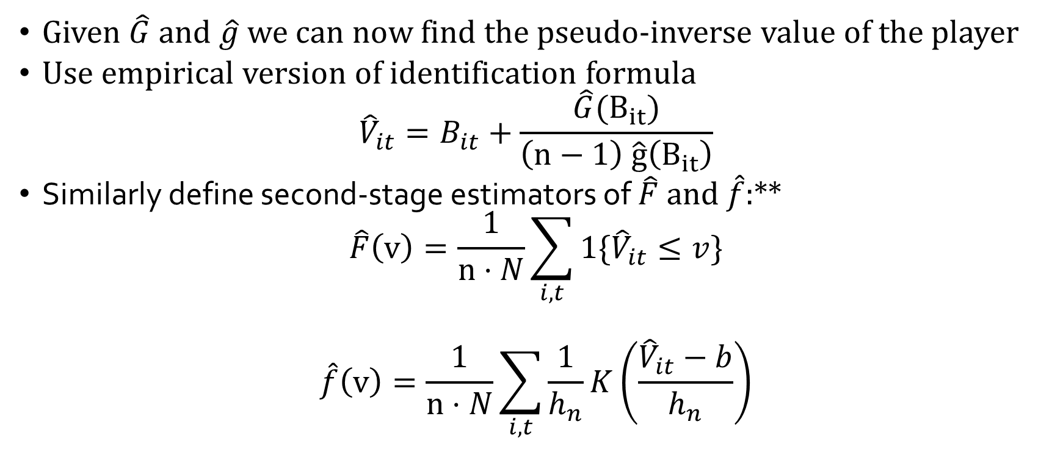
First Price Auction: Non-Parametric Estimation
[Guerre-Perrigne-Vuong’00]
Given $\hat{G}$ and $\hat{g}$ we can now find the pseudo-inverse value of the player
Use empirical version of identification formula
$${\hat{V}}_{it}=B_{it}+\frac{\hat{G}(B_{it})}{\left(n−1\right) \hat{g}\left(B_{it}\right)}$$
Similarly define second-stage estimators of $\hat{F}$ and $\hat{f}$:**
$$\hat{F}\left(v\right)=\frac{1}{n⋅N}\sum_{i,t}{1\{{\hat{V}}_{it}≤v\}}$$
$$\hat{f}\left(v\right)=\frac{1}{n⋅N}\sum_{i,t}{\frac{1}{h_{n}}K\left(\frac{{\hat{V}}_{it}−b}{h_{n}}\right)}$$
** Need some modifications if one wants unbiasedness

Slide 8
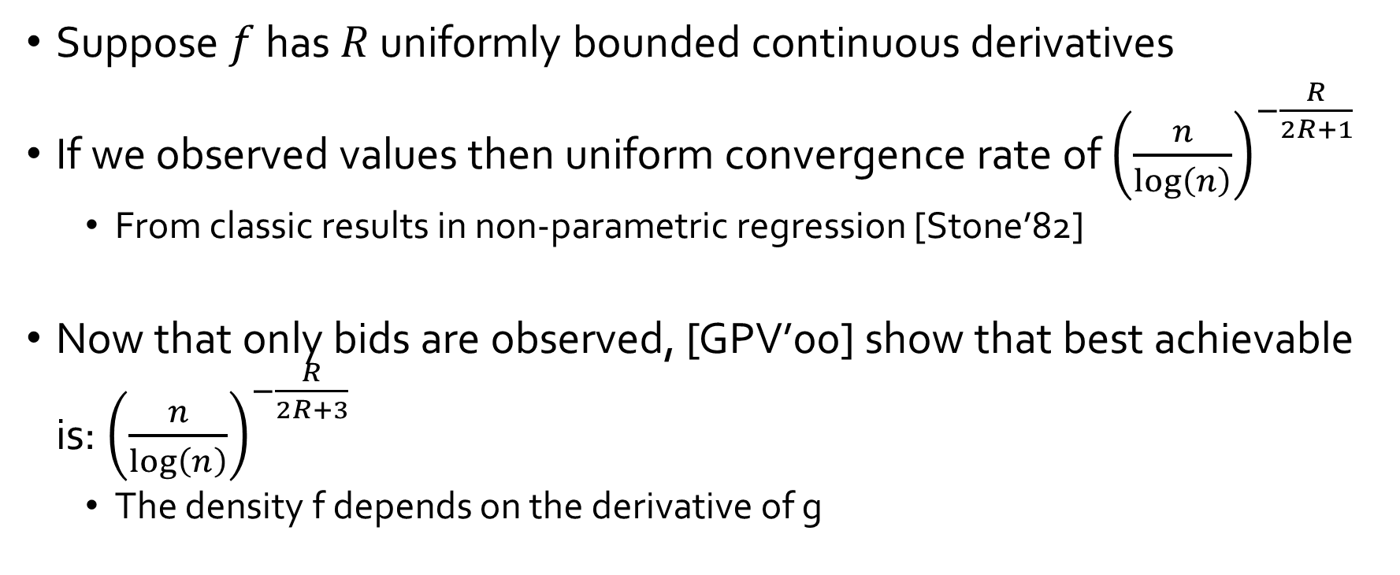
Uniform Rates of Convergence
Suppose $f$ has $R$ uniformly bounded continuous derivatives
If we observed values then uniform convergence rate of ${\left(\frac{n}{\log\left(n\right)}\right)}^{−\frac{R}{2R+1} }$
  From classic results in non-parametric regression [Stone’82]
Now that only bids are observed, [GPV’00] show that best achievable is: ${\left(\frac{n}{log\left(n\right)}\right)}^{−\frac{R}{2R+3}}$
  The density f depends on the derivative of g

Slide 9
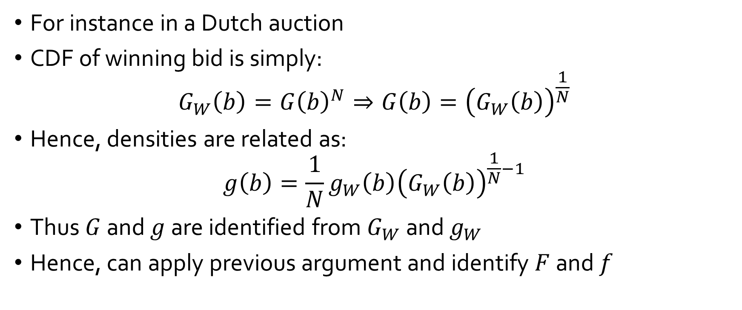
What if only winning bid is observed?
For instance in a Dutch auction
CDF of winning bid is simply:
$$G_{W}\left(b\right)=G{\left(b\right)}^{N}⇒G\left(b\right)={\left(G_{W}\left(b\right)\right)}^{\frac{1}{N}}$$
Hence, densities are related as:
$$g\left(b\right)=\frac{1}{N}g_{W}\left(b\right){\left(G_{W}\left(b\right)\right)}^{\frac{1}{N}−1}$$
Thus $G$ and $g$ are identified from $G_{W}$ and $g_{W}$
Hence, can apply previous argument and identify $F$ and $f$

Slide 10
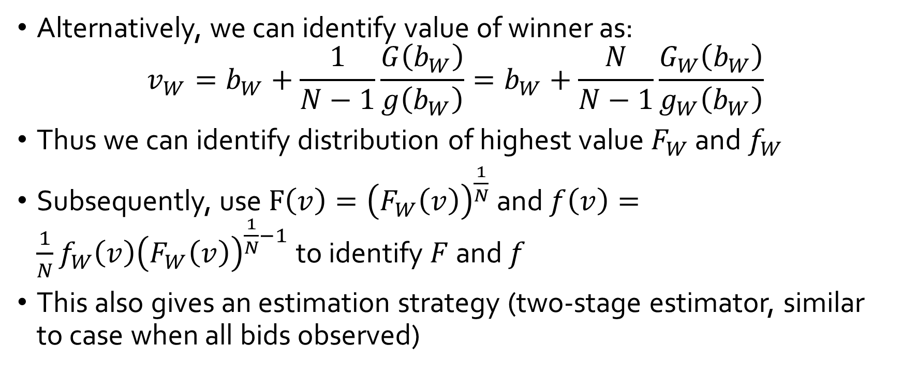
What if only winning bid is observed?
Alternatively, we can identify value of winner as:
$$v_{W}=b_{W}+\frac{1}{N−1}\frac{G\left(b_{W}\right)}{g\left(b_{W}\right)}=b_{W}+\frac{N}{N−1}\frac{G_{W}\left(b_{W}\right)}{g_{W}\left(b_{W}\right)}$$
Thus we can identify distribution of highest value $F_{W}$ and $f_{W}$
Subsequently, use $F\left(v\right)={\left(F_{W}\left(v\right)\right)}^{\frac{1}{N}}$ and $f\left(v\right)=\frac{1}{N}f_{W}\left(v\right){\left(F_{W}\left(v\right)\right)}^{\frac{1}{N}−1}$ to identify $F$ and $f$
This also gives an estimation strategy (two-stage estimator, similar to case when all bids observed)

Slide 11
Notable Literature
[Athey-Haile’02]
  Identification in more complex than independent private values setting.
  Primarily second price and ascending auctions
  Mostly, winning price and bidder is observed
  Most results in IPV or Common Value model
[Haile-Tamer’03]
  Incomplete data and partial identification
  Prime example: ascending auction with large bid increments
  Provides upper and lower bounds on the value distribution from necessary equilibrium conditions
[Paarsch-Hong’06]
  Complete treatment of structural estimation in auctions and literature review
  Mostly presented in the IPV model

Slide 12
Main Take-Aways
Closed form solutions of equilibrium bid functions in auctions
Allows for non-parametric identification of unobserved value distribution
Easy two-stage estimation strategy (similar to discrete incomplete information games)
Estimation and Identification robust to what information is observed (winning bid, winning price)
Typically rates for estimating density of value distribution are very slow

Slide 13
Algorithmic Game Theory and Econometrics
Mechanism Design for Inference
Econometrics for Learning Agents

Slide 14
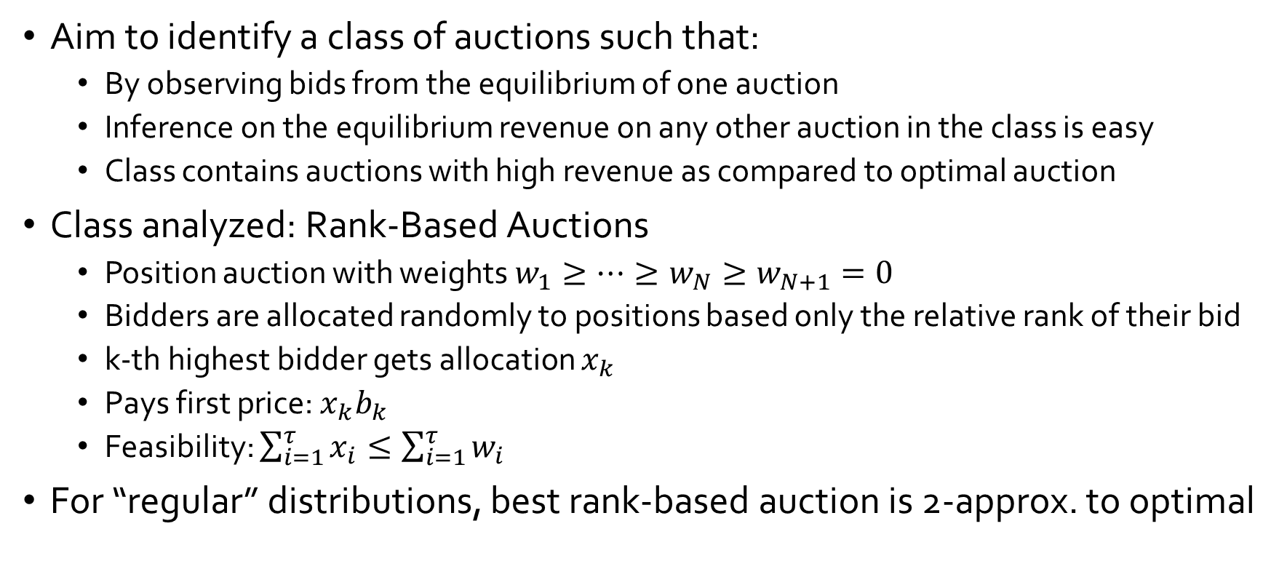
Mechanism Design for Data Science
[Chawla-Hartline-Nekipelov’14]
Aim to identify a class of auctions such that:
  By observing bids from the equilibrium of one auction
  Inference on the equilibrium revenue on any other auction in the class is easy
  Class contains auctions with high revenue as compared to optimal auction
Class analyzed: Rank-Based Auctions
  Position auction with weights $w_{1}≥…≥w_{N}≥w_{N+1}=0$
  Bidders are allocated randomly to positions based only the relative rank of their bid
  k-th highest bidder gets allocation $x_{k}$
  Pays first price: $x_{k}b_{k}$
  Feasibility: $\sum_{i=1}^{τ}{x_{i}}≤\sum_{i=1}^{τ}{w_{i}}$
For “regular” distributions, best rank-based auction is 2-approx. to optimal

Slide 15
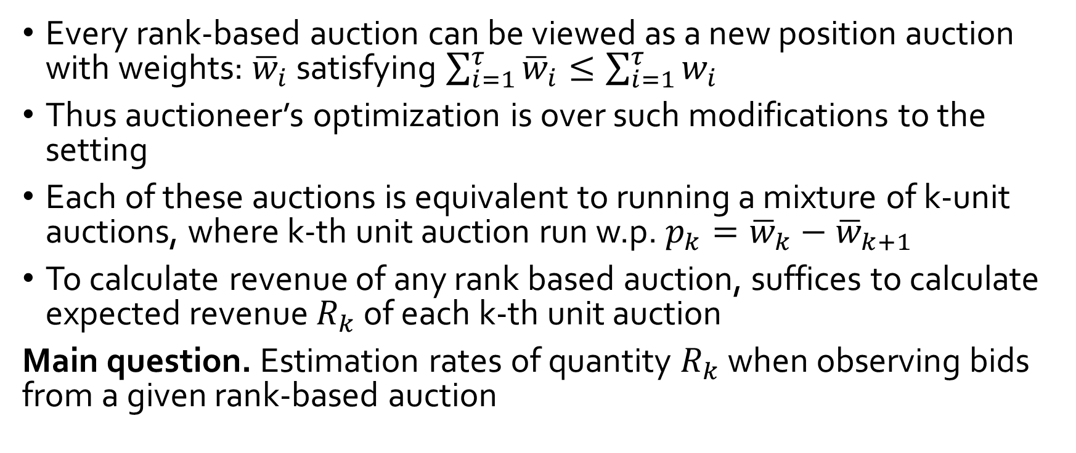
Optimizing over Rank-Based Auctions
[Chawla-Hartline-Nekipelov’14]
Every rank-based auction can be viewed as a new position auction with weights: ${\overline{w}}_{i}$ satisfying $\sum_{i=1}^{τ}{{\overline{w}}_{i}}≤\sum_{i=1}^{τ}{w_{i}}$
Thus auctioneer’s optimization is over such modifications to the setting
Each of these auctions is equivalent to running a mixture of k-unit auctions, where k-th unit auction run w.p. $p_{k}={\overline{w}}_{k}−{\overline{w}}_{k+1}$
To calculate revenue of any rank based auction, suffices to calculate expected revenue $R_{k}$ of each k-th unit auction
Main question. Estimation rates of quantity $R_{k}$ when observing bids from a given rank-based auction

Slide 16
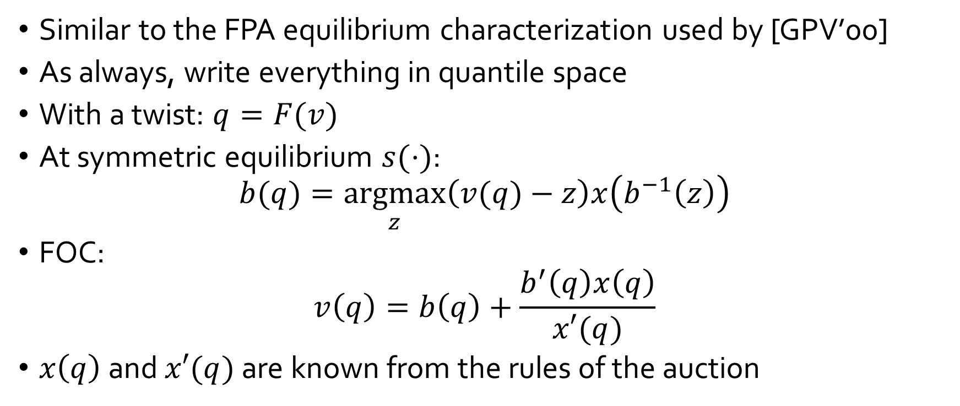
Estimation analysis
[Chawla-Hartline-Nekipelov’14]
Similar to the FPA equilibrium characterization used by [GPV’00]
As always, write everything in quantile space
With a twist: $q=F(v)$
At symmetric equilibrium $s(⋅)$:
$$b(q)=\underset{z}{argmax}\left(v(q)−z\right)x\left(b^{−1}\left(z\right)\right)$$
FOC:
$$v\left(q\right)=b\left(q\right)+\frac{b^{′}\left(q\right)x\left(q\right)}{x′(q)}$$
$x\left(q\right)$ and $x′(q)$ are known from the rules of the auction

Slide 17
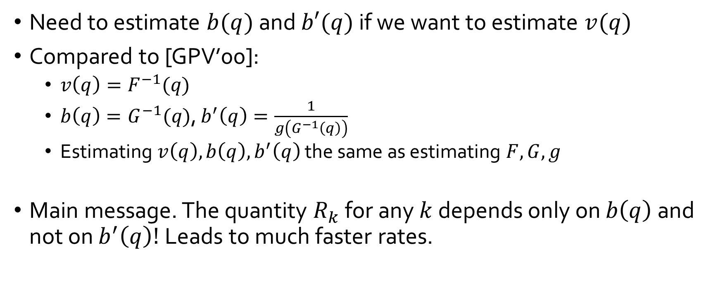
Estimation
[Chawla-Hartline-Nekipelov’14]
Need to estimate $b(q)$ and $b′(q)$ if we want to estimate $v(q)$
Compared to [GPV’00]:
  $v\left(q\right)=F^{−1}(q)$
  $b\left(q\right)=G^{−1}(q)$, $b^{′}\left(q\right)=\frac{1}{g\left(G^{−1}\left(q\right)\right)}$
  Estimating $v\left(q\right),b\left(q\right), b^{′}\left(q\right)$ the same as estimating $F,G,g$
Main message. The quantity $R_{k}$ for any $k$ depends only on $b\left(q\right)$ and not on $b^{′}\left(q\right)!$ Leads to much faster rates.

Slide 18

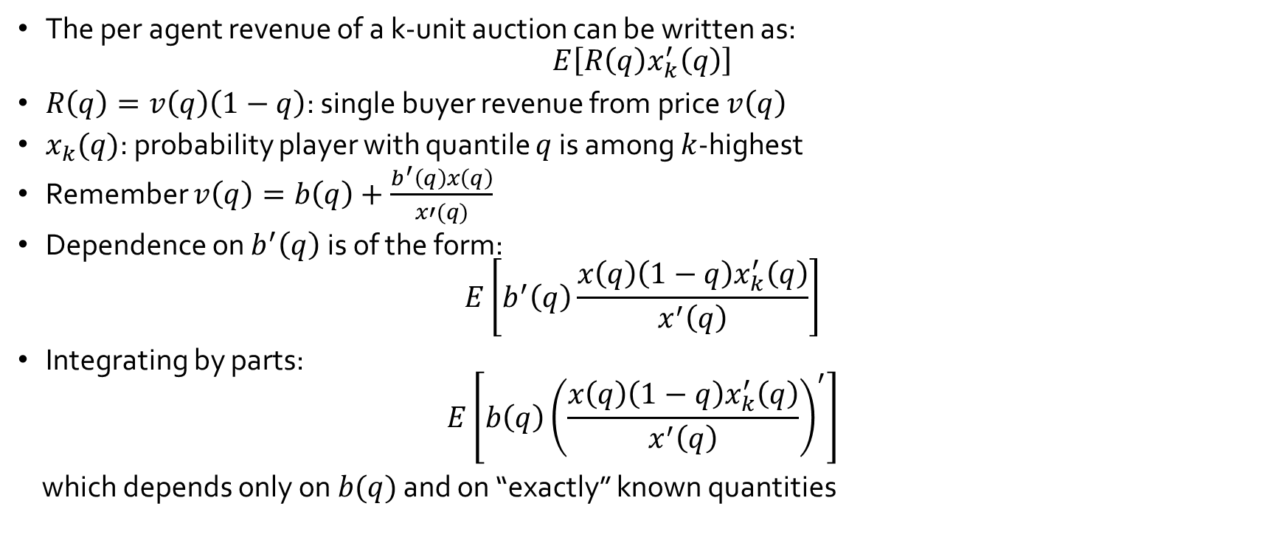

Fast Convergence for Counterfactual Revenue
[Chawla-Hartline-Nekipelov’14]
The per agent revenue of a k-unit auction can be written as:
$$E\left[R\left(q\right)x_{k}^{′}\left(q\right)\right]$$
$R\left(q\right)=v\left(q\right)\left(1−q\right)$: single buyer revenue from price $v\left(q\right)$
$x_{k}(q)$: probability player with quantile $q$ is among $k$-highest
Remember $v\left(q\right)=b\left(q\right)+\frac{b^{′}\left(q\right)x\left(q\right)}{x′(q)}$
Dependence on $b^{′}\left(q\right)$ is of the form:
$$E\left[b^{′}\left(q\right)\frac{x\left(q\right)\left(1−q\right)x_{k}^{′}\left(q\right)}{x^{′}\left(q\right)}\right]$$
Integrating by parts:
$$E\left[b\left(q\right){\left(\frac{x\left(q\right)\left(1−q\right)x_{k}^{′}\left(q\right)}{x^{′}\left(q\right)}\right)}^{′}\right]$$
which depends only on $b(q)$ and on “exactly” known quantities
Yields $O\left(\frac{1}{\sqrt{N}}\right)$ convergence* of MSE, since $b(q)$ is essentially a CDF inverted
*Exact convergence depends inversely on $x^{′}\left(q\right)$
Need to restrict to rank-based auctions where $x^{′}\left(q\right)>ε$ (e.g. mixing each k-unit auction with probability $ε/n$)

Slide 19
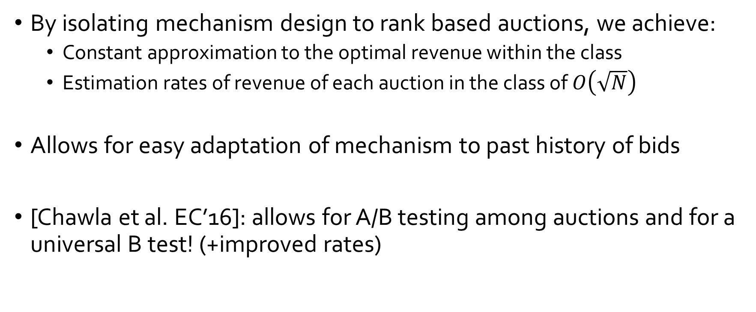
Take-away points
[Chawla-Hartline-Nekipelov’14]
By isolating mechanism design to rank based auctions, we achieve:
  Constant approximation to the optimal revenue within the class
  Estimation rates of revenue of each auction in the class of $O\left(\sqrt{N}\right)$
Allows for easy adaptation of mechanism to past history of bids
[Chawla et al. EC’16]: allows for A/B testing among auctions and for a universal B test! (+improved rates)

Slide 20
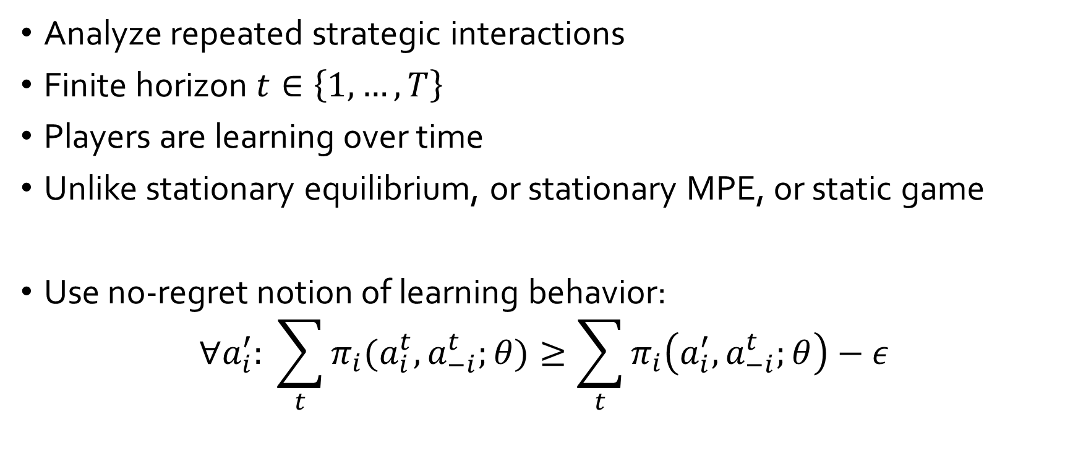
Econometrics for Learning Agents
[Nekipelov-Syrgkanis-Tardos’15]
Analyze repeated strategic interactions
Finite horizon $t∈\left\{1,…,T\right\}$
Players are learning over time
Unlike stationary equilibrium, or stationary MPE, or static game
Use no-regret notion of learning behavior:
$$∀a_{i}^{′}: \sum_{t}{π_{i}(a_{i}^{t},a_{−i}^{t};θ)}≥\sum_{t}{π_{i}\left(a_{i}^{′},a_{−i}^{t};θ\right)}−ε$$

Slide 21


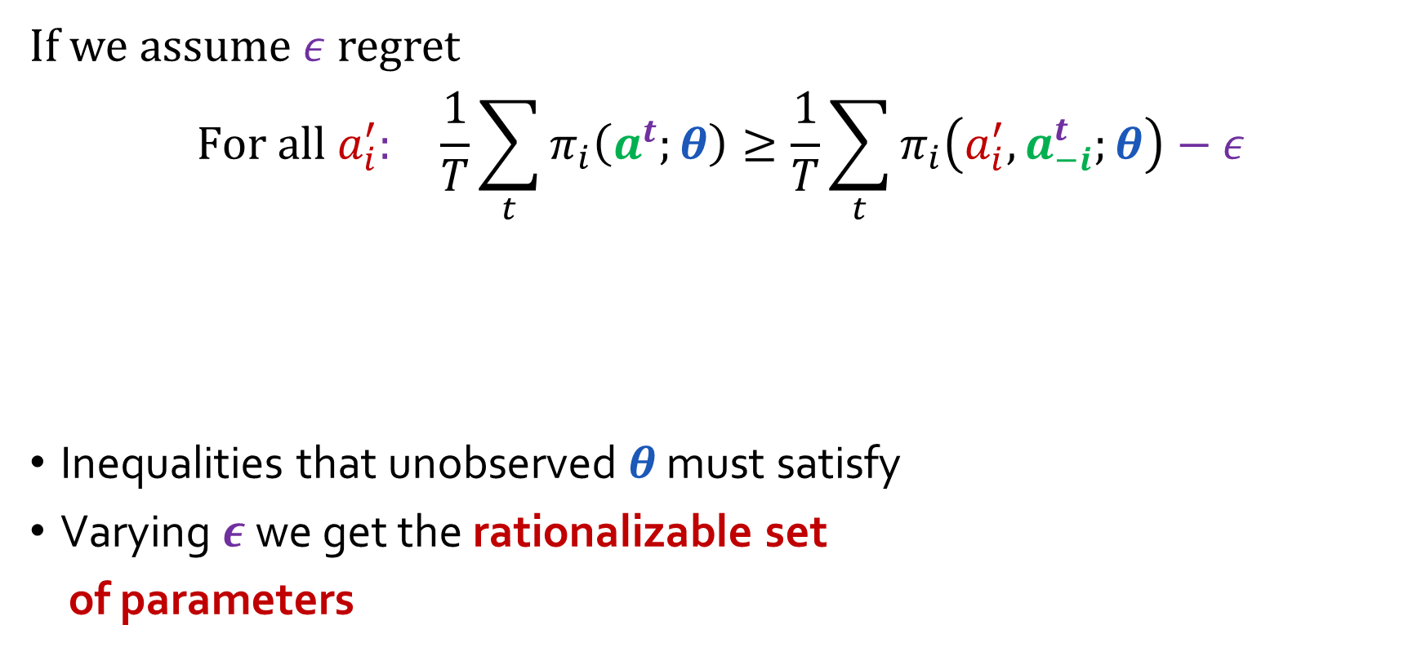



High-level approach
[Nekipelov-Syrgkanis-Tardos’15]
If we assume $ε$ regret
$$For all a_{i}^{′}: \frac{1}{T}\sum_{t}{π_{i}\left(a^{t};θ\right)}≥\frac{1}{T}\sum_{t}{π_{i}\left(a_{i}^{′},a_{−i}^{t};θ\right)}−ε$$
Inequalities that unobserved $θ$ must satisfy
Varying $ε$ we get the rationalizable set
of parameters
Current average utility
Average deviating utility from fixed action
Regret
$$ε$$
rationalizable set
$$ε′′$$
$$ε′$$
$$ε$$
$$θ$$

Slide 22

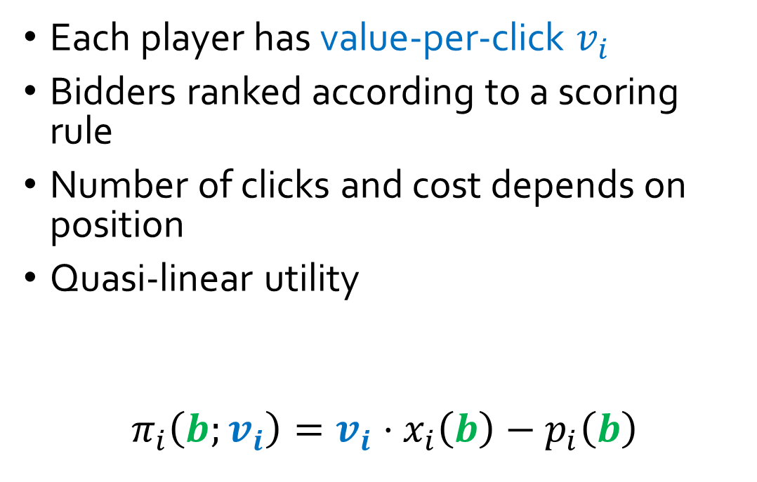
Application: Online Ad Auction setting
[Nekipelov-Syrgkanis-Tardos’15]
Each player has value-per-click $v_{i}$
Bidders ranked according to a scoring rule
Number of clicks and cost depends on position
Quasi-linear utility
$$π_{i}\left(b;v_{i}\right)=v_{i}⋅x_{i}\left(b\right)−p_{i}\left(b\right)$$
Value-Per-Click
Expected Payment
Expected click probability

Slide 23
Main Take-Aways of Econometric Approach
[Nekipelov-Syrgkanis-Tardos’15]
Rationalizable set is convex
Support function representation of convex set depends on a one dimensional function
Can apply one-dimensional non-parametric regression rates
Avoids complicated set-inference approaches
Comparison with prior econometric approaches:
Behavioral learning model computable in poly-time by players
Models error in decision making as unknown parameter rather than profit shock with known distribution
Much simpler estimation approach than prior repeated game results
Can handle non-stationary behavior

Slide 24
Potential Points of Interaction with Econometric Theory
Inference for objectives (e.g. welfare, revenue, etc.) + combine with approximation bounds (see e.g. Chawla et al’14-16, Hoy et al.’15, Liu-Nekipelov-Park’16,Coey et al.’16)
Computational complexity of proposed econometric methods, computationally efficient alternative estimation approaches
Game structures that we have studied exhaustively in theory (routing games, simple auctions)
Game models with combinatorial flavor (e.g. combinatorial auctions)
Computational learning theory and online learning theory techniques for econometrics
Finite sample estimation error analysis

Slide 25
AGT+Data Science
Large scale mechanism design and game theoretic analysis needs to be data-driven
Learning good mechanisms from data
Inferring game properties from data
Designing mechanisms for good inference
Testing our game theoretic models in practice (e.g. Nisan-Noti’16)

Slide 26
References
Auctions
Guerre-Perrigne-Vuong, 2000: Optimal non-parametric estimation of first-price auctions, Econometrica
Haile-Tamer, 2003: Inference in an incomplete model of English auctions, Journal of Political Economy
Athey-Haile, 2007: Non-parametric approaches to auctions, Handbook of Econometrics
Paarsch-Hong, 2006: An introduction to the structural econometrics of auction data, The MIT Press
Algorithmic Game Theory and Econometrics
Chawla-Hartline-Nekipelov, 2014: Mechanism design for data science, ACM Conference on Economics and Computation
Nekipelov-Syrgkanis-Tardos, 2015: Econometrics for learning agents, ACM Conference on Economics and Computation
Chawla-Hartline-Nekipelov, 2016: A/B testing in auctions, ACM Conference on Economics and Computation
Hoy-Nekipelov-Syrgkanis, 2015: Robust data-driven guarantees in auctions, Workshop on Algorithmic Game Theory and Data Science

