Slide 1
The Complexity of Equilibria in Cost Sharing Games
Vasilis Syrgkanis
Cornell University

Slide 2
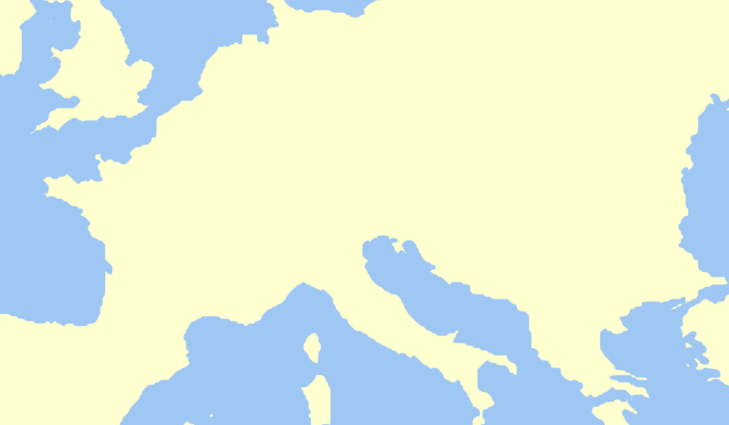



Motivation
4
10
12
10
7

Slide 3
Motivation
2
10
2
5
5
10
4

Slide 4
This Work
Can we efficiently compute some Pure Nash Equilibrium of such games?
  Not in the “general case”: PLS-hard
Can we efficiently compute a “good” Pure Nash Equilibrium so that we can propose it to the players?
  Yes if players choose Spanning Trees or, in general, a base of some player-specific Matroid

Slide 5
Outline
Formal Definitions
Algorithm for Computing a Good Pure Nash Equilibrium
PLS-hardness Results

Slide 6
General Cost Sharing Model
N players and F facilities
For each player a set of strategies
Given a strategy profile , denote:
  : the number of players using
  : a decreasing cost function
  : the cost of player
  : the social cost

Slide 7
Previous Work
Anshelevich et al., FOCS ’04
Fabrikant et al., STOC ‘04 - Ackermann et al., J ACM ‘08
  If has the form and is a non-decreasing concave function then there exists a PNE with social cost (the worst PNE can be as bad as )
  It is PLS-complete to compute any PNE in Network Congestion Games with

Slide 8
This Work – Positive Results
  There exists a polynomial time greedy algorithm that computes a PNE with social cost at most for Matroid Cost Sharing Games with of the form , where is a non-decreasing concave function.
  Note: Computing the best PNE or the PNE minimizing the potential function is NP-hard even in very simple matroid cost-sharing games.
  For general decreasing cost functions the algorithm computes a PNE with social cost at most the potential of the optimal strategy profile.

Slide 9
This Work – Hardness Results
  It is PLS-complete to compute any PNE in Undirected Network Cost Sharing Games with of the form , where is a non-decreasing concave function.
  If we extend to Directed Networks then it is PLS-complete even in the case when have the form

Slide 10
Outline
Formal Definitions
Algorithm for Computing a Good Pure Nash Equilibrium
PLS-hardness Results

Slide 11
PoS and the Potential Method
The Price of Stability of a game is the fraction of the Social Cost of the best PNE over the Optimal Social Cost.
If a game admits a Potential such that for some quantity and for any strategy profile :
Then, the PoS is at most
  Let be the global minimum of and the socially optimal outcome. Then:

Slide 12
PoS of Cost Sharing Games
Cost Sharing Games are Congestion Games and admit Rosenthal’s Potential:
If , then ,

Slide 13
Our Notion of “Good”
Compute a PNE that is as good as the upper bound on the PoS produced by the Potential Method

Slide 14
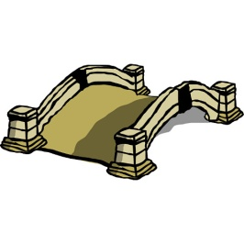

Singleton Cost Sharing

Slide 15
Computing a Good PNE
Recall the proof of the Potential Method
Attempt 1: Compute Socially Optimal PNE
  [ADKTWR04]: NP-hard even when
Attempt 2: Compute global Potential Minimizer
  [CCLNO07]: NP-hard even when

Slide 16
Greedy Algorithm for Selfish People
Consider the following generalization of the greedy set cover approximation algorithm:
  At each iteration pick the facility that has minimum cost if all currently unassigned players were assigned to it.
  Assign all possible players to the chosen facility.
When , the above is exactly the greedy - approximation algorithm for Set Cover

Slide 17
Example

Slide 18
Greedy Algorithm for Selfish People
Theorem 1
The greedy algorithm computes a PNE with social cost at most the potential of the socially optimal solution
Corollary
The greedy algorithm computes a PNE with social cost at most the best upper bound on the PoS given by the Potential Method

Slide 19

Sketch of Proof
……
……
……
……

Slide 20
Extending to Matroids
Matroid Cost Sharing:
is the set of bases of a matroid
  e.g. Spanning Trees on a set of nodes (possibly different nodes for each player)
4
10
12
10
7

Slide 21
Extending to Matroids
Algorithm 2:
  Build player’s strategies incrementally starting from empty sets
  At each iteration pick the facility that has minimum cost if it is added to the strategy of all possible players
  Add the facility to the strategy of all possible players

Slide 22

Example
Player 1
9
Player 2
8
Player 3
5
10
12
10
7

Slide 23
Main Positive Result
Theorem 2
Algorithm 2 computes a PNE of any Matroid Cost Sharing Game with social cost at most the potential of the optimal strategy profile.
  Prove outcome is PNE:
  A base of a matroid is minimum iff it is locally minimum under (1,1) exchanges
  Prove efficiency guarantee:
  Construct a 1-1 mapping of the facilities of a player in the greedy strategy and those in the optimum:
  When algorithm adds a facility to a player its corresponding optimal facility was also an option

Slide 24
Outline
Formal Definitions
Algorithm for Computing a Good Pure Nash Equilibrium
PLS-hardness Results

Slide 25
General Cost Sharing Games
Theorem 3
Computing a PNE in General Cost Sharing Games where is PLS-complete
Proof: Reduction from MAX CUT
  MAX CUT: Given a weighted graph find a cut that cannot be increased by switching a node from one side to the other.
  Given an instance of MAX CUT create a Cost Sharing Game such that any PNE is a locally maximum cut.

Slide 26
Proof
Create a player for each node of the graph
Each player has two strategies:
Given a strategy profile if a player is playing then assign the corresponding node to partition A, else to B
Create incentives for players to play opposite strategies
…
…
i
w_{i,j}
j
…
…

Slide 27
Proof
2
1
3

Slide 28
Network Cost Sharing
Network Cost Sharing Games
Given a directed graph , is the set of paths in a graph between two nodes
2
10
2
5
5
10
4

Slide 29
Main Hardness Results
Theorem 5
Computing a PNE in Network Cost Sharing Games where is PLS-complete.
Theorem 6
Computing a PNE in Undirected Network Cost Sharing Games where and is an non decreasing concave function.

Slide 30
Proof for Directed Networks

Slide 31
Proof for Directed Networks

Slide 32
Proof for Undirected Networks

Slide 33
Conclusion
Despite NP-completeness of computing Social Cost Minimizer and Potential Minimizer we manage to compute a PNE with very good social cost.
  Computing equilibria with social cost at most the potential of the optimal might prove useful in other games too
For Network Games our results show that the decreasing cost function case is not easier than the increasing one

